Slide 1
Who Does NOT Need a Tourniquet U.S./Ukraine Tourniquet Working Group
UNCLASSIFIED
Dr. Frank Butler, Dr Warren Dorlac, Dr. John Holcomb
Feb 03, 2025
Notes:
Welcome to the new DHA PowerPoint template. Each slide contains helpful information for making the entire presentation user-friendly and accessible to people of all abilities. **Disclaimer** Additional remediation is required after you add content to this template to ensure 508 compliance.
Please note: if your presentation is being presented online, the PowerPoint file must be converted and remediated as a PDF.
A NOTE ABOUT CONTROL MARKINGS: Once you determine if your presentation needs security markings, please delete the irrelevant marking and re-center the box. This marking should be in the top center of each slide. To put it in the same place ever time, simply copy (Ctrl + C) from one slide and paste (Ctrl + V) on the next slide. There is no need to position a cursor to have it paste in the correct location.

Slide 2
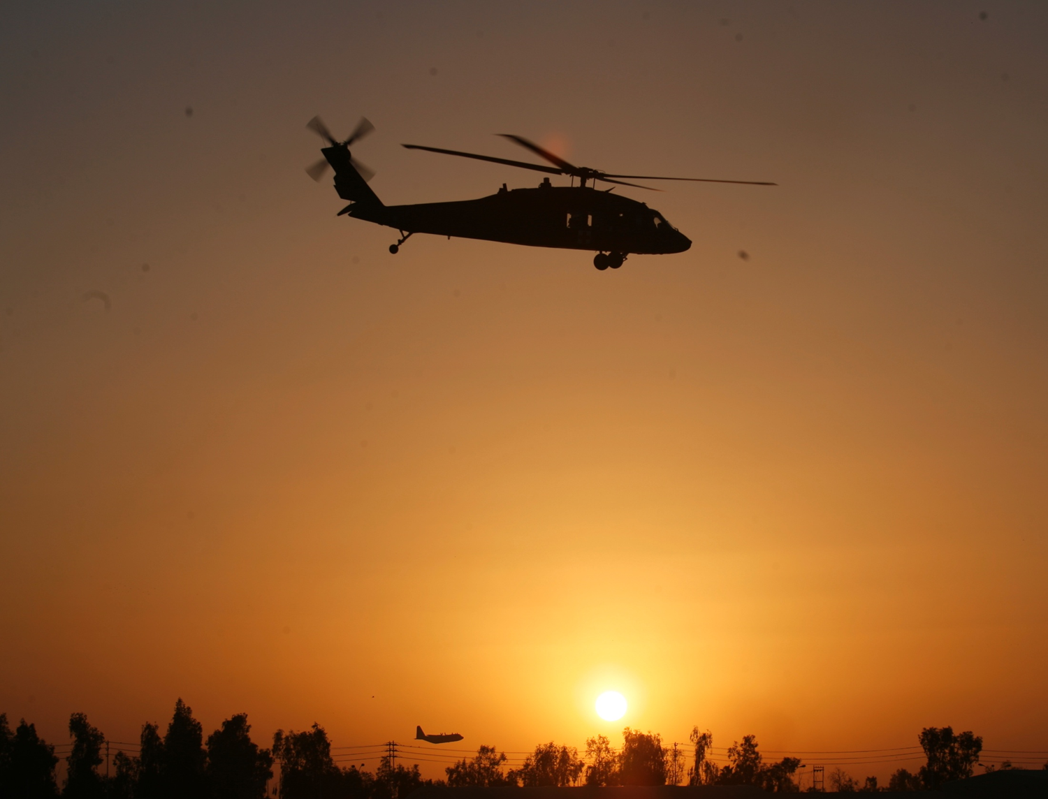
Disclaimer
UNCLASSIFIED
“The opinions or assertions contained herein are the private views of the author and are not to be construed as official or as reflecting the views of the Departments of the Army, Air Force, Navy or the Department of Defense.”
~ No financial interests in items discussed

Slide 3
Bottom Line Up Front
UNCLASSIFIED
Many tourniquets are being placed on extremities that do not need one.
That has not caused problems when transport times to a treatment facility are short (< 2 hours.)
Where evacuations are prolonged (like Ukraine), however, unnecessary tourniquets are causing unnecessary amputations + kidney damage.
Tourniquet training needs to be modified to include better training on what kind of wounds do NOT require a tourniquet.
Notes:
Your slides are preformatted. It’s not necessary for you to change the colors or the list labels (bullets and numbers).
Adhering to the guidance in this template will ensure that your presentation is not only accessible, but also consistent and user-friendly for everyone.
Each slide requires a unique title. No two slides should have the same title.
Ensure hyperlinked text is clear, unique, and makes sense when announced in isolation. Limit each hyperlink to one line of text.

Slide 4
U.S. Military Tourniquet Use in Afghanistan and Iraq
UNCLASSIFIED
Estimated 2000+ lives saved with tourniquets.
“At the start of the war in Afghanistan, very few American service members carried tourniquets. By the end of the war, nobody went onto a battlefield without a tourniquet.”
Limbs were not lost to tourniquet ischemia with the short (< 2 hr) evacuation times seen in those two conflicts.
Butler 2015, Hartford Consensus Compendium Bulletin of the ACS
Notes:
It is important to remember when to use an ordered list or an unordered list.
Unordered lists begin with bullet points or shapes. Use these when the order of steps doesn’t matter – like your grocery list.
Ordered lists begin with numbers, roman numerals, or letters (1, I, A, a) and have a sequential order
If your list contains only one item, you can do one of two things:
Remove the list label (number, letter, bullet, or symbol).
Move the second level list item up to the first level.

Slide 5
Tourniquet Use: 2024
UNCLASSIFIED
There has been increasing evidence that many tourniquets are being applied when they are not medically indicated.
Both military and civilian
Not a big problem in urban civilian settings because of short transport times; likely more of a problem in rural civilian settings.
Not a problem to date in the US military because of short transport times in recent conflicts.
Ukraine conflict: Much longer evacuation times
And a lack of medics to reassess tourniquets
Limbs are being lost to prolonged tourniquet ischemia in that conflict.
Notes:
Your slides are preformatted. It’s not necessary for you to change the colors or the list labels (bullets and numbers).
Adhering to the guidance in this template will ensure that your presentation is not only accessible, but also consistent and user-friendly for everyone.
Each slide requires a unique title. No two slides should have the same title.
Ensure hyperlinked text is clear, unique, and makes sense when announced in isolation. Limit each hyperlink to one line of text.

Slide 6
Tourniquets Applied that Were Not Medically Indicated
UNCLASSIFIED
U.S. Civilian Sector
Ode – J Trauma 2015: 9 of 24 tourniquets (38%) were not medically indicated (Charlotte, NC)
Mikdad – J Trauma 2021: 72 of 147 tourniquets (49%) had no clear medical indication (Boston)
Legare – Am Surg 2022 – 585 of 1392 tourniquets (42%) were not medically indicated (29 trauma centers)
Notes:
Your slides are preformatted. It’s not necessary for you to change the colors or the list labels (bullets and numbers).
Adhering to the guidance in this template will ensure that your presentation is not only accessible, but also consistent and user-friendly for everyone.
Each slide requires a unique title. No two slides should have the same title.
Ensure hyperlinked text is clear, unique, and makes sense when announced in isolation. Limit each hyperlink to one line of text.

Slide 7
Tourniquet Use In Ukraine (2016)
UNCLASSIFIED
Casualties in Ukraine from May– August 2016
102 tourniquets on 95 limbs
75% of the tourniquets applied were found not to have been medically indicated.
Military Medicine 2022
Notes:
Your slides are preformatted. It’s not necessary for you to change the colors or the list labels (bullets and numbers).
Adhering to the guidance in this template will ensure that your presentation is not only accessible, but also consistent and user-friendly for everyone.
Each slide requires a unique title. No two slides should have the same title.
Ensure hyperlinked text is clear, unique, and makes sense when announced in isolation. Limit each hyperlink to one line of text.

Slide 8
Tourniquet Use In Ukraine (Present Conflict)
UNCLASSIFIED
Prolonged evacuation times
Lack of air superiority and medics; drones
Numerous anecdotal examples of prolonged tourniquet application times (>6 hours)
Significant morbidity - including amputations and Acute Kidney Injury (AKI) - as a result
“Because of operational security issues surrounding casualty numbers and outcomes, summary data are not available describing numbers of patients, extremity injuries, tourniquet application, and outcomes across the Ukrainian theater. However, multiple frontline medical personnel have relayed these observations (authors O.Le., A.M., G.B., O.D., and O.Li.).” ~ Holcomb JTACS 2023
Notes:
Your slides are preformatted. It’s not necessary for you to change the colors or the list labels (bullets and numbers).
Adhering to the guidance in this template will ensure that your presentation is not only accessible, but also consistent and user-friendly for everyone.
Each slide requires a unique title. No two slides should have the same title.
Ensure hyperlinked text is clear, unique, and makes sense when announced in isolation. Limit each hyperlink to one line of text.

Slide 9
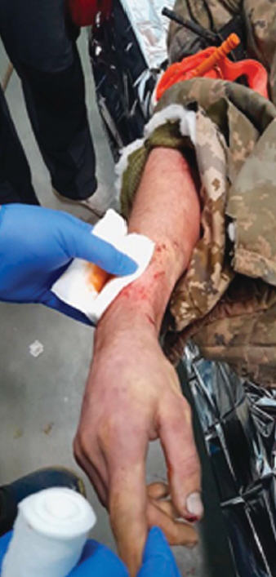
Rethinking TQ Conversion, Holcomb et al – JTACS 2023
UNCLASSIFIED
Arm Lost to Tourniquet Ischemia
Only wound was minor fragment injury of the soft tissues of the back surface of the right forearm (under the gauze dressing).
Tourniquets applied around 11:00 AM.
No qualified medic nearby.
Daytime evacuation impossible due to heavy artillery shelling - casualty arrived at the stabilization point at 10:30 PM (11.5 hours tourniquet time).
No massive bleeding on tourniquet release.
Patient was stable, awake and alert.
No other injuries.
The right upper limb was cold with no distal pulse, no sensation and no movement.
Arm had to be amputated
Notes:
Your slides are preformatted. It’s not necessary for you to change the colors or the list labels (bullets and numbers).
Adhering to the guidance in this template will ensure that your presentation is not only accessible, but also consistent and user-friendly for everyone.
Each slide requires a unique title. No two slides should have the same title.
Ensure hyperlinked text is clear, unique, and makes sense when announced in isolation. Limit each hyperlink to one line of text.

Slide 10
Ukraine TCCC Training
UNCLASSIFIED
The Ukrainian military uses the U.S. TCCC Guidelines to train their personnel.
The TCCC Training material on the Deployed Medicine website has been translated into Ukrainian.
There are 10 NAEMT-certified TCCC Training Centers in Ukraine at present.
Notes:
Your slides are preformatted. It’s not necessary for you to change the colors or the list labels (bullets and numbers).
Adhering to the guidance in this template will ensure that your presentation is not only accessible, but also consistent and user-friendly for everyone.
Each slide requires a unique title. No two slides should have the same title.
Ensure hyperlinked text is clear, unique, and makes sense when announced in isolation. Limit each hyperlink to one line of text.

Slide 11
Beyond Ukraine
UNCLASSIFIED
Prolonged tourniquet application times may be encountered in other combat environments as well:
New combat theaters
Naval surface warfare combat
Non-permissive environments for flight operations (weather, anti-aircraft threat, drone threat)
Amphibious operations
Urban conflict (Mogadishu)
Large-scale combat operations
Notes:
Your slides are preformatted. It’s not necessary for you to change the colors or the list labels (bullets and numbers).
Adhering to the guidance in this template will ensure that your presentation is not only accessible, but also consistent and user-friendly for everyone.
Each slide requires a unique title. No two slides should have the same title.
Ensure hyperlinked text is clear, unique, and makes sense when announced in isolation. Limit each hyperlink to one line of text.

Slide 12
Tourniquets and Limb Survival
UNCLASSIFIED
“It’s just physiology and time, not the geographic location.”
~ Dr. John Holcomb
Notes:
Your slides are preformatted. It’s not necessary for you to change the colors or the list labels (bullets and numbers).
Adhering to the guidance in this template will ensure that your presentation is not only accessible, but also consistent and user-friendly for everyone.
Each slide requires a unique title. No two slides should have the same title.
Ensure hyperlinked text is clear, unique, and makes sense when announced in isolation. Limit each hyperlink to one line of text.

Slide 13
Prolonged Tourniquet Application Time
UNCLASSIFIED
Reducing Morbidity from Prolonged Tourniquet Application Time
The published evidence documents a clear opportunity and a pressing need to improve tourniquet training in TCCC.
The presence of an extremity wound does NOT automatically indicate a need for a tourniquet to be applied.
TCCC students need an improved ability to distinguish between extremity bleeding that is life-threatening and that which is not.
Notes:
Your slides are preformatted. It’s not necessary for you to change the colors or the list labels (bullets and numbers).
Adhering to the guidance in this template will ensure that your presentation is not only accessible, but also consistent and user-friendly for everyone.
Each slide requires a unique title. No two slides should have the same title.
Ensure hyperlinked text is clear, unique, and makes sense when announced in isolation. Limit each hyperlink to one line of text.

Slide 14
TCCC Lessons Learned
UNCLASSIFIED
“If what you’re doing is not working – do something else.”
~ Dr. Frank Butler, TCCC Leadership Lessons JTACS 2017
Notes:
Your slides are preformatted. It’s not necessary for you to change the colors or the list labels (bullets and numbers).
Adhering to the guidance in this template will ensure that your presentation is not only accessible, but also consistent and user-friendly for everyone.
Each slide requires a unique title. No two slides should have the same title.
Ensure hyperlinked text is clear, unique, and makes sense when announced in isolation. Limit each hyperlink to one line of text.

Slide 15
Recognizing Life-Threatening Extremity Bleeding
UNCLASSIFIED
Tactical Combat Casualty Care training on tourniquets as of December 2023 is shown on the following slides from the Deployed Medicine website.
Deployedmedicine.com
Notes:
Your slides are preformatted. It’s not necessary for you to change the colors or the list labels (bullets and numbers).
Adhering to the guidance in this template will ensure that your presentation is not only accessible, but also consistent and user-friendly for everyone.
Each slide requires a unique title. No two slides should have the same title.
Ensure hyperlinked text is clear, unique, and makes sense when announced in isolation. Limit each hyperlink to one line of text.

Slide 16
Recognizing Life-Threatening Extremity Bleeding
UNCLASSIFIED
Care Under Fire/Threat
Tactical considerations are pre-eminent
No chance to carefully assess wound
If you see blood and think that the casualty might need a tourniquet – apply one!
Apply it just proximal to the bleeding site
If unsure of where the source of the bleeding is – apply the tourniquet “high and tight” – as proximal as feasible - on the injured extremity and move the casualty to cover.
Video on Deployed Medicine
https://books.allogy.com/web/tenant/8/books/a30c619d-7270-4bfe-be4f-eb4d27adc783/
Notes:
Your slides are preformatted. It’s not necessary for you to change the colors or the list labels (bullets and numbers).
Adhering to the guidance in this template will ensure that your presentation is not only accessible, but also consistent and user-friendly for everyone.
Each slide requires a unique title. No two slides should have the same title.
Ensure hyperlinked text is clear, unique, and makes sense when announced in isolation. Limit each hyperlink to one line of text.

Slide 17
Life-threatening Bleeding
UNCLASSIFIED
Recognizing Life-Threatening Extremity Bleeding: Tactical Field Care and Tactical Evacuation Care
02 Nov 2023, Deployed Medicine
Notes:
Your slides are preformatted. It’s not necessary for you to change the colors or the list labels (bullets and numbers).
Adhering to the guidance in this template will ensure that your presentation is not only accessible, but also consistent and user-friendly for everyone.
Each slide requires a unique title. No two slides should have the same title.
Ensure hyperlinked text is clear, unique, and makes sense when announced in isolation. Limit each hyperlink to one line of text.

Slide 18
What New Training Is Needed?
UNCLASSIFIED
Based on the Ukrainian tourniquet experience and the potential for prolonged evacuation times in future conflicts, there needs to be additional emphasis in TCCC training on ensuring that tourniquets are medically indicated.
We need images that illustrate what NON-life-threatening extremity bleeding looks like.
This needs to be an objectively tested skill with its own skill performance sheet.
Notes:
Your slides are preformatted. It’s not necessary for you to change the colors or the list labels (bullets and numbers).
Adhering to the guidance in this template will ensure that your presentation is not only accessible, but also consistent and user-friendly for everyone.
Each slide requires a unique title. No two slides should have the same title.
Ensure hyperlinked text is clear, unique, and makes sense when announced in isolation. Limit each hyperlink to one line of text.

Slide 19
Who Needs a Tourniquet? And Who Does Not?
UNCLASSIFIED
The slides to follow are examples of extremity wounds.
The task is to identify which wounds need a tourniquet (i.e. show life-threatening extremity bleeding.)
If the bleeding is not life-threatening, the extremity does not need a tourniquet.
Notes:
Your slides are preformatted. It’s not necessary for you to change the colors or the list labels (bullets and numbers).
Adhering to the guidance in this template will ensure that your presentation is not only accessible, but also consistent and user-friendly for everyone.
Each slide requires a unique title. No two slides should have the same title.
Ensure hyperlinked text is clear, unique, and makes sense when announced in isolation. Limit each hyperlink to one line of text.

Slide 20
Recognizing Life-Threatening Extremity Bleeding
UNCLASSIFIED
Consider the wounds on the following slides as NOT being seen during Care Under Fire but seen during Tactical Field Care or TACEVAC Care. The first responder has time to examine the casualty.
The casualty is alert and oriented with a normal radial pulse unless otherwise indicated. (i.e. – not in shock).
Evacuation time to surgical care is estimated to be greater than 6 hours.
Which of the following 25 wounds need a tourniquet (tourniquet YES) which ones do not (tourniquet NO)?
Answers are on slide 54 at the end of this presentation.
Notes:
Your slides are preformatted. It’s not necessary for you to change the colors or the list labels (bullets and numbers).
Adhering to the guidance in this template will ensure that your presentation is not only accessible, but also consistent and user-friendly for everyone.
Each slide requires a unique title. No two slides should have the same title.
Ensure hyperlinked text is clear, unique, and makes sense when announced in isolation. Limit each hyperlink to one line of text.

Slide 21
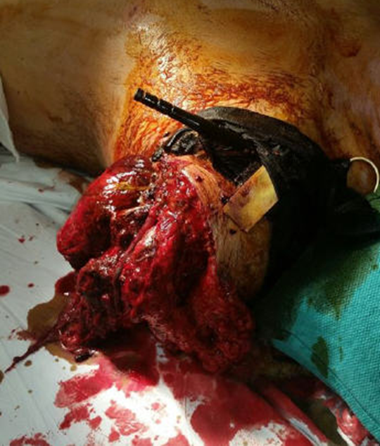
Tourniquet Application
UNCLASSIFIED
Major traumatic amputations call for a tourniquet.
This tourniquet stays ON.
Photo by Dr. John Holcomb
Notes:
Your slides are preformatted. It’s not necessary for you to change the colors or the list labels (bullets and numbers).
Adhering to the guidance in this template will ensure that your presentation is not only accessible, but also consistent and user-friendly for everyone.
Each slide requires a unique title. No two slides should have the same title.
Ensure hyperlinked text is clear, unique, and makes sense when announced in isolation. Limit each hyperlink to one line of text.

Slide 22
Tourniquet Application: Yes or No?
UNCLASSIFIED
Case #1
(Play the video from Dr. John Holcomb - Baghdad - 2006)
Notes:
YES

Slide 23
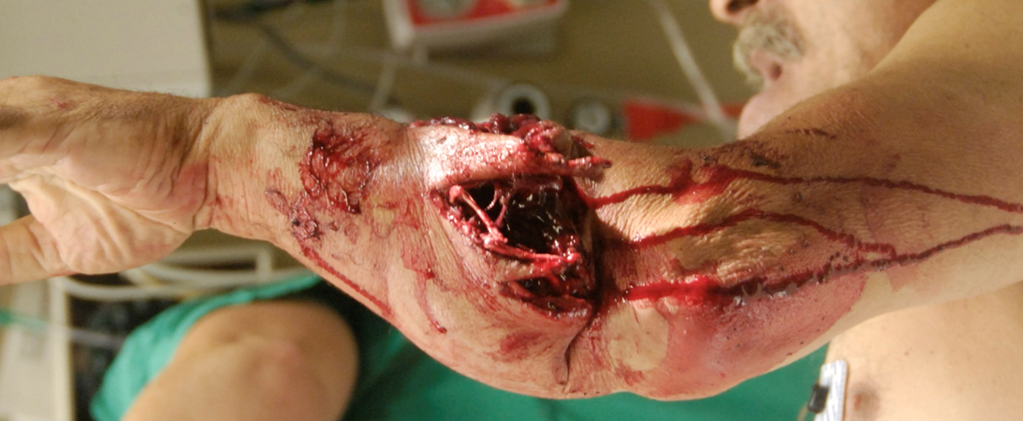
Tourniquet Application: Yes or No?
UNCLASSIFIED
Case #2
Photographer Unknown
Notes:
NO

Slide 24
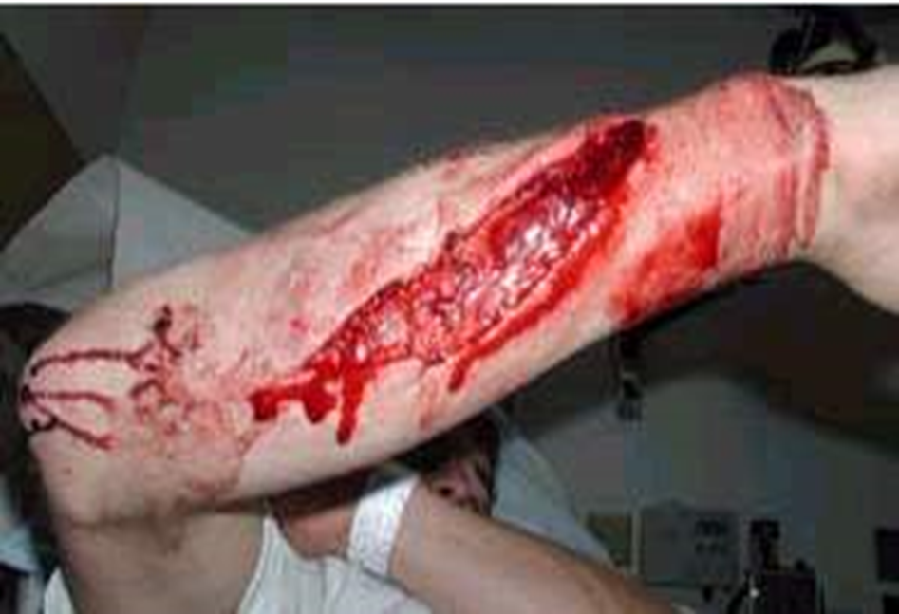
Tourniquet Application: Yes or No?
UNCLASSIFIED
Case #3
Photo: 2018 TCCC Curriculum
Notes:
NO

Slide 25
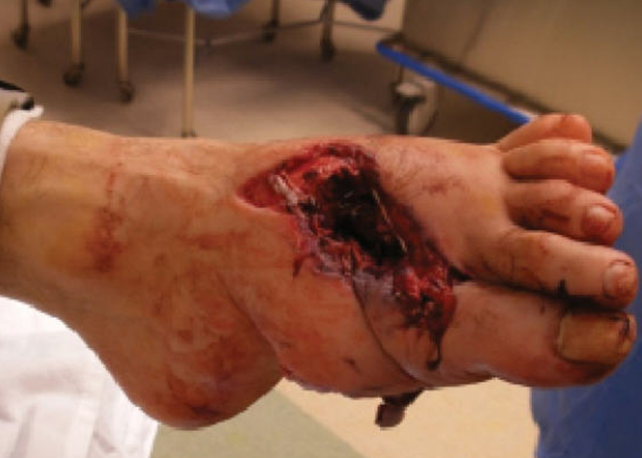
Tourniquet Application: Yes or No?
UNCLASSIFIED
Case #4
Photographer Unknown
Notes:
NO

Slide 26
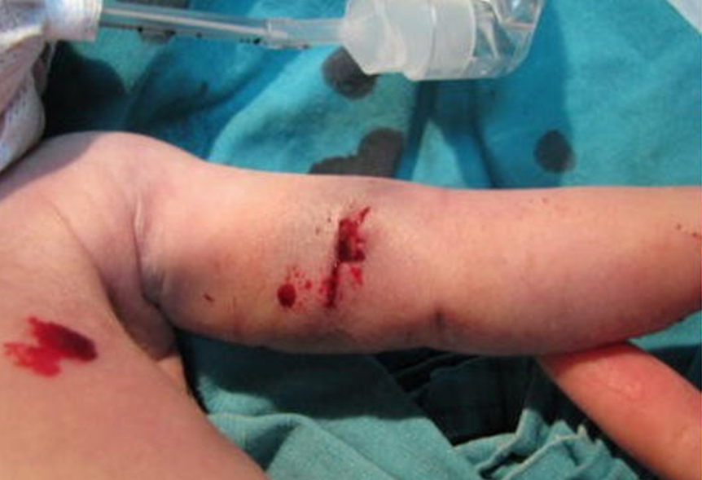
Tourniquet Application: Yes or No?
UNCLASSIFIED
Case #5
Photo by Dr. Warren Dorlac
Notes:
NO

Slide 27
Tourniquet Application: Yes or No?
UNCLASSIFIED
Case #6
Illustration by American College of Surgeons
Notes:
YES

Slide 28
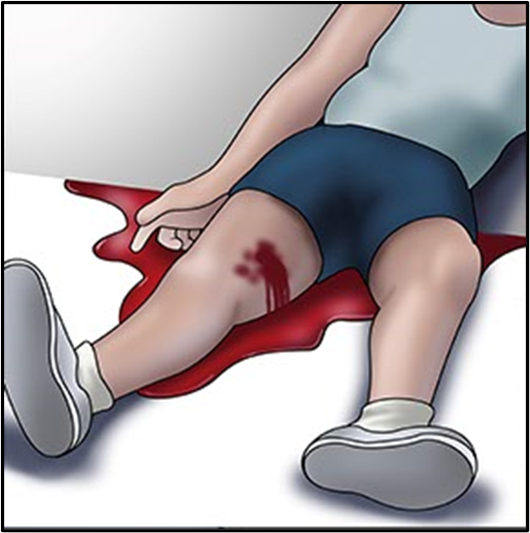
Tourniquet Application: Yes or No?
UNCLASSIFIED
Case #7
Illustration by American College of Surgeons
Notes:
YES

Slide 29
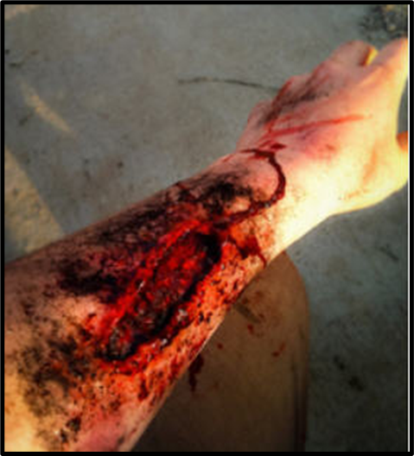
Tourniquet Application: Yes or No?
UNCLASSIFIED
Case #8
Photo by Mr. Mike Meoli
Notes:
NO

Slide 30
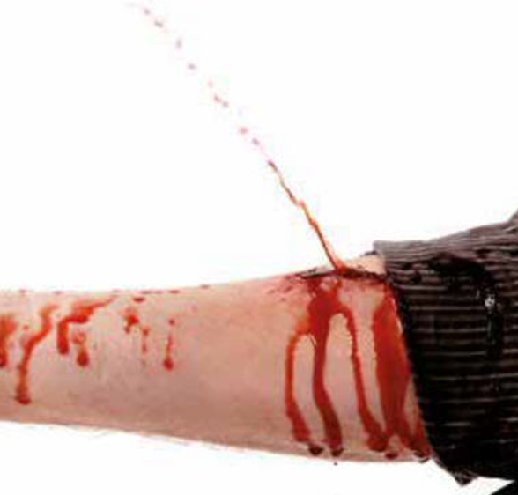
Tourniquet Application: Yes or No?
UNCLASSIFIED
Case #9
Photo by Mr. Mike Meoli
Notes:
NO

Slide 31
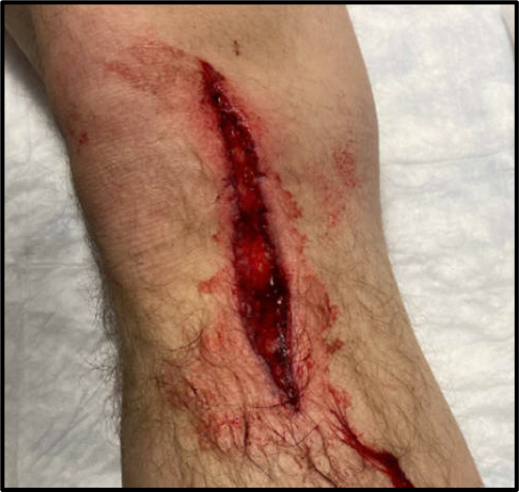
Tourniquet Application: Yes or No?
UNCLASSIFIED
Case #10
Unknown photographer
Notes:
NO

Slide 32
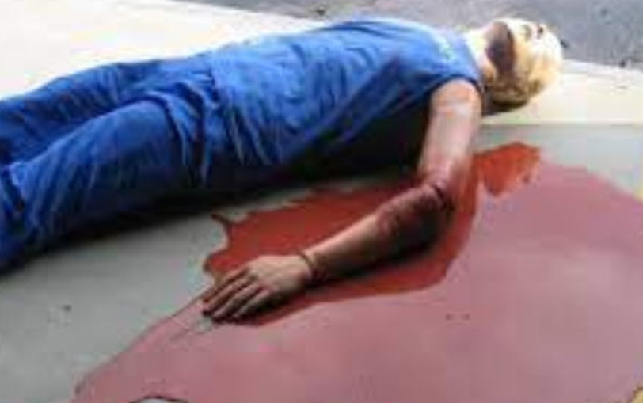
Tourniquet Application: Yes or No?
UNCLASSIFIED
Case #11
Unknown photographer
Notes:
YES

Slide 33
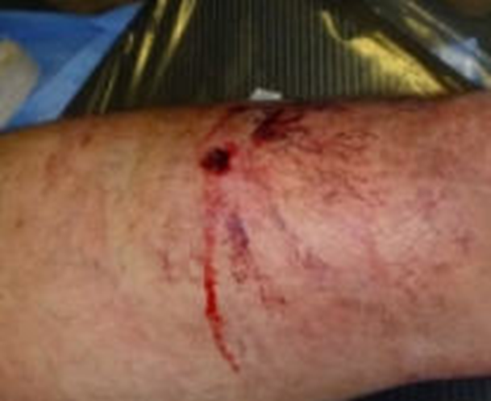
Tourniquet Application: Yes or No?
UNCLASSIFIED
Case #12
Photo by Dr. Oleksandr Linchevskyy
Notes:
NO

Slide 34
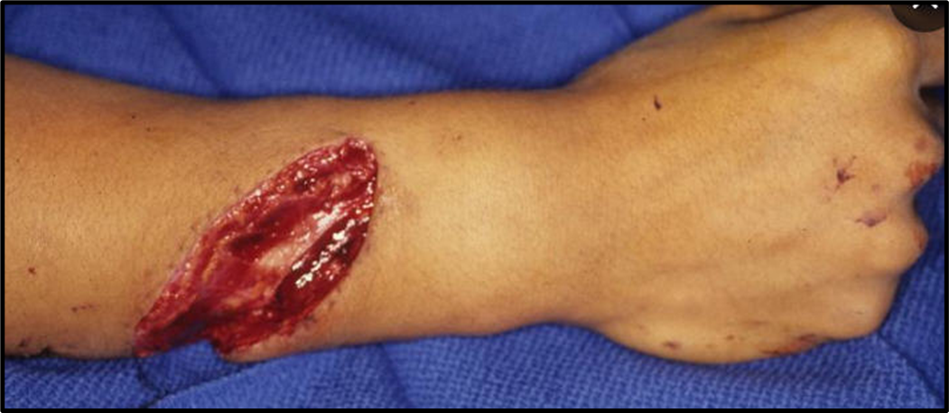
Tourniquet Application: Yes or No?
UNCLASSIFIED
Case #13
Unknown photographer
Notes:
NO

Slide 35
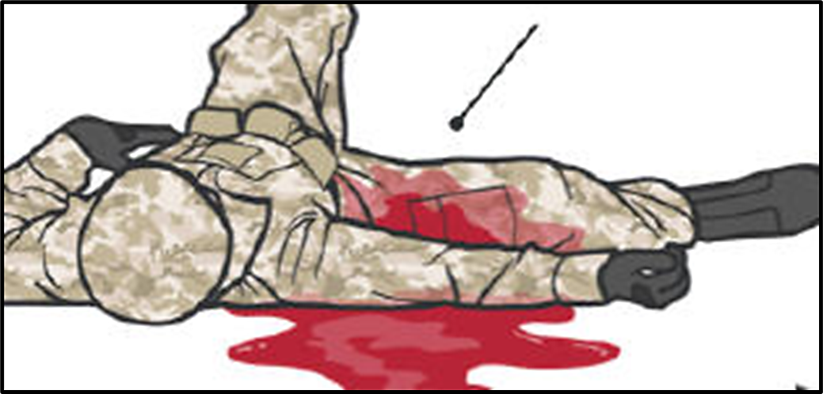
Tourniquet Application: Yes or No?
UNCLASSIFIED
Case #14
Photo: Deployed Medicine
Notes:
YES

Slide 36
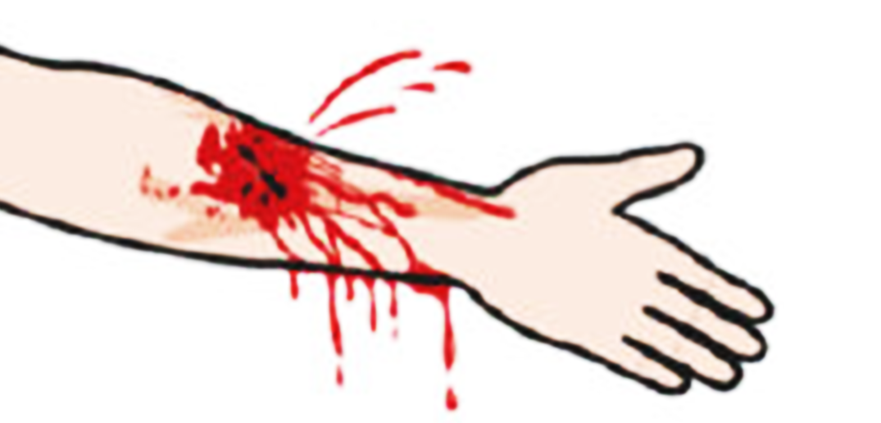
Tourniquet Application: Yes or No?
UNCLASSIFIED
Case #15
Photo: Deployed Medicine
Notes:
YES

Slide 37
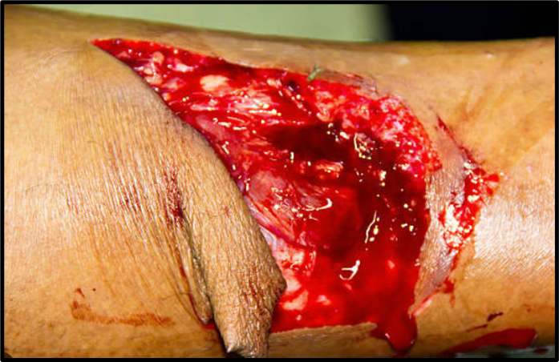
Tourniquet Application: Yes or No?
UNCLASSIFIED
Case #16
Unknown photographer
Notes:
NO

Slide 38
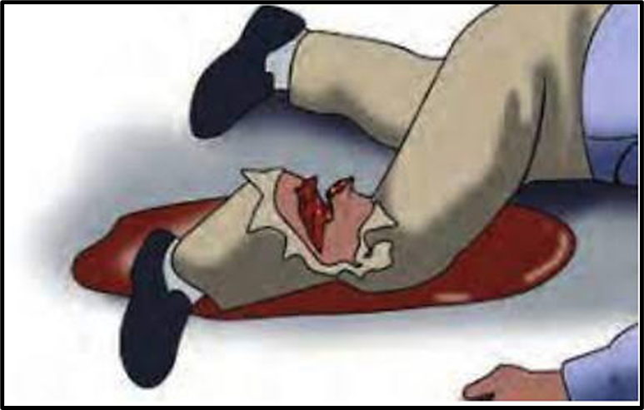
Tourniquet Application: Yes or No?
UNCLASSIFIED
Case #17
Illustration by American College of Surgeons
Notes:
YES

Slide 39
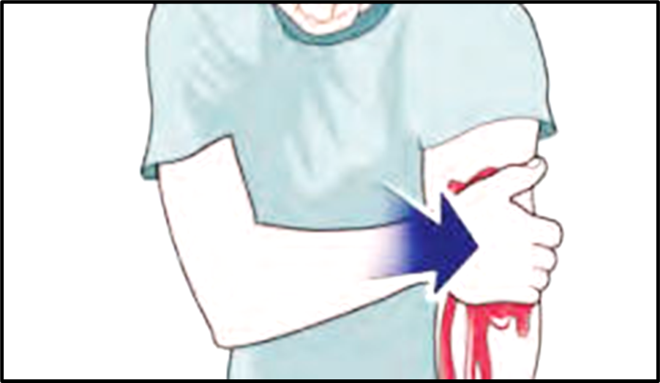
Tourniquet Application: Yes or No?
UNCLASSIFIED
Case #18
Illustration by American College of Surgeons
Notes:
YES

Slide 40
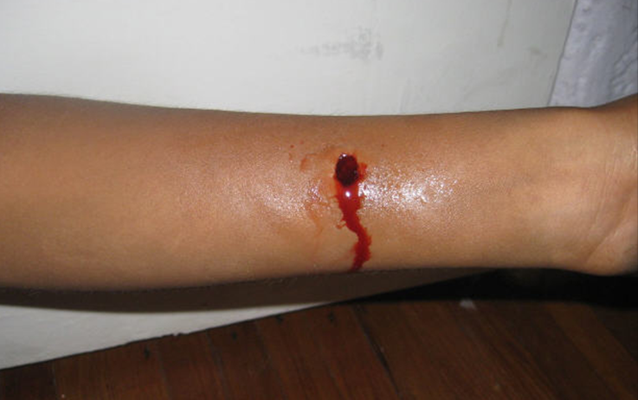
Tourniquet Application: Yes or No?
UNCLASSIFIED
Case #19
Unknown photographer
Notes:
NO

Slide 41
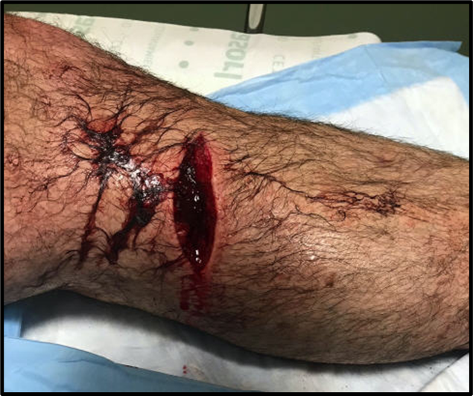
Tourniquet Application: Yes or No?
UNCLASSIFIED
Case #20
Unknown photographer
Notes:
NO

Slide 42
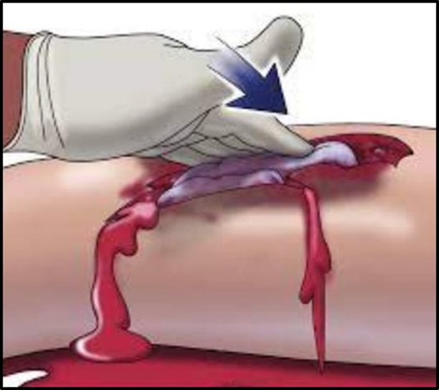
Tourniquet Application: Yes or No?
UNCLASSIFIED
Case #21
Illustration by American College of Surgeons
Notes:
YES

Slide 43
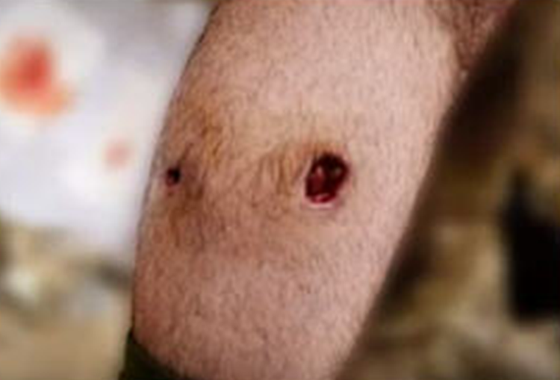
Tourniquet Application: Yes or No?
UNCLASSIFIED
Case #22
Photo by Mr. Harold Montgomery
Notes:
NO

Slide 44
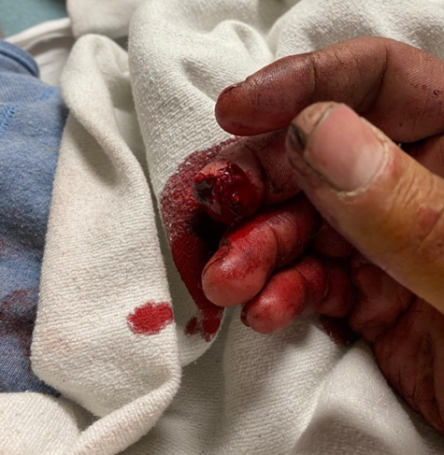
Tourniquet Application: Yes or No?
UNCLASSIFIED
Case #23
Photo by Dr. Andy Fischer
Notes:
Tourniquet - NO
And yet – this arm had a tourniquet applied.
The fingertip amputation was the only wound

Slide 45
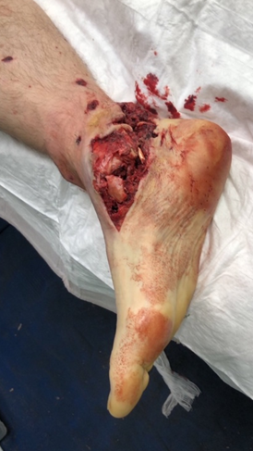
Tourniquet Application: Yes or No?
UNCLASSIFIED
Case #24
Photo by Dr. Oleksandr Danyliuk
Notes:
NO

Slide 46
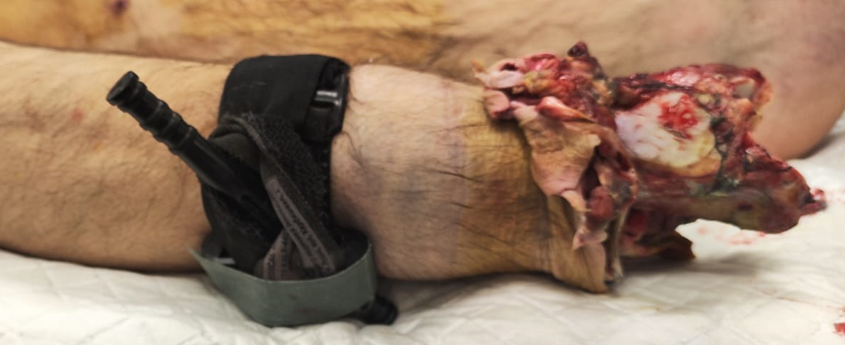
Tourniquet Application: Yes or No?
UNCLASSIFIED
Case #25
Photo by Dr. Oleksandr Danyliuk
Notes:
YES
Major Traumatic Amputation

Slide 47
Reassess, Reassess, Reassess!
UNCLASSIFIED
Reassess applied tourniquets frequently: convert, replace (reposition), or remove as indicated
The rate of bleeding and need for a tourniquet may change over time:
Muscle relaxation
Tourniquet loses pressure
Casualty movement
Fluid resuscitation
Notes:
Your slides are preformatted. It’s not necessary for you to change the colors or the list labels (bullets and numbers).
Adhering to the guidance in this template will ensure that your presentation is not only accessible, but also consistent and user-friendly for everyone.
Each slide requires a unique title. No two slides should have the same title.
Ensure hyperlinked text is clear, unique, and makes sense when announced in isolation. Limit each hyperlink to one line of text.

Slide 48
Tourniquet Terminology
UNCLASSIFIED
Remove a tourniquet – take it off the injured extremity.
Replace a tourniquet – reposition a tourniquet that was applied high on the limb during Care Under Fire/Threat to a location 2-3 inches above the bleeding site directly on the skin.
Convert a tourniquet – apply hemostatic dressings to control extremity hemorrhage, thus allowing the tourniquet pressure to be released and blood flow to the limb to be restored.
Notes:
Your slides are preformatted. It’s not necessary for you to change the colors or the list labels (bullets and numbers).
Adhering to the guidance in this template will ensure that your presentation is not only accessible, but also consistent and user-friendly for everyone.
Each slide requires a unique title. No two slides should have the same title.
Ensure hyperlinked text is clear, unique, and makes sense when announced in isolation. Limit each hyperlink to one line of text.

Slide 49
Frequent Reassessment of Tourniquets
UNCLASSIFIED
How quickly and how frequently the individual caring for the casualty will be able to reassess the need for the tourniquet will vary with the tactical scenario.
Current TCCC Guidelines call for a reassessment to be done by two hours of tourniquet time.
Do it as soon as possible. Earlier is better!
Reassess as frequently as the tactical situation permits but especially during periods of casualty movement and fluid resuscitation.
Notes:
Your slides are preformatted. It’s not necessary for you to change the colors or the list labels (bullets and numbers).
Adhering to the guidance in this template will ensure that your presentation is not only accessible, but also consistent and user-friendly for everyone.
Each slide requires a unique title. No two slides should have the same title.
Ensure hyperlinked text is clear, unique, and makes sense when announced in isolation. Limit each hyperlink to one line of text.

Slide 50
Tourniquet Reassessments/Conversions
UNCLASSIFIED
Who Should Do Tourniquet Reassessments/Conversions?
In the past, TCCC recommended that tourniquet reassessment be done by a Combat Medic or more advanced provider.
But medics may be early casualties. Others may be needed to perform this task.
The Committee on TCCC has recently added tourniquet reassessment to the Combat Lifesaver skill set.
The Ukrainian military now allows All Combatants to do tourniquet reassessment.
Combat units should ensure that they have sufficient trained personnel to perform tourniquet reassessments, conversions, and replacement.
Notes:
Your slides are preformatted. It’s not necessary for you to change the colors or the list labels (bullets and numbers).
Adhering to the guidance in this template will ensure that your presentation is not only accessible, but also consistent and user-friendly for everyone.
Each slide requires a unique title. No two slides should have the same title.
Ensure hyperlinked text is clear, unique, and makes sense when announced in isolation. Limit each hyperlink to one line of text.

Slide 51
Tourniquet Reassessment Training
UNCLASSIFIED
Training for Whoever Is Going to Do Tourniquet Reassessments
Many casualties who have tourniquets applied never needed a tourniquet in the first place.
This ability to determine whether extremity bleeding is not life-threatening should be included in the skills that are objectively assessed in the TCCC training course.
Leaders (line and medical) need to ensure that reassessment of tourniquets applied during combat operations is performed as early and as often as tactically feasible, especially when evacuation will be prolonged.
Notes:
Your slides are preformatted. It’s not necessary for you to change the colors or the list labels (bullets and numbers).
Adhering to the guidance in this template will ensure that your presentation is not only accessible, but also consistent and user-friendly for everyone.
Each slide requires a unique title. No two slides should have the same title.
Ensure hyperlinked text is clear, unique, and makes sense when announced in isolation. Limit each hyperlink to one line of text.

Slide 52
Leadership
UNCLASSIFIED
“Medical care is commander’s business…. We can delegate authority to the medical community, but not the responsibility for ensuring it is taken care of……I take this responsibility very seriously and expect that others in the command do as well.”
~ Gen Joe Votel, Heroes of Military Medicine Awards, 03 May 2018
Notes:
Your slides are preformatted. It’s not necessary for you to change the colors or the list labels (bullets and numbers).
Adhering to the guidance in this template will ensure that your presentation is not only accessible, but also consistent and user-friendly for everyone.
Each slide requires a unique title. No two slides should have the same title.
Ensure hyperlinked text is clear, unique, and makes sense when announced in isolation. Limit each hyperlink to one line of text.

Slide 53
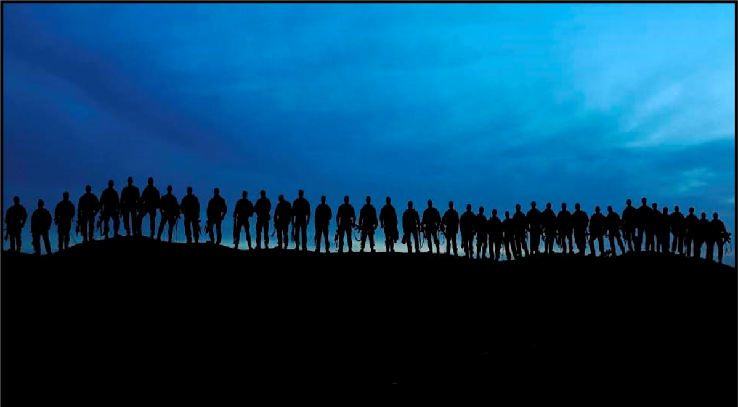
Thank You!
UNCLASSIFIED
Notes:
Your slides are preformatted. It’s not necessary for you to change the colors or the list labels (bullets and numbers).
Adhering to the guidance in this template will ensure that your presentation is not only accessible, but also consistent and user-friendly for everyone.
Each slide requires a unique title. No two slides should have the same title.
Ensure hyperlinked text is clear, unique, and makes sense when announced in isolation. Limit each hyperlink to one line of text.

Slide 54
Answer Key
UNCLASSIFIED
Answers for the previous 25 cases (slides 22 - 46)
1. yes
2. no
3. no
4. no
5. no
6. yes
7. yes
8. no
9. yes
10. no
11. yes
12. no
13. no
14. yes
15. yes
16. no
17. yes
18. yes
19. no
20. no
21. yes
22. no
23. no
24. no
25. yes
Notes:
Your slides are preformatted. It’s not necessary for you to change the colors or the list labels (bullets and numbers).
Adhering to the guidance in this template will ensure that your presentation is not only accessible, but also consistent and user-friendly for everyone.
Each slide requires a unique title. No two slides should have the same title.
Ensure hyperlinked text is clear, unique, and makes sense when announced in isolation. Limit each hyperlink to one line of text.

