Slide 1
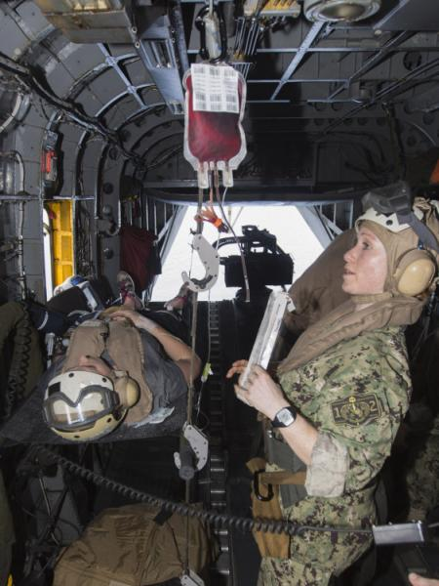
Joint Trauma System
Transfusion Medicine for Combat Trauma
Joint Trauma System Battlefield Trauma Educational Program
Notes:
The administration of blood and blood products down range has changed over the last 20 years. This lecture will cover the application of blood product transfusion in combat casualty care.

Slide 2
EWS Transfusion
Scenario
A 29 year old marine was hit by a dismounted IED. He arrives at your Role 2 facility with bilateral, high above-knee-amputations, perineal wounds, and abdominal wounds. His vitals are: HR 138, BP 84/42, RR 32, SaO2 96%. Your medics get 2 large bore IVs.
What comprises damage control resuscitation?
What agents should be used to resuscitate?
What blood products are available based at Role 2? Role 3?
Notes:
In this scenario, we have a 29-year-old Marine injured by a dismounted Improvised Explosive Device (IED) blast. He presents to your role 2 facility with bilateral high above-knee amputations, perineal injuries, and abdominal trauma. He is in shock, with a HR of 138, BP 84/42, tachypneic to 32, and saturating 96%. Medics have place two large bore IVs for access. The key questions and objectives pertinent to this scenario that we will cover in this lecture include: 1) what comprises damage control resuscitation, 2) what agents and products should be used in resuscitation of combat casualties, and 3) what blood products are available for use at role 2 and 3 facilities?

Slide 3
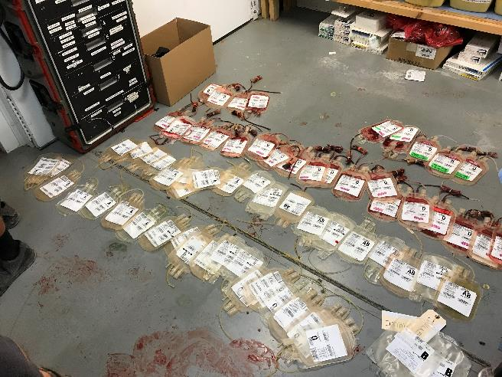
EWS Transfusion
Objectives
Define “emergency release” blood.
Review massive transfusion protocols.
Review whole blood use.
Review blood product availability at different roles.
Notes:
During this lecture we will define what emergency release blood and massive transfusion protocols are as they are different, but are often mistaken for one another. We will also review how and when whole blood is utilized in resuscitations, and we will cover the availability and use of blood products at the different roles of care.

Slide 4
EWS Transfusion
Coagulopathy of Trauma (1)
Lethal Triad
Acidosis - pH < 7.2
Hypothermia - Temperature < 34° C
Coagulopathy - PT > 19 sec, PTT > 60 sec
Trauma-induced coagulopathy
Coagulation activation
Procoagulants released into systemic circulation
Impairment of endogenous anticoagulant activity
Thrombin-generation in the systemic circulation
Borden Institute: War Surgery in Afghanistan and Iraq
Notes:
Trauma patient’s suffer a coagulopathy that is often deadly. The lethal triad of acidosis, hypothermia, and coagulopathy has long been known to complicate and drive the physiologic deterioration of trauma patients.
Trauma and coagulopathy go hand in hand. Trauma patients are often exposed to the elements for a variable amount of time. This predisposes to hypothermia. Coagulation factor and platelet function are optimal at normal human body temperatures, and hypothermia markedly impairs their function. This begets bleeding, which worsens end-organ and tissue perfusion and drives worsening acidosis, which feeds further hypothermia.
The trauma itself also causes its own coagulopathy. Tissue injury activates the coagulation cascade and can induce both a hyperfibrinolytic state and a consumptive coagulopathy.

Slide 5
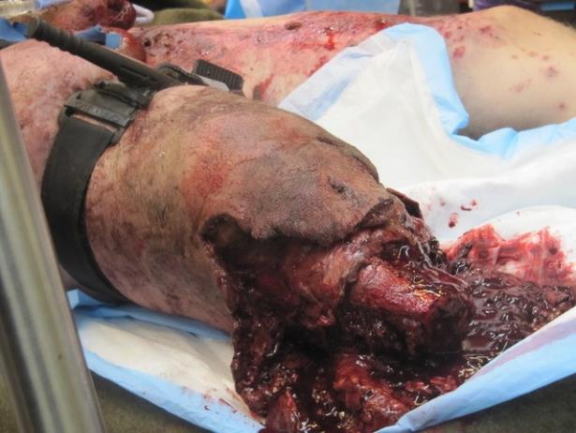
EWS Transfusion
Coagulopathy of Trauma (2)
Trauma-induced coagulopathy (cont.)
Hyperfibrinolysis
Acute release of tPA -> induces hyperfibrinolysis
Coagulation activation -> induces hyperfibrinolysis
Consumptive coagulopathy
Massive transfusion effects
Hypocalcemia
Fibrinogen deficiencies
Bleeding war wound controlled with tourniquet
Notes:
Trauma induced coagulopathy is further exacerbated by hyperfibrinolysis. This is a direct result of an acute release of tPA which leads to a consumptive coagulopathy. Massive transfusions can contribute to this coagulopathy as they can cause hypocalcemia and fibrinogen deficiencies.

Slide 6
EWS Transfusion
Coagulopathy of Trauma (3)
Derangements in coagulation occur rapidly after trauma. By arrival to the ED, ~28% of trauma patients have a detectable coagulopathy that was associated with a poor outcome
Hypothermia dramatically affects coagulopathy
PT and PTT rise when T<36°C
Platelet activation by vWF profoundly reduced at 30°C
Notes:
This derangement of coagulopathy noted in trauma patients, can occur quickly after injury. Approximately 28% of trauma patients may present with part of this lethal triad. The subsequent hypothermia contributes more to the rise in PT and PTT, especially when the core body temperature is below 36C. Platelet activation by Von-Willibrand factor is profoundly reduced by temperatures less than 30C.

Slide 7
Emergency Release Blood
EWS Transfusion
Universal Donor Guidance
∎ Packed Red Blood Cells (PRBC)
Males and post-menopausal women
– O+ blood (37.4% of population)
Pre-menopausal women – O- blood
(6.6% of population)
or O+ blood PLUS RhoGAM if woman subsequently found to be Rh –’ve
Within 72 hours of transfusion – 20 µg / mL O+ blood transfused
Comes in 300 µg bottles
∎ Plasma (FFP)
AB + (3.4% of population)
Alternative: A+ (35.7% of population) due to the relatively low prevalence of B blood (8.5% of population)
∎ Platelets
A₂ Platelets (35.7% of population)
∎ Fresh Whole Blood (FWB)
Type Specific:
Significant limitation - Need a match
Alternate: Low Titer O Whole Blood
Notes:
Before we go further, we should review the blood products that are used for emergency release transfusion. O blood is the universal donor for packed red blood cells. O- is the true universal donor, however O+ blood is more frequently used due to its increased prevalence in the population as well as the low rate of transfusion reactions to the Rh antigen. Pre-menopausal women are typically given O- blood to reduce the risk of a subsequent miscarriage should she conceive a child with an Rh+ male. Alternatively, pre-menopausal women may be given O+ blood with Rhogam.
Plasma, which contains antibodies, works exactly the opposite. AB +’ve is the universal donor. Given the extremely low prevalence of AB+ blood and low rate of reactions to B antibodies, type A+ plasma is an acceptable alternate universal donor.
Platelets are even more complex. In short, type A platelets are universal donors.
Should a whole blood drive be initiated, then type specific blood is required. The amount of whole blood available may be significantly limited by the blood types of the recipient and donor pool. An alternative that is being fielded is low-titer, type O whole blood as the low titer minimizes the risk of a transfusion reaction.

Slide 8
EWS Transfusion
Damage Control Resuscitation
∎ Hemorrhage is the leading cause of preventable death.
∎ Early control of hemorrhage is essential.
∎ Focuses on a “Balanced Resuscitation.”
Replaces blood components in equal parts - More hemostatic.
∎ Goal: SBP 90 mmHg
Theoretically prevents clot from dislodging from thrombosed vessels.
May need higher blood pressure in Traumatic Brain Injury.
Maintain MAP > 80 mmHg (keeps CPP > 60 mm Hg if ICP 20 mmHg or less).
Series of 246 combat casualties receiving > 1o U PRBCs and or Whole Blood
Group | Ratio | Mortality (p<0.001)
Low plasma:RBC ratio | 1:8 | 92.5%
Medium plasma:RBC ratio | 1:2.4 | 78%
High plasma:RBC ratio | 1:1.4 | 37%
Notes:
Damage control resuscitation captures the core concepts necessary to hemorrhage control and prevention of coagulopathy. It focuses on balanced resuscitation, or the replacement of blood components to best approximate the whole blood in which they were lost. In addition, in damage control resuscitation we do not try to restore a patient’s blood pressure to their normal baseline. We typically use a systolic blood pressure of 90mmHg as the goal, which will maintain end organ perfusion while minimizing potential to disrupt formed clot. In patients with known or suspected TBI, we will violate this and aim for a mean arterial pressure of 80mmHg to maintain adequate cerebral perfusion pressure of at least 60mmHg. Without an intracranial pressure monitor in place, this is not easy to determine, but it is a guideline. In patients with other signs of compromised end organ perfusion, such as a myocardial infarction, these blood pressure goals may need to be adjusted upwards as the situation dictates as the goal is the restoration of end organ perfusion while minimizing the risk of exacerbating ongoing bleeding.

Slide 9
EWS Transfusion
Transfusion Priority
Transfusion priority - Based on availability
Whole blood (Fresh whole blood or group O low titer)
Blood: Plasma: Platelets: Cryoprecipitate at 1:1:1:1
Blood: Plasma at 1:1
Plasma with or without PRBCs
PRBCs only
Albumin 5% or 25%
Crystalloids (Balanced salt solutions such as LR or Plasmalyte)
Standard of Care is blood – not crystalloid or colloid
Notes:
The Damage Control Resuscitation CPG prioritizes the order of blood product transfusion. Whole blood is the ideal. When not available, we follow with balanced blood product transfusion in a 1:1:1:1 ratio. This equates to transfusion of 6 units of packed red blood cells to 6 units of plasma to one apheresis or pooled unit of platelets to a pooled 10 units of cryoprecipitate. Cryo’s importance to component therapy cannot be forgotten. While this list still includes crystalloids, they should be avoided and almost never used.
Some of these options will not be available at every location, especially for those with small austere surgical teams. Mass casualty events and slow supply chains may also affect your decision making. Combat medics are supplied with starch solutions due to their compact size, but they should not be used once a patient reaches a surgical facility as they worsen coagulopathy and mortality.

Slide 10
EWS Transfusion
Massive Transfusion Protocol (1)
Military definition = >10 PRBC
(or WB) in 1st 24 hours post-injury
Major risk factors
Systolic Blood Pressure < 110 mHg
Heart rate > 105 bpm
Initial Hematocrit < 32%
□ pH < 7.25
3/4 -> 70% risk of needing a massive transfusion
4/4 -> 85% risk!
Source: Borden Institute: War Surgery in Afghanistan and Iraq
Notes:
The US military defines a massive transfusion protocol as transfusion of more than 10 units of red blood cells, whether they come as packed red cells or as whole blood, in 24 hours. The major risk factors that should alert you to the potential for an MTP include: systolic blood pressure less than 110, heart rate greater than 105, initial hematocrit less than 32, and pH less than 7.25. Early recognition is essential, especially if your supplies are limited as you may need to activate a whole blood drive. All team members should be familiar with these risk factors and the associated need for a massive transfusion.

Slide 11
EWS Transfusion
Massive Transfusion Protocol (2)
Minor risk factors
∎ Traumatic above knee amputation
∎ Multiple traumatic amputations
∎ Penetrating chest or abdominal injuries
∎ Vertical shear and anterior/posterior compression pelvis fractures
∎ > 2 regions positive on FAST scan
∎ Admission lactate > 2.5
∎ Admission INR > 1.4
∎ Admission base deficit -6 mEq/L or worse
Notes:
Several other factors have been shown to lead to massive transfusion—but they are not consistent. These minor factors are especially helpful during the triage process. The minor risk factors for MTP are as listed on the slide.

Slide 12
Massive Transfusion Protocol (3)
EWS Transfusion
Example Protocol
No universal protocol.
Establish a protocol if none is in place.
Notes:
There is no universally accepted or officially endorsed massive transfusion protocol, whether that’s looking at the military, the Joint Trauma System, or the major trauma societies, such as AAST and EAST. Here is one example of an MTP, which uses 4 units of packed red blood cells, 4 units of fresh frozen plasma, and 1 apheresis pack of platelets to equate to 4 units of whole blood.

Slide 13
EWS Transfusion
Massive Transfusion Protocol (4)
End points
∎ Bleeding is CONTROLLED
∎ Lactate falling
∎ Base deficit correcting
∎ Blood pressure rising
∎ Heart rate normalizing
∎ Creatinine falling
DO NOT use laboratory directed transfusion thresholds until hemorrhage is corrected.
Notes:
Massive transfusion should end when bleeding is controlled and key markers of end organ perfusion are improved and normalizing. There are more markers than those listed here, such as ultrasound evaluation of the inferior vena cava, central venous pressure, SvO2, and stroke volume variability, but the ones listed are some of the easier things to check in the austere environment. Clinical markers serve as a better indicator vs laboratory thresholds.

Slide 14
EWS Transfusion
Massive Transfusion Protocol (5)
Adverse outcomes of over resuscitation
∎ Abdominal compartment syndrome
∎ Pulmonary edema
∎ Acute Respiratory Distress Syndrome
∎ Cardiac overload
∎ Extremity compartment syndrome
∎ Cerebral herniation
Notes:
Just as adequate resuscitation is essential to improving patient survival, we must be mindful of the key end points of resuscitation to avoid over resuscitation and the subsequent issues that can result. These adverse effects include abdominal and extremity compartment syndromes, cardiac overload, cerebral herniation, pulmonary edema, and acute respiratory distress syndrome.

Slide 15
EWS Transfusion
Hemostatic Adjuncts (1)
Tranexamic Acid
∎ Promotes clot stability
∎ Prevents fibrinolysis by binding to plasminogen and preventing conversion to plasmin
∎ 1 gm in 100 mL NS over 10 min
∎ Efficacious if given within 3 hours of injury
∎ May give another 1 gm over 8 hours
∎ Do not give if patient arrives > 3 hours of injury
Notes:
Tranexamic acid (TXA) is a common antifibrinolytic agent that helps stabilize clot formation by inhibiting our native fibrinolytic pathways which break down clot. 1 gram is typically given over 10 minutes, and a second gram is given as a continuous infusion over 8 hours. Key to the use of TXA is that it is only beneficial if given within the first 3 hours after injury. Data has shown increased mortality if it is initiated after 3 hours post-injury. This is the current guideline, but there are other studies that demonstrating 2 grams initially may demonstrate better outcomes. One also has to remember that if the patient requires a massive transfusion, how much of the given TXA or antibiotics actually are in the circulating volume-this is the art of trauma management.

Slide 16
EWS Transfusion
Hemostatic Adjuncts (2)
Calcium
Either calcium gluconate or calcium citrate
Factor IV in coagulation cascade
Citrate, used to prevent PRBCs and WB from clotting, works by binding calcium.
Massive transfusion can lead to profound hypocalcemia
Extreme hypocalcemia may result in seizures or cardiac arrest
Calcium gluconate – may be given peripherally
Calcium chloride – give via central line – can cause tissue necrosis if given peripherally
Goal ionized Calcium (iCa+2) > 1.0
Notes:
Massive transfusion predisposes patients to hypocalcemia due to the citrate that blood products are stored in. Citrate functions by binding calcium which inhibits the coagulation cascade. The ionized calcium level of patients who require an MTP should be closely monitored and repleted as needed. This is either as calcium Gluconate (G for good to go anywhere) , which can be given via peripheral IV access, or calcium Chloride (C for central line), which requires central access as it can cause peripheral tissue necrosis.

Slide 17
EWS Transfusion
Hemostatic Adjuncts (3)
Agents not currently available for austere use
∎ Vitamin K (phytonadione – 2.5 mg-10mg sq/IV/po)
∎ Prothrombin Concentrate Complex – PCC (25-50 U/kg)
∎ Direct Xa inhibitor reversal
∎ Direct thrombin inhibitor reversal
∎ Recombinant Factor VII
∎ Fibrinogen Concentrate
Notes:
A number of hemostatic adjuncts and agents seen here are not readily available for austere use. Vitamin K and PCC are often used for reversal of Coumadin’s effects. Direct Xa inhibitor reversal with Andexanet alfa and direct thrombin inhibitor reversal with Praxbind are unlikely to be required in the austere setting. Recombinant Factor VII and fibrinogen concentrates are rarely used even in stateside damage control resuscitation.

Slide 18
EWS Transfusion
Hemostatic Adjuncts (4)
Thromboelastography (or Viscoelastic Testing of Clot Function)
Real-time test of coagulation
Provides global assessment of hemostatic function from clot initiation through clot lysis.
More accurate assessment of clotting function and platelet activity than PT, PTT, INR, fibrinogen levels, and platelet counts.
Allows more judicious and patient specific delivery of blood products.
Notes:
Thromboelastrography (TEG) offers a real-time modality to evaluate a patient’s clot formation and lysis. It provides a more accurate assessment of overall clotting function than other labs that we have looked to historically, such as PT/PTT/INR and platelet and fibrinogen counts. The data that TEG provides can help to better guide blood product use. TEG and ROTEM function in slightly different ways, but the data that they produce is essentially the same. We must note that these are not commonly available at Role 2 facilities. If you have one of these devices, you will need to ensure it is serviceable and your personnel are trained to use it as well as to interpret the results.

Slide 19
EWS Transfusion
Hemostatic Adjuncts (5)
2 products exist:
TEG®- Formerly known as ROTEG®
ROTEG® - Technically is thromboelastometry, which measures exactly the same thing, but the way in which the device measures clot formation and degradation is slightly different.
See Damage Control Resuscitation CPG for instructions on interpretation.
Notes:
Thromboelastrography (TEG) offers a real-time modality to evaluate a patient’s clot formation and lysis. It provides a more accurate assessment of overall clotting function than other labs that we have looked to historically, such as PT/PTT/INR and platelet and fibrinogen counts. The data that TEG provides can help to better guide blood product use. TEG and ROTEM function in slightly different ways, but the data that they produce is essentially the same. We must note that these are not commonly available at Role 2 facilities. If you have one of these devices, you will need to ensure it is serviceable and your personnel are trained to use it as well as to interpret the results.

Slide 20
EWS Transfusion
Complications Management
Management of Complications during Massive Transfusion
Hypothermia: Fluid warmers, blankets, damage control techniques.
Acidosis: Restoration of adequate tissue perfusion, bicarbonate/THAM.
Hyperkalemia: Transfusing through peripheral lines, fresher blood, insulin/dextrose, inhaled beta agonists.
Hypocalcemia: 1 amp of calcium chloride on initial transfusion and with every 4 units of citrated blood products.
Transfusion Reactions: Stop the transfusion and work up source.
Notes:
During the course of transfusion of blood products, numerous complications can arise. Refrigerated blood products can precipitate hypothermia. Use of older blood products that have greater cell lysis can lead to hyperkalemia. It is especially important to monitor closely for hypocalcemia. Calcium should be administered on initial transfusion and with every 4th unit of citrated blood products to mitigate this. Your entire team needs to be familiar with these mitigation and treatment strategies.

Slide 21
EWS Transfusion
Whole Blood
2 Variations: Stored Whole Blood & Fresh Whole Blood
Stored Whole Blood (SWB)
Drawn from donors and refrigerated within 8 hours
Stored in anticoagulant CPD at 1-6°C and good for 21 days
Stored in anticoagulant CPDA-1 at 1-6°C and good for 35 days
SWB at Role 2 and 3’s are Low Titer O Whole Blood (LTOWB) Safe to use for emergency release, or uncrossmatched
Preferred transfusion product.
Notes:
Downrange, we have two types of whole blood available. The first is stored whole blood. This is pre-drawn. The units that are sent downrange for emergency release are low titer O whole blood. They can be given without crossmatching with no significant risk of transfusion reaction from incompatibility. This is the preferred transfusion product for hemodynamically unstable trauma patients.

Slide 22
EWS Transfusion
Whole Blood
Fresh whole blood
Derived from a “Walking Blood Bank” (WBB) using pre-screened donors.
Good for 24 hours if stored at room temperature, then discard.
Needs to be transfused as type specific
To prevent host versus graft reaction against RBC component
To prevent graft versus host reaction against plasma and platelet components
Use for clinically significant shock or coagulopathy when:
SWB unavailable
Balanced component therapy unavailable
Balanced component therapy not adequately resuscitating a patient with life-threatening injuries
Notes:
The second type of whole blood is fresh whole blood which is obtained from “walking blood bank” donors who have been pre-screened. With fresh whole blood, only type specific transfusion is safe. This is reserved for scenarios in which stored whole blood or balanced component therapy is either unavailable or not adequately resuscitating a patient who has a life-threatening injury complex. For more austere missions, Fresh whole blood may be converted to Stored Whole Blood if the units are cooled within 8 hours—one must note however, that the screening process is still not the same and these units require further testing.

Slide 23
EWS Transfusion
Whole Blood Benefits
Benefits of Fresh Whole Blood
∎ Provides closest ratio for red cells, plasma, platelets, and fibrinogen to what is lost in a bleeding patient.
∎ Transfusion strategy includes FWB
with RBC’s and plasma has an improved survival rate for casualties presenting
in hemorrhage shock as opposed to
the use of stored products only.
∎ No loss of clotting factor or platelet activity associated with cold storage.
∎ May be only blood product available in austere conditions.
Set-up for whole blood donation
Source: Borden Institute: War Surgery in Afghanistan and Iraq
Notes:
Fresh whole blood transfusion offers a number of advantages over component therapy. It gives us the closest ratio of red cells, plasma, platelets, and fibrinogen to what is lost during hemorrhage. The lack of cold storage means that there is no degradation of clotting factors and platelet activity and conveys much less of a hypothermia risk. Fresh whole blood may be the only product available in austere settings. You will need to familiarize yourself with the collection kits and the associated point of care infection testing kits that are also required.

Slide 24
EWS Transfusion
Fresh WB Risks
Risks of Fresh Whole Blood
∎ Increased risk of transfusion-transmitted infections (e.g., HIB, hepatitis B/C, syphilis)
∎ Increased risk of clerical errors (i.e. ABO typing and crossmatching) due to potentially chaotic environment in which WBB are performed.
∎ Field conditions are unsanitary, increasing the risk for bacterial contamination.
∎ WBB requires significant rehearsal to mitigate these risks.
Notes:
By their nature, whole blood drives occur in austere settings in emergent situations. We must be mindful of the risks and pitfalls involved with use of fresh whole blood. This includes increased risk of viral infection already present in the transfused blood or bacterial infection from unsanitary handling and processing of the blood. The chaotic environment involved during activation of a walking blood bank also raises the risks of ABO mismatch. For these reasons, walking blood banks should be rehearsed multiple times.

Slide 25
EWS Transfusion
Walking Blood Bank
∎ In practice all forward-deployed MTFs should establish a WBB.
∎ Preferred donors are pre-screened, low titer O DoD members/beneficiaries.
∎ Donors should be screened to international mandated and national standards. Dog tags are inaccurate 4% of the time.
∎ Use of non-standard blood donation material and equipment may lead to adverse transfusion reactions.
∎ Whole blood units should not be collected more than every 8 weeks to prevent injury to donors.
∎ Role 1 - Role 3 must have ability to perform emergency fresh whole blood drive.
∎ Takes about 45 minutes even if well rehearsed.
Standard operating procedures for pre-screening blood donors and emergency whole blood drives are available in the whole blood transfusion CPG.
Notes:
All forward-deployed MTFs should establish a walking blood bank. Donors must be pre-screened, and it is important to note that dog tags list an incorrect blood type 4% of the time. The ideal donor is a pre-screened, low titer O DOD member or beneficiary. Donors should not donate more than every 8 weeks to prevent harm to themselves. Roles 1, 2 and 3 should all be able to complete an emergency fresh whole blood drive with the first unit being collected approximately 45 minutes after activation. Rehearsal is paramount to achieving this benchmark.

Slide 26
EWS Transfusion
Special Blood Product
Special Blood Product: Frozen Deglycerized Red Blood Cells
∎ RBC’s that have been refrigerated < 7 days at 1-6°C, placed in glycerol, and frozen to -65°C for up to 10 years.
∎ When needed, they are thawed, washed with 12% saline followed by 0.9% saline and 0.2% glucose, stored in AS-3 preservative, and stored at 1-6°C.
∎ Good for 14 days.
∎ Same efficacy and safety profile as normal PRBC’s.
Notes:
Deglycerized red blood cells were developed for times of great need and short notice, such as major wars between the US and a near peer. Red blood cells that are less than 7 days old are placed in glycerol and frozen to -65C for up to 10 years. They can then be thawed, washed to clear the glycerol, and put into standard preservatives. These units are then viable for 14 days and carry the same efficacy and safety profile as conventional packed red blood cells. The difficulty with Deglycerized red blood cells for austere surgery, is the lack of means to wash and thaw them.

Slide 27
EWS Transfusion
Last In First Out
Last In First Out is No Longer Policy
∎ Prior argument for utilizing FWB was due to storage lesions decreasing the efficacy of “old” packed red blood cells
∎ This “Last In First Out” theory has been debunked over multiple multicenter, randomized control trials in diverse populations
∎ If packed cells are still within FDA-approved limits, use them!!!
42 days at 1-6°C
Notes:
Previously, older blood products were thought to be inferior due to storage lesions which degraded the oxygen carrying capacity of red blood cells. This prompted a Last In, First Out policy for use of packed red blood cells and stored whole blood. Five large, multicenter, randomized trials have shown this not to be the case. Packed red blood cells and stored whole blood should be utilized First In, First Out to minimize potential waste

Slide 28
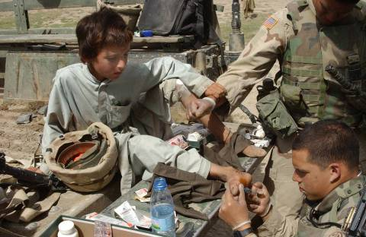
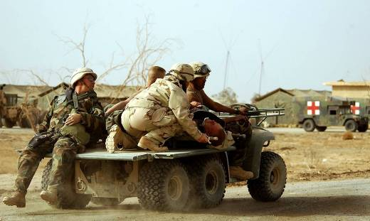
EWS Transfusion
Role 1 Transfusion
First Aid/Buddy Aid
Medics/Hospital Corpsman
Battalion Aid Station
Blood products available can be variable
Ability to perform fresh whole blood drive
Notes:
The availability of blood products for transfusion can vary widely, even amongst equivalent roles of care. Medics and battalion aid stations may have very limited supplies, making the ability to perform a fresh whole blood drive essential.

Slide 29
EWS Transfusion
Role 2 Transfusion
∎ Forward surgical team
∎ Mobile forward surgical team
∎ Fleet surgical team
∎ Predominately low titer group O whole blood, group O stored RBCs, AB or A plasma
∎ Variable, but generally limited quantities
20-40U SWB or 20-40U PRBC/FFP
combined; WBB; No platelets
Notes:
Role 2 facilities typically have at their disposal some combination of low titer O stored whole blood, group O red blood cells, and A or AB plasma. They typically do not carry platelets. Role 2s that are further split, may even have less blood availability and will likely need to rely on walking blood banks.

Slide 30
EWS Transfusion
Role 3 Transfusion
∎ Forward surgical team
∎ Mobile forward surgical team
∎ Fleet surgical team
∎ Larger inventories of ABO type-specific blood products
80-120U of SWB or Component Therapy – RBCs, FFP, Platelets; WBB
∎ Apheresis platelets
∎ Cryoprecipitate
Notes:
Role 3 facilities generally have a formal blood bank and excellent laboratory and blood capabilities. In addition to stored whole blood, they carry the full spectrum of component therapy, to include red blood cells, FFP, platelets, and cryoprecipitate. Many Role 3 blood facilities are similar to blood centers in the continental US. However, fresh whole blood may still be required depending on the number of patients and the severity of their injuries.

Slide 31
EWS Transfusion
Exercise
A 29 year old marine was hit by a dismounted IED. He arrives at your Role 2 facility with bilateral, high above-knee-amputations, perineal wounds, and abdominal wounds. His vitals are: HR 138, BP 84/42, RR 32, SaO2 96%. Your medics get 2 large bore IVs.
What comprises damage control resuscitation?
What agents should be used to resuscitate?
What blood products are available based at Role 2? Role 3?
Notes:
We now return to our initial scenario. What are the key aspects of damage control resuscitation as they apply to the care of this Marine? What blood products should we utilize in the resuscitation? How do our options for transfusion change when we move this Marine from role 2 to role 3 care?

Slide 32
EWS Transfusion
References
∎ Joint Trauma System (JTS) Frozen Deglycerolized Red Blood Cells Clinical Practice Guideline (CPG), 11 Jul 2016
https://jts.amedd.army.mil/assets/docs/cpgs/JTS_Clinical_Practice_Guidelines_(CPGs)/Frozen_Deglycerolized_ Red_Blood_Cells_11_Jul_2016_ID26.pdf
∎ JTS Whole Blood Transfusion CPG, 15 May 2018
https://jts.amedd.army.mil/assets/docs/cpgs/JTS_Clinical_Practice_Guidelines_(CPGs)/Whole_Blood_Transfusi on_15_May_2018_ID21.pdf
∎ JTS Damage Control Resuscitation CPG, 12 Jul 2019
https://jts.amedd.army.mil/assets/docs/cpgs/JTS_Clinical_Practice_Guidelines_(CPGs)/Damage_Control_Resus citation_12_Jul_2019_ID18.pdf
∎ Office of The Surgeon General, Borden Institute, Emergency War Surgery, 5th U.S. Edition, Chap 33. 2018
https://www.cs.amedd.army.mil/Portlet.aspx?ID=cb88853d-5b33-4b3f-968c-2cd95f7b7809
All photos and images, not otherwise cited, are courtesy of the JTS Collection
Notes:
These JTS clinical practice guidelines and the 5th edition of Emergency War Surgery provide the bulk of the information contained in this presentation. They are always available for immediate reference.

