Slide 1
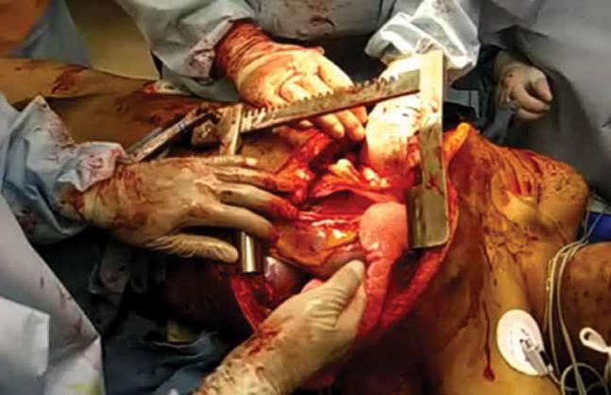
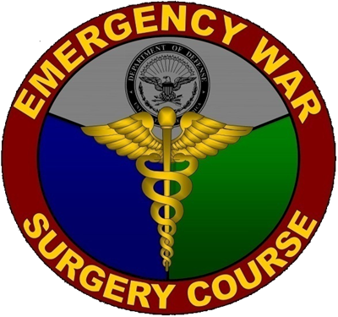
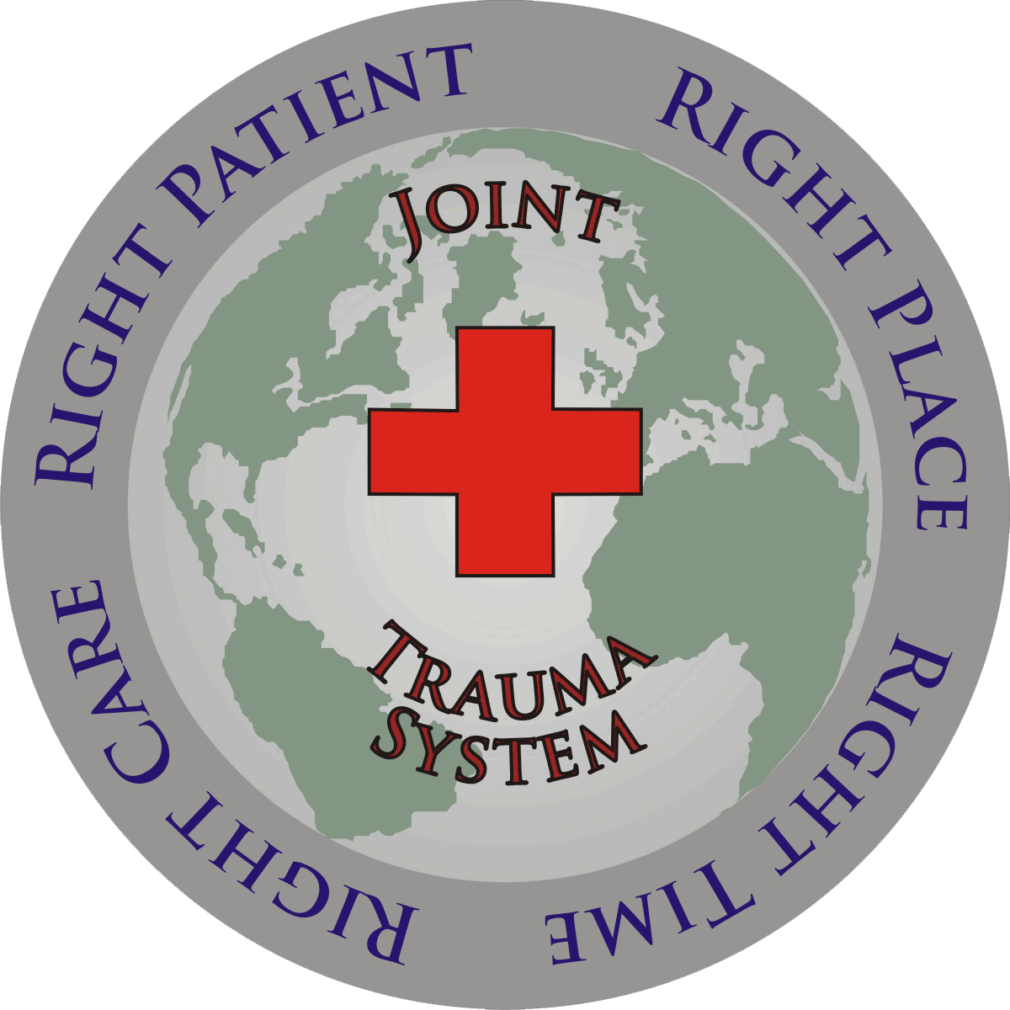
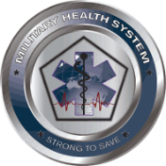
Joint Trauma System
Thoracic Injuries
Joint Trauma System Battlefield Trauma Educational Program
Notes:
In civilian trauma, thoracic injuries are present in 12-50% of patients. Over 90% of these are due to a blunt mechanism and <10% of these require surgical intervention. In contrast, 10- 15% of war injuries involve the torso and the majority of these are associated with a penetrating mechanism. The most common thoracic injuries are pneumothorax, pulmonary contusion and chest wall trauma. Injuries to the lung or great vessels have the highest mortality rate. The vast majority of injuries of the lung parenchyma are managed by the insertion of a chest tube and local wound care. Although penetrating injuries are more common in the deployed setting, blunt chest trauma does occur and may result in disruption of the thoracic contents and injury to the chest wall itself.

Slide 2
EWS Thoracic Injuries Objectives
Recognize and manage specific thoracic and cardiac injuries on the battlefield.
Describe the indications and technique for performing a resuscitative thoracotomy.
Describe common thoracic and cardiac exposures and recognize which injuries they address.
Notes:
Objectives of this lesson. 1. Recognize and manage specific thoracic and cardiac injuries on the battlefield. 2. Describe the indications and technique for performing a resuscitative thoracotomy. 3. Describe common thoracic and cardiac surgical exposures and recognize which injuries they address.

Slide 3
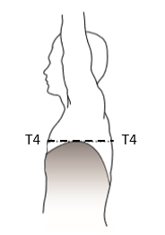
EWS Thoracic Injuries Evaluation & Diagnosis
Injuries to the chest can profoundly affect breathing and circulation.
Penetrating thoracic injuries below the T4 level/nipple line require evaluation for abdominal injuries due to variable position of the diaphragm.
Injuries requiring urgent intervention include:
Tension pneumothorax
Open pneumothorax
Massive hemothorax
Cardiac tamponade
Source: The Office of The Surgeon General, Borden Institute. Emergency War Surgery, 5th U.S. Edition, 2018.
Notes:
Evaluation and diagnosis of Thoracic Injuries. Injuries to the chest can profoundly affect breathing and circulation, and a complete and rapid assessment of each injury is mandatory. Knowledge of the mechanism of injury such as blast or fragment, may increase the index of suspicion for a particular injury. If the casualty is able to talk without hoarseness or stridor, there is reasonable assurance that the airway is intact. Penetrating thoracic injuries below the T4 level or nipple line requires evaluation for abdominal injuries due to variable position of the diaphragm during the respiratory cycle as illustrated in the figure at the right. Thoracic Injuries requiring urgent intervention include: Tension pneumothorax, open pneumothorax, massive hemothorax, and cardiac tamponade. Flail chest is not immediately life-threatening in most cases, but can present with a severe associated lung injury. Tube thoracostomy is often indicated in a severely injured thoracic trauma patient, and will generally provide useful clinical information, and potential treatment, regardless of the diagnosis.

Slide 4
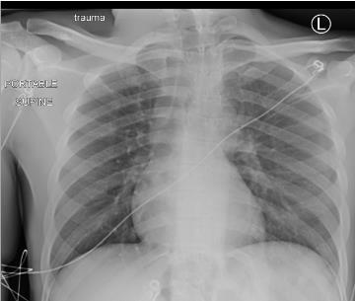
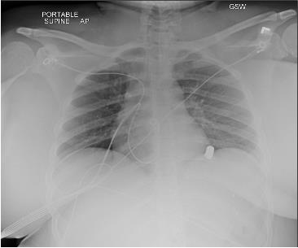
EWS Thoracic Injuries Pneumothorax & Hemothorax
Characteristics
Air or blood enters potential space between visceral and parietal pleura.
Signs & Symptoms
Unilateral breath sounds
Respiratory distress
Small left pneumothorax
Left Hemothorax secondary to penetrating trauma
Notes:
Characteristics of Pneumothorax and Hemothorax. Air or blood enters the potential space between visceral and parietal pleura. Signs and Symptoms of pneumothorax. Unilateral breath sounds and respiratory distress. The photo on the left shows a small left pneumothorax. The photo on the right shows a left hemothorax secondary to penetrating trauma.

Slide 5
EWS Thoracic Injuries Pneumothorax & Hemothorax
Absent or markedly decreased breath sounds with known thoracic trauma indicate need for intervention without additional testing. Tube thoracostomy (chest tube) is both diagnostic and therapeutic.
It is reasonable to perform chest x-ray (CXR) or ultrasound prior to chest tube if normal hemodynamics and adequate oxygenation/ventilation.
Tube thoracostomy is indicated in all patients with penetrating chest trauma or suspected hemothorax or pneumothorax.
Notes:
Absent or markedly decreased breath sounds with known thoracic trauma indicate the need for intervention without additional testing. Tube thoracostomy placement is both diagnostic if there is a rush of air or blood, and therapeutic. It is reasonable to perform chest x-ray or ultrasound prior to chest tube insertion if patient has normal hemodynamics and adequate oxygenation and ventilation. Tube thoracostomy is indicated in all patients with penetrating chest trauma or suspected hemothorax or pneumothorax.

Slide 6
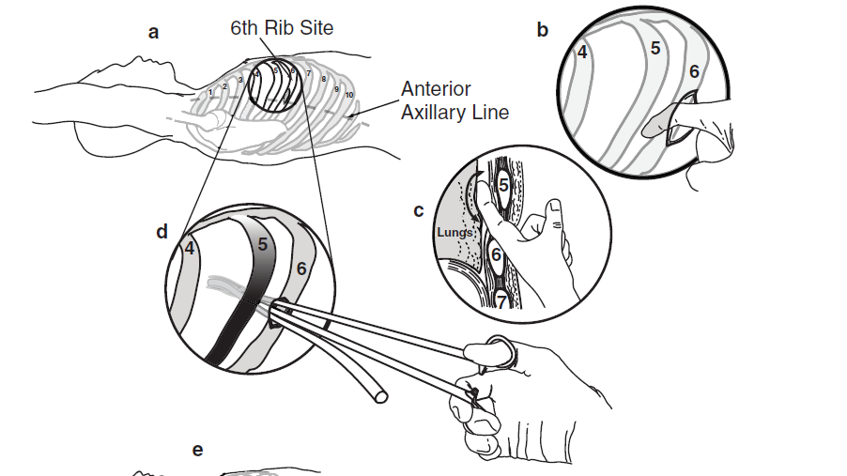
EWS Thoracic Injuries Pneumothorax & Hemothorax
Chest Tube Insertion key points:
Plan an incision at the nipple level (male) or at the inframammary crease (female) – approximately the 5th or 6th rib, centered over the anterior axillary line. If rib levels are difficult to determine, err on the high side to avoid abdominal entry.
Infiltrate a local anesthetic at the skin and muscle level in an awake patient if the conditions allow.
Make a transverse incision 3-4 cm in length, along and centered over the rib, carrying it down to the bone.
Source: The Office of The Surgeon General, Borden Institute. Emergency War Surgery, 5th U.S. Edition, 2018.
Notes:
Steps for tube thoracostomy insertion. Consider antibiotic administration with gram positive coverage prior to tube thoracostomy placement to reduce infectious complications provided this will not lead to a clinically significant delay in treatment. One does not need to position the ipsilateral arm over the patient’s head. The arm can be placed at the patient’s side on a rolled sheet or towel, or in an extended position at the elbow, but slightly flexed at the shoulder to allow adequate chest wall access. If time allows, prep the anterior and lateral chest on the affected side and administer antibiotics prior to incision. Make an incision at the level of the 5th or 6th rib. This is approximately the nipple level in males or at the inframammary crease in females. The incision should be centered over the anterior axillary line. If rib levels are difficult to determine, err on the high side to avoid abdominal entry. Infiltrate a local anesthetic at the skin and muscle level in an awake patient if the conditions allow. Make a transverse incision 3-4 cm in length, along and centered over the rib, carrying it down to the bone.

Slide 7
EWS Thoracic Injuries Pneumothorax & Hemothorax
Chest Tube Insertion Key Points:
Insert a curved clamp in the incision, directing it over the top of the rib, and push through the pleura. A distinct pop is frequently encountered when entering the chest. Insertion depth of the tip of the clamp should be limited by the surgeon’s hand to only 3 or 4 cm to ensure the clamp does not travel deeper into the chest, damaging underlying structures.
A finger is inserted into the incision to confirm entry into the pleural space.
Insert a chest tube into the hole, directing it posteriorly and apically. All chest tube side holes must be in the pleural space (not just below skin level).
Source: The Office of The Surgeon General, Borden Institute. Emergency War Surgery, 5th U.S. Edition, 2018.
Notes:
Insert a curved clamp in the incision, spread several times with a clamp to bluntly mobilize overlying chest wall muscle. Then direct the clamp over the top of the rib, and push into the chest through the pleura. A distinct pop is frequently encountered when entering the chest and a moderate amount force is necessary to achieve this entry. A rush of air or blood out of the chest will confirm a pneumothorax or hemothorax, respectively. Insertion depth of the tip of the clamp should be limited by the surgeon’s hand to only 3 or 4 cm to make sure that the clamp does not travel deeper into the chest, resulting in damage to underlying structures. Spread the clamp gently with the tips at the level of the ribs and remove. The operator’s finger is then inserted to confirm entry into the pleural space. Insert a 24 French to 36 French chest tube into the hole, directing it posteriorly and apically. All chest tube side holes must be in the pleural space (not just below skin level). Attach a chest tube to a Heimlich valve, standardized closed drainage system or bottles. In a resource-constrained environment, a cut off glove with a slit in the end or a Penrose drain may be attached to the end of the chest tube. Although these are only temporizing measures for chest tube drainage, they should serve as a one-way valve to prevent tension pneumothorax. Secure the tube with sutures, if possible, and dress to prevent contamination.

Slide 8
EWS Thoracic Injuries Tension Pneumothorax
Characteristics
“One-way” valve traps air
Lung collapse
Mediastinal shift to contralateral side
Decreases venous return to heart (preload)
Death
Signs & Symptoms
Respiratory distress
Unilateral breath sounds
Distended neck veins
Tracheal deviation away from the injury
Hypotension
Tachycardia
Patient with known chest injury presenting with a patent airway and difficulty breathing has a tension pneumothorax until proven otherwise.
BEWARE: Mechanical Ventilation can quickly turn a simple pneumothorax into a tension pneumothorax.
Notes:
A tension pneumothorax is a more complicated version of a pneumothorax. Air continues to enter the pleural cavity from a parenchymal or bronchial tree injury. The air gets trapped in the pleura, causing the lung to collapse, and the mediastinum to shift to the contralateral side of the chest. Venous return to the heart is compromised, causing a rapid drop in preload and cardiac output. This is manifested as tachycardia and hypotension. This is rapidly fatal if not diagnosed quickly. Patients have severe or progressive respiratory distress, decreased or unilateral breath sounds, distended neck veins, tracheal deviation away from the injured side, hypotension in the setting of chest trauma, and tachycardia. One should be able to make the diagnosis clinically. If a chest X-ray is obtained, it would demonstrate a large pneumothorax with marked deviation of the trachea to the opposite side. A patient with known chest injury presenting with a patent airway, difficulty breathing, and hypotension has a tension pneumothorax until proven otherwise. It requires rapid decompression and the insertion of a chest tube. Needle decompression alone is insufficient. BEWARE: Mechanical ventilation can quickly turn a simple pneumothorax into a tension pneumothorax. Differentiating between a simple pneumothorax and a tension pneumothorax is based on the presence of hemodynamic effects. While a patient with thoracic trauma and a pneumothorax may present with multiple injuries and an alternate explanation for hypotension - such as cardiac tamponade, intraabdominal bleeding, or hemothorax, immediate needle or tube thoracostomy is the necessary first step in this scenario. In the case of a tension pneumothorax, this maneuver should have both diagnostic and therapeutic benefit. Patients who are hypovolemic are more susceptible to the hemodynamic effects of tension pneumothorax.

Slide 9
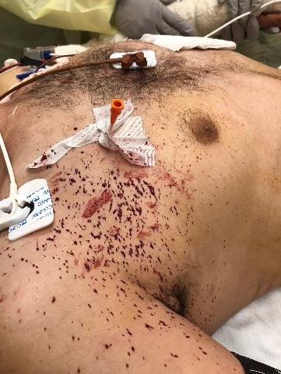
EWS Thoracic Injuries Tension Pneumothorax
Treatment: Immediate Decompression
Needle Decompression – 14 gauge/3.25 in/8cm spinal needle
First Choice: 4th and 5th Intercostal Space anterior axillary line
Second Choice: 2nd Intercostal space at the mid clavicular line (first choice for children)
Short catheters will rarely penetrate the thoracic cavity; using something long like a spinal needle with an angiocath
A chest tube should be placed as soon as feasible and safe after needle thoracostomy.
Needle Decompression
Notes:
Tension pneumothorax treatment is immediate decompression. Needle decompression should be performed with a large bore needle, at least 14 gauge, and 3.25 inch or 8 cm spinal needle in length in the 4th or 5th intercostal space in the anterior axillary line. The alternate decompression site is the 2nd intercostal space at the mid-clavicular line. This is the primary site for children. Ensure dedicated needle decompression catheters are available with all emergency medical supplies, shorter catheters used for venous access should be avoided as these will rarely penetrate the thoracic cavity. Needle decompression alone is insufficient treatment for a pneumothorax or a hemothorax. A chest tube should be placed as soon as feasible and safe after needle thoracostomy. For stable patients who have undergone needle thoracostomy, evaluation with ultrasound or chest x-ray to assess the need for chest tube placement is appropriate.

Slide 10
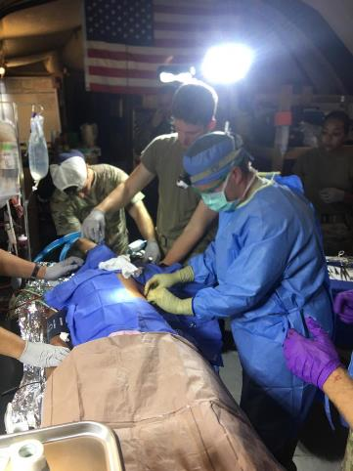
EWS Thoracic Injuries Tension Pneumothorax
Treatment: Immediate Decompression
Tube thoracostomy: 5th intercostal space (nipple line/mammary crease), anterior-mid axillary line
If chest tube placement delayed, be prepared to repeat needle decompression as needed.
Failure to improve after two needle decompressions likely indicates an alternate diagnosis.
Chest tube being inserted
Notes:
After needle decompression, a tube thoracostomy should be performed. If chest tube placement is delayed, be prepared to repeat needle decompression as needed. Failure to improve after two needle decompressions likely indicates an alternate diagnosis such as hemothorax, pulmonary contusion or diaphragm injury.

Slide 11
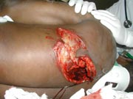
EWS Thoracic Injuries Open Pneumothorax
Characteristics
“Sucking” chest wound
Defect in the wall large enough to impair effective air exchange
Generally larger than 2/3 of the tracheal diameter
Treatment
Flutter-valve dressing: Taped on 3-sides
Tube thoracostomy at remote site
Operative intervention
Dressing that is taped on 4 sides results in a tension pneumothorax
Large, open chest wound to patient’s left posterior chest.
Notes:
Characteristics of an open pneumothorax: “sucking” chest wound, defect in the chest wall large enough to impair air exchange, generally larger than 2/3 of the tracheal diameter. Treatment consists of placement of a tube thoracostomy at remote site from injury, a flutter-valve dressing and operative intervention. A dressing that is taped on 4 sides results in a tension pneumothorax. The photo at the right shows a large, open chest wound to patient’s left posterior chest.

Slide 12
EWS Thoracic Injuries Massive Hemothorax
Characteristics
Rapid accumulation >1500 mL of blood from chest tube or bleeding continues such that ongoing blood transfusions are required.
Injury to:
Chest wall vascular injury
Hilar pulmonary injury
Great vessel/cardiac injury
Signs & Symptoms
Hypotension
Unilateral breath sounds
Dullness to percussion
Hypoxia
Notes:
Characteristics of a massive hemothorax: rapid accumulation of greater than 1500 mL of blood from chest tube or bleeding continues such that ongoing blood transfusions are required. Parenchymal lung injuries are the most common source of hemothorax, but massive hemothorax is likely due to a chest wall vascular injury, hilar pulmonary injury, or great vessel or cardiac injury. Signs and symptoms of a massive hemothorax include: hypotension, unilateral breath sounds, dullness to percussion, and hypoxia.

Slide 13
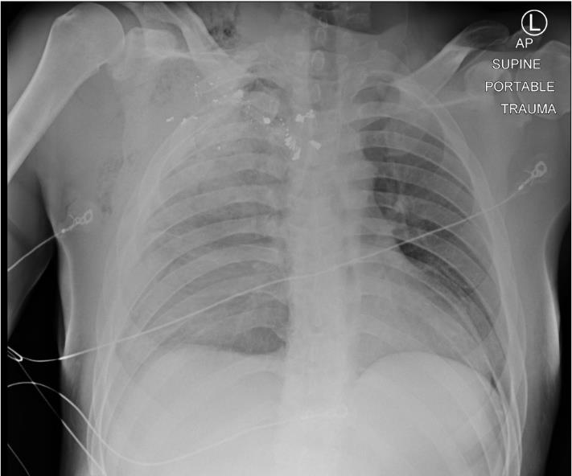
EWS Thoracic Injuries Massive Hemothorax
Diagnosis
CXR
US (E-FAST)
Tube thoracostomy
Treatment
Tube thoracostomy (may need 2)
Thoracotomy
≥1500 mL blood out initially
> 250 mL / hr of blood
Ongoing transfusion requirement
Patients will require massive transfusion protocol
Right Hemothorax secondary to penetrating trauma. Required urgent thoracotomy for hemorrhage control.
Notes:
Diagnosis of a massive hemothorax can be made by Chest X-ray, Ultrasound – as part of the E-FAST, or placement of a tube thoracostomy which is also therapeutic. Needle decompression will not identify a hemothorax. Treatment consists of a tube thoracostomy. Indications for a thoracotomy: greater than or equal to 1500 mL blood out of chest tube initially, greater than 200 mL per hour of blood from chest tube for 2-4 hours, or ongoing blood transfusion requirement. Patients will require a massive transfusion protocol. Chest tube output may not always be reliable because the thoracostomy tubes may kink or become occluded from clot. A second chest tube may need to be placed to completely drain the hemothorax. Photo at right. A Right hemothorax secondary to penetrating trauma. This injury required urgent thoracotomy for hemorrhage control.

Slide 14
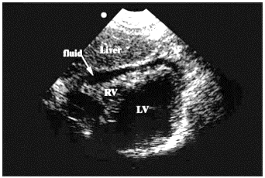
EWS Thoracic Injuries Cardiac Tamponade
Characteristics
Penetrating >> blunt trauma
Pathophysiology
Fluid in pericardium
Compression of right heart
Obstruction of venous return
Cardiovascular collapse
Positive FAST. Fluid seen between the pericardium and the ventricles.
Source: The Office of The Surgeon General, Borden Institute. Emergency War Surgery, 5th U.S. Edition, 2018.
Notes:
Characteristics of cardiac tamponade: much more likely with penetrating injury than with blunt trauma. Pathophysiology of cardiac tamponade: fluid in pericardium leads to compression of right heart, obstruction of venous return, and cardiovascular collapse. The photo at right shows a positive FAST. Fluid is seen between the pericardium and the ventricles.

Slide 15
EWS Thoracic Injuries Cardiac Tamponade
Classical Signs & Symptoms
Beck’s Triad:
Distended neck veins
Hypotension
Muffled heart sounds
Respiratory distress
Bilateral breath sounds
Unilateral breath sounds with tension pneumothorax
Midline trachea
Tracheal deviation with tension pneumothorax
Classic physical exam findings are unreliable and do not rule out injury.
Notes:
Classical signs and symptoms of cardiac tamponade include Beck’s triad. This consists of distended neck veins, hypotension and muffled heart sounds. Patients might also have respiratory distress, bilateral breath sounds are usually presents. Unilateral breath sounds occur with tension pneumothorax. The trachea is midline. Tracheal deviation occurs with tension pneumothorax. Classic physical exam findings are unreliable and do not rule out injury. Distended neck veins may be absent in the setting of significant blood loss.

Slide 16
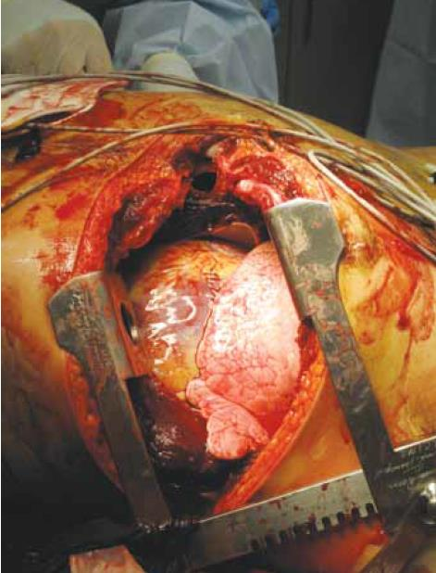
EWS Thoracic Injuries Cardiac Tamponade
Diagnosis
FAST
Pericardial window (best option if unsure and patient stable)
Treatment
Unstable patient: Left anterolateral thoracotomy -> can convert to clamshell thoracotomy if needed for better exposure
Median Sternotomy: In stable patients with positive subxiphoid pericardial window. Best exposure for heart and great vessels.
WARNING: These patients may arrest upon induction of anesthesia. Be READY.
Source: Combat Casualty Care: Lessons Learned from OEF and OIF, Borden Institute, 2012.
Notes:
Diagnosis of cardiac tamponade can be made by Ultrasound as part of the FAST. Pericardial window is the best option if you are unsure whether or not the patient has cardiac tamponade and the patient is stable. Treatment requires surgical control of the bleeding and repair of the cardiac injury. In the unstable patient a left anterolateral thoracotomy is performed which can be converted to clamshell thoracotomy if needed for better exposure. In stable patients with a positive subxiphoid pericardial window, a median sternotomy is the best exposure for heart and great vessels. Warning – these patients may arrest upon induction of anesthesia. Be Ready. Photo at the right shows a left anterolateral thoracotomy with retractor in place.

Slide 17
EWS Thoracic Injuries Flail Chest
Characteristics
Gross chest wall instability
Paradoxical chest wall movement with respirations (section of ribs ‘floating’ with two fractures on each rib).
Signs and Symptoms
Respiratory distress: Commonly associated with pulmonary contusion
Visible chest wall deformity
Notes:
Characteristics of a flail chest: gross chest wall instability and paradoxical chest wall movement with respirations, due to a section of “floating” ribs with two fractures per rib. Signs and symptoms include: respiratory distress and a visible chest wall deformity. Flail chest is commonly associated with an underlying pulmonary contusion.

Slide 18
EWS Thoracic Injuries Flail Chest
Diagnosis
Clinical presentation
CXR or CT scan: Multiple contiguous rib fractures in at least 2 locations
Treatment
Resuscitation from initial trauma
Adequate oxygenation
Improve ventilation
Analgesia
Pharmacologic (opiates, Tylenol, etc.)
Regional nerve blocks (epidural, intercostal blocks)
Ipsilateral chest tube placed prior to transport
Notes:
Diagnosis of flail chest relies on the clinical presentation. On chest X-ray or chest CT, multiple contiguous rib fractures in at least two locations will be seen. Treatment consists of resuscitation, adequate oxygenation, good pulmonary toilet, and ventilation optimization which may require aggressive analgesia and intubation. Analgesia can be pharmacologic with opiates, NSAIDs, etc, and/or regional nerve blocks such as epidural and intercostal nerve blocks. If physical exam or chest x-ray suggests the possibility of pneumothorax or hemothorax, a tube thoracostomy should be placed. If clinical or radiographic findings are equivocal, err on the side of caution and place an ipsilateral chest tube prior to transport.

Slide 19
EWS Thoracic Injuries Vascular Injuries
Initial Control
Digital occlusion
Sponge stick (venous injury)
Fogarty or Foley catheter
Side-biting vascular clamp
Damage Control Procedures
May require temporary proximal and distal control
Consider shunting Aorta shunt = chest tube
Primary repair
Digital occlusion of an injured innominate vein
Venous control achieved with vessel loops
Source: The Office of The Surgeon General, Borden Institute. Emergency War Surgery, 5th U.S. Edition, 2018.
Notes:
Most combat-related great vessel injuries are fatal at the point of injury. In some cases, particularly after major blunt trauma, a patient may present with a contained great vessel injury associated with a mediastinal hematoma. Initial control of thoracic vascular injuries is by digital occlusion, sponge stick, Fogarty or Foley catheter, or side-biting vascular clamp. The top photo shows digital occlusion of an injured innominate vein. The bottom photo shows venous control achieved with vessel loops of the innominate vein. The damage control procedures for vascular injuries may require temporary proximal and distal control for additional resuscitation prior to attempted repair. For an aortic injury, a side-biting clamp may be placed after aortic mobilization for temporary control. Also consider shunting vessels prior to primary repair. An aorta shunt is a chest tube. Repair of vessels should follow the principles detailed in the JTS CPG on Vascular injuries with shunting or repair by autogenous or synthetic grafts as indicated.

Slide 20
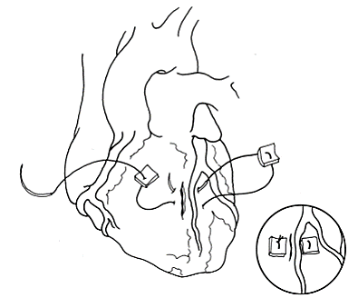
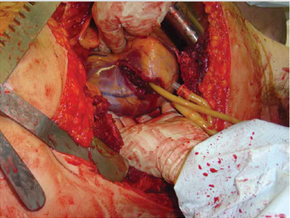
EWS Thoracic Injuries Heart
Expose and temporarily occlude punctures
Digital occlusion
Foley catheter
Skin stapler
Definitive repair of injury
2-0 Prolene, pledgeted sutures
Place in horizontal mattress format if near coronary vessel (pictured at top right)
Maintain high index of suspicion for injury to more than one cardiac structure or hidden, intra-cardiac injury.
More complex repairs are impractical without cardiac bypass.
Foley catheter
Sources: Emergency War Surgery, 5th U.S. Edition, 2018. Combat Casualty Care: Lessons Learned from OEF and OIF, 2012.
Notes:
Treatment of injuries to the heart. First expose and temporarily occlude punctures. Isolated injuries to the heart should be exposed by opening the pericardium and placing pericardial stay sutures. Temporary control can be obtained by digital occlusion, Foley catheter, or skin stapler. In the photo at bottom right a cardiac injury is controlled with a Foley catheter. For definitive repair of a cardiac injury, use pledgeted horizontal mattress on a 2-0 prolene on a large, tapered needle, MH or SH. Care must be taken to avoid additional injury to coronary vessels. Sutures must be tied only to the point of hemostasis to avoid tearing potentially friable cardiac tissue. Autologous pericardium can be used if commercial pledgets are not available. Atrial injuries may be controlled with a side-biting clamp followed by running closure with 2-0 or 3-0 polypropylene suture. Temporary inflow occlusion, occluding the superior and inferior vena cava for brief intervals, may prove helpful in repair. If injury to a distal coronary artery is identified, it should be ligated to control the bleeding. Maintain a high index of suspicion for injury to more than one cardiac structure or hidden, intra-cardiac injury. More complex repairs are impractical without cardiac bypass.

Slide 21
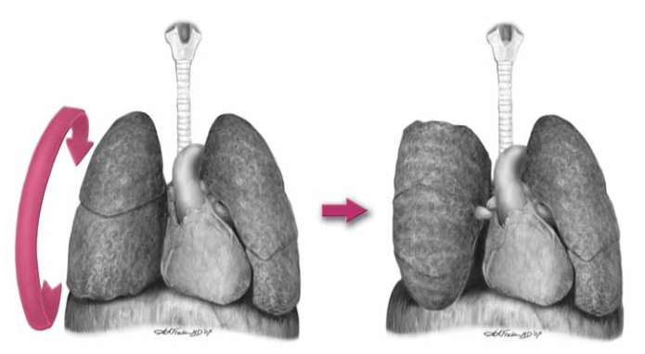
EWS Thoracic Injuries Lung
Chest tube adequate for most parenchymal injuries
Damage control procedures
To control immediately life threatening bleeding:
Cross-clamp hilum
Pulmonary twist
Pulmonary twist
Source: Out Of The Crucible: How The US Military Transformed Combat Casualty Care In Iraq and Afghanistan, 2012.
Notes:
Chest tube placement is adequate treatment for most parenchymal lung injuries. Posterolateral thoracotomy is preferred for isolated lung injuries, but is only appropriate in a stable patient with adequate resuscitation and no other uncontrolled injuries. Anterolateral thoracotomy is more appropriate in the urgent or damage control setting. Damage control procedures to control immediately life threatening bleeding are cross clamping the pulmonary hilum and pulmonary twist. This is illustrated at right. Good communication with the anesthesia provider is essential to manage the resultant sudden decrease in lung volume and right heart strain.

Slide 22
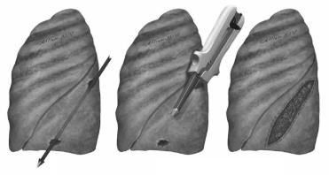
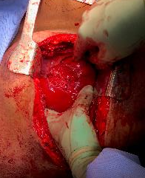
EWS Thoracic Injuries Lung
Further Damage Control Procedures
Tractotomy
Divide bleeding tracts with GIA stapler
Non-anatomic wedge resection (GIA stapler)
Pneumonectomy last resort
Stepwise increase in mortality with more extensive resections when lung injuries are encountered
Trauma pneumonectomy mortalities range from 50-100%
Contact ECMO team
Tractotomy
Source: Out Of The Crucible: How The US Military Transformed Combat Casualty Care In Iraq and Afghanistan, 2012.
Notes:
Bleeding from simple pulmonary parenchymal tears may be repaired with absorbable suture on a tapered needle or with stapling of the lung parenchyma. For deeper through-and-through injuries, a tractotomy may be performed by opening the injury tract with a GIA stapler or between straight vascular clamps followed by running suture repair to control bleeding and air leaks from the exposed lung parenchyma. The illustration and photo at right show a tractotomy. For more severe and/or destructive lung injuries, non-anatomical partial lung resection with serial GIA stapler fires may be needed. Note – do not simply close the entrance and exit points of penetrating tracts in the lung. With positive pressure ventilation, there is a risk of air embolism. The more central the injury, the higher the risk. Pneumonectomy is a last resort if an injury cannot be repaired. There is a stepwise increase in mortality with more extensive resections when lung injuries are encountered. Trauma pneumonectomy mortalities range from 50-100%. In these cases, ECMO may be needed to ensure survival. If this is the case, one should contact the ECMO team at 210-916-ECMO (210-916-3266).

Slide 23
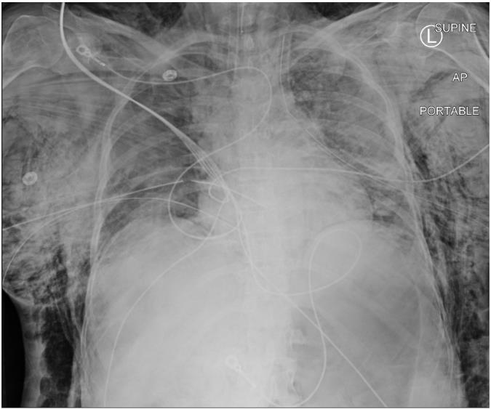
EWS Thoracic Injuries Tracheobronchial Tree
Clinical Findings
Persistent and/or massive air leak in chest tube chamber
Frothy hemoptysis
Pneumomediastinum
Confirmed via bronchoscopy (if available)
If after intubation there is no large air leak and ventilation appears adequate along no other surgical indications, then further intervention should be deferred to definitive care center.
Subcutaneous emphysema and pneumothorax requiring multiple chest tubes on the right.
Notes:
Clinical findings of injuries to the tracheobronchial tree include: persistent and/or massive air leak into the chest tube chamber, frothy hemoptysis, and pneumomediastinum. Patients may also have hoarseness and dysphonia. A tracheobronchial tree injury may also present with sudden hypotension and/or arrest after intubation and initiation of positive pressure ventilation. The diagnosis can be confirmed via bronchoscopy, if available. The most important priority is to control the airway, which should be combined with tube thoracostomy, usually bilaterally. The photo at right shows subcutaneous emphysema and pneumothorax requiring multiple chest tubes on the right. If after intubation there is no large air leak and ventilation appears adequate and there are no other emergent surgical indications, then further intervention should be deferred to definitive care centers. If there is difficulty with ventilation of the patient after tube thoracostomy due to a large air leak, the chest tube should be placed to water seal instead of suction.

Slide 24
EWS Thoracic Injuries Tracheobronchial Tree
Surgical exposure
Mid-distal trachea – median sternotomy
Distal trachea and carina – right thoracotomy
Left mainstem bronchus – left thoracotomy
Damage control procedures
Repair over ET tube with absorbable suture.
Bolster with pleural or intercostal muscle flap, especially between trachea and esophagus.
Temporization with bronchial blockers or double lumen ET tubes is possible.
Notes:
When intervention is needed, surgical exposure depends on the location of the injury. For proximal to mid-trachea injuries, a median sternotomy is the best approach. For proximal injuries, a cervical extension of the sternotomy may be needed. Alternatively, cervical tracheal injuries can be approached from a collar incision. The distal trachea, carina, and proximal mainstem bronchi can be well visualized via a right posterolateral thoracotomy with lung isolation. Injuries to the distal left mainstem bronchus or more distal left-sided bronchial tree injuries generally require left-sided thoracotomy for repair. Repair tracheal injuries over an endotracheal tube with absorbable suture. Bolster repairs with pleural tissue, strap muscle or intercostal muscle flaps, especially between the trachea and esophagus. Temporary control of injuries with bronchial blockers or double lumen ET tubes is possible. It may also be possible to control the airway through the tracheal defect with cervical tracheal injuries by inserting a endotracheal tube through the injury.

Slide 25
EWS Thoracic Injuries Esophagus
Diagnosis
Rarely isolated injury – will be identified with other injuries.
Clues include pain, fever, leukocytosis, cervical emphysema.
Chest X-ray: pneumothorax, mediastinal air, pleural effusion.
CT and endoscopy for isolated injuries if available.
Notes:
Isolated thoracic esophageal injuries are rare. Most of them will be identified during the course of exploration for other injuries. Clues to esophageal injury include pain, fever, leukocytosis, and cervical emphysema. On chest X-ray there may be pneumothorax, mediastinal air, and/or a pleural effusion. The diagnosis may be suspected or confirmed if there is drainage of gastrointestinal contents after placement of a chest tube. CT scan, endoscopy, and esophagram can help with the diagnosis of isolated injuries, if available.

Slide 26
EWS Thoracic Injuries Esophagus
Damage control procedures
Broad spectrum antibiotics
Drainage via tube thoracostomy and careful placement of nasogastric tube above the level of injury
Definitive repair if < 24 hours since injury
Single or double-layer closure with absorbable suture
Bolster with pleura or intercostal muscle flap
>24 hours: wide drainage only
Resection should only be utilized in the setting of extensive tissue devitalization.
Approach for isolated injury in stable patient:
Upper to mid thoracic esophagus: right posterolateral thoracotomy
Lower thoracic esophagus: left posterolateral thoracotomy
Notes:
Resources for definitive repair may not be available in the deployed setting. The key principles of treatment are adequate fluid resuscitation, broad spectrum antibiotics, debridement of any clearly non-viable tissue, control of ongoing contamination, and wide drainage. Start broad spectrum IV antibiotics as soon as the diagnosis is suspected. Drainage and control of contamination of the mediastinum and pleural space are paramount. If repair is not feasible most patients can be temporized with wide drainage of the pleural space and mediastinum with chest tube drainage and a nasogastric tube placed above the level of the injury. Ideally, primary repair is performed within 24 hours of injury. Primary repair can be more challenging or even impossible after this interval. If the time since injury is greater than 24 hours, don’t attempt repair and drain widely. The preferred approach for intrathoracic esophageal injuries in a stable patient is right posterolateral thoracotomy for upper and mid-esophagus and left thoracotomy for the lower esophagus. Locate the injury by mobilizing the esophagus, ideally aided by placement of a nasogastric or orogastric tube. Mobilize the esophageal muscle above and below the mucosal injury to ensure complete visualization of the defect. Esophageal repair can be done in a single or double-layer closure with absorbable suture. Bolster the repair with pleura, cervical strap or intercostal muscle flaps. Do not wrap the repair circumferentially and place drains near the repair. If primary repair is not possible, wide drainage with proximal esophageal diversion should be considered. Resection should only be utilized in the setting of extensive tissue devitalization.

Slide 27
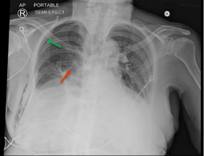
EWS Thoracic Injuries Diaphragm
Diagnosis
CXR: Gastric bubble or colon outline
CT scan: Only available at some treatment facilities
Direct visualization
Usually found directly when exploring for penetrating trauma
Pneumothorax (green arrow), but also note outline of bowel in right chest (red arrow)
Notes:
Diaphragm injuries may manifest as a gastric bubble or colonic outline seen above the diaphragm on CXR. If there is ambiguity, a nasogastric or orogastric tube can be placed and seen curling above the diaphragm. A diaphragm injury may also be diagnosed on CT scan but this is only available at some treatment facilities in deployed locations. Most injuries are found at the time of surgical exploration. The photo demonstrates a diaphragm injury. A right pneumothorax is indicated by the green arrow, but also note the outline of bowel in the right chest by the red arrow.

Slide 28
EWS Thoracic Injuries Diaphragm
Access
If identified during thoracic procedure, the abdomen must be evaluated for intra-abdominal injury.
Repair
Use running or simple interrupted 0 or 2-0 non-absorbable suture.
If significant contamination of pleural space by enteric contents, copious irrigation with drainage of chest.
Small diaphragmatic injury (arrow) Source: Borden Institute: War Surgery in Afghanistan and Iraq
Notes:
If a diaphragm injury is identified during a thoracic procedure, the abdomen must be evaluated for intra-abdominal injury. All injuries of the diaphragm should be closed. In the damage control setting, repair of diaphragm lacerations can be deferred until re-exploration. Injuries should be repaired using running or simple interrupted 0 or 2-0 non-absorbable suture. If there is significant contamination of pleural space by enteric contents, copious irrigation and placement of pleural drains is indicated after repair. For large defects, mesh repair may be necessary, but should be used with caution in the face of contamination. Central tendon injuries of the pericardial diaphragm are rare, but they can cause tamponade physiology due to either cardiac herniation into the abdomen or herniation of the bowel into the pericardium. Prior to closing central tendon tears, copiously irrigate the pericardial space with warm saline to wash out blood clots or enteric contents. Carefully inspect the heart and pleural pericardium to ensure there are no other injuries or tears. A small diaphragmatic injury is identified by the arrow in the photo at right.

Slide 29
EWS Thoracic Injuries Chest wall
Bleeding from intercostal arteries not likely to stop without intervention.
During thoracotomy:
Assess non-chest wall bleeding sources.
Temporize with manual pressure and packing.
Clips, cautery or pericostal sutures
May need temporary cessation of ventilation for assessment and control of bleeding.
Notes:
Chest wall bleeding usually will not resolve with tube thoracostomy alone. Bleeding from intercostal arteries reflects systemic pressure since they are direct branches of the thoracic aorta or internal mammary artery. Conversely, bleeding from the lung parenchyma is from a low-pressure vascular system. It can be difficult to discern the exact source of thoracic bleeding until after thoracotomy. The subclavian vessels are closely associated with the anteroapical chest wall. If significant bleeding appears to arise from this location, additional supraclavicular or infraclavicular incisional exposure may be needed. Once a direct site of bleeding is identified on the chest wall, it can be controlled with cautery, clips or suture. Figure-of-eight peri-costal sutures using a large blunt needle around the involved rib proximal and distal to the bleeding site may be effective. Adequate visualization and repair of the chest well may require enlarging an incision or a separate counter incision. Temporary holding of ventilation may be needed for assessment and control of bleeding. In an unstable patient, packing the chest will temporize the vast majority of bleeding.

Slide 30
EWS Thoracic Injuries Surgical Exposures
Positioned to maximize necessary interventions
Supine with arms out
Prepped from chin to knees and chest to elbows
Large bore IV access
Anesthesia concerns
Induction can cause cardiovascular collapse, especially with cardiac tamponade.
Consider having patient prepped and draped prior to inducing anesthesia.
If clinical pattern allows, suspected great vessel injury should receive short-acting beta blocker with goal SBP 100-120.
Notes:
Patients undergoing surgical intervention of acute thoracic trauma should be positioned supine with arms out and prepped from chin to knees and chest to elbows. This will allow for multiple potential incisions. Patients should also have large bore IV access. Thoracic injuries can cause cardiovascular collapse upon induction especially with cardiac tamponade. Consider having the patient prepped and draped prior to inducing anesthesia. If the clinical pattern allows, suspected great vessel injury should receive a short-acting beta blocker with a goal systolic blood pressure of 100-120 mmHg.

Slide 31
EWS Thoracic Injuries Surgical Exposures
Median Sternotomy
Suspected cardiac injury
Positive subxiphoid window
Suspect injury to great vessels of chest
Weaknesses: Poor exposure to left subclavian or thoracic aorta
Extensions
Subclavicular: Mid-to-distal subclavian artery injury (preferred)
Trap Door: Proximal left subclavian artery injury
Notes:
A median sternotomy is indicated for suspected cardiac and/or great vessel injury based on ultrasound or positive pericardial window. In the setting of an obvious concomitant pleural space hemorrhage, anterolateral thoracotomy is preferable to sternotomy. A median sternotomy does not provide adequate exposure of the left subclavian artery, distal aortic arch or descending aorta and provides only limited exposure of the pleural spaces. A thoracotomy can be converted to a clamshell or a trap door incision as needed to expose the heart or great vessels. For a right subclavian vascular injury, a sternotomy can be extended to a right supraclavicular incision. For a left subclavian vascular injury, the incisions can be extended to a trap door.

Slide 32
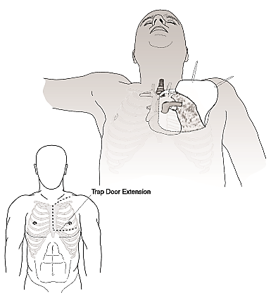
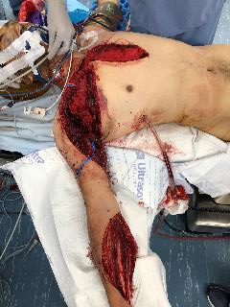
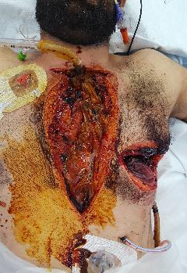
EWS Thoracic Injuries Median Sternotomy
Trap Door Extension
Median sternotomy with subclavicular extension for subclavian injury
Median Sternotomy with left anterolateral thoracotomy with temporary packing
Notes:
These photos illustrate extensions of a midline sternotomy. The illustration on the left is of a trap door extension of a median sternotomy. The center photo is a median sternotomy with subclavicular extension for subclavian injury. The photo on the right is a median sternotomy with left anterolateral thoracotomy with temporary packing.

Slide 33
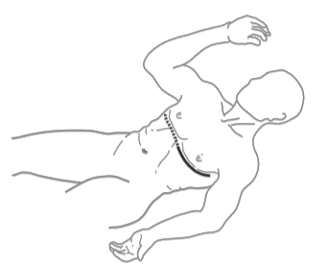
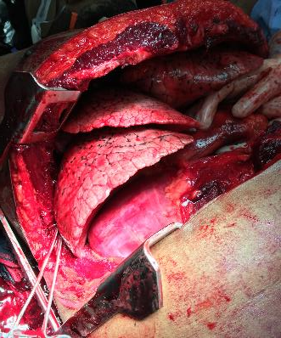
EWS Thoracic Injuries Surgical Exposures
Left anterolateral thoracotomy
Ideal for the patient in extremis or is profoundly unstable.
Should be combined with right tube thoracostomy.
Same incision used for emergency resuscitative thoracotomy.
Extensions
Transverse sternotomy with right anterolateral thoracotomy (“clamshell”).
Suspected intra-pericardial injury or right pleural space bleeding.
Trans-mediastinal gunshot wound with active cardiac massage
Notes:
Left anterolateral thoracotomy is ideal for the patient in extremis or who is profoundly unstable. This should be combined with right tube thoracostomy. This is the same incision used for emergency resuscitative thoracotomy. A left anterolateral thoracotomy can be extended with a transverse sternotomy and right anterolateral thoracotomy or clamshell incision for better visualization of a suspected cardiac injury or right pleural space bleeding. This incision is illustrated at right. The photo shows a clamshell incision in a patient with a trans-mediastinal gunshot wound with active cardiac massage.

Slide 34
EWS Thoracic Injuries Surgical Exposures
Right anterolateral thoracotomy
Used for injuries known to be to right chest
Posterolateral thoracotomy
Rarely appropriate in the acute trauma setting.
May be indicated for definitive repair of posterior mediastinal or lung injuries in well resuscitated patients.
Notes:
A right anterolateral thoracotomy is used for injuries known to be isolated to the right chest. A posterolateral thoracotomy is rarely appropriate in the acute trauma setting. In stable, well resuscitated patients, a posterolateral thoracotomy will provide better visualization of the esophagus and may be indicated for definitive repair of posterior mediastinal or lung injuries.

Slide 35
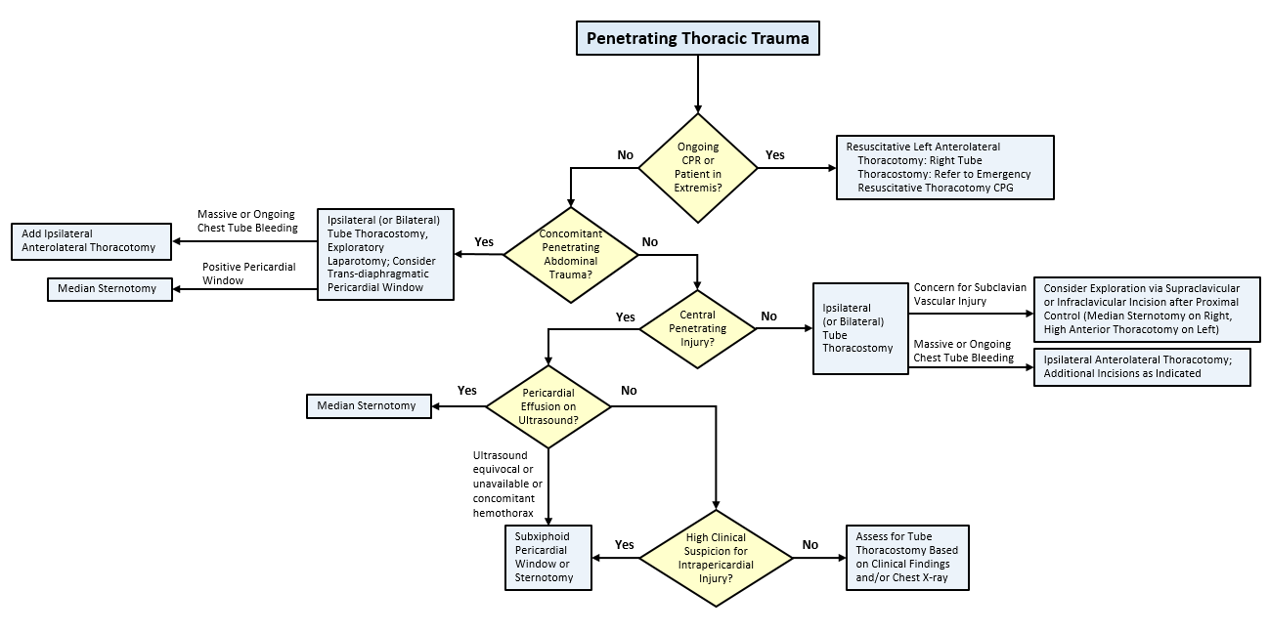
EWS Thoracic Injuries Penetrating Thoracic Trauma
Notes:
This is the algorithm for penetrating thoracic trauma from the JTS Wartime Thoracic Injury CPG.

Slide 36
EWS Thoracic Injuries References
JTS, Emergent Resuscitative Thoracotomy CPG, 18 Jul 2018. https://jts.amedd.army.mil/assets/docs/cpgs/JTS_Clinical_Practice_Guidelines_(CPGs)/Emergent_Resuscitative_Thoracotomy_ERT_18_Jul_2018_ID20.pdf
JTS, Wartime Thoracic Injury CPG, 26 Dec 2018. https://jts.amedd.army.mil/assets/docs/cpgs/JTS_Clinical_Practice_Guidelines_(CPGs)/Thoracic_Injury_26_Dec_2018_ID74.pdf
The Office of The Surgeon General, Borden Institute. Emergency War Surgery, 5th U.S. Edition, 2018. Chap 16. https://www.cs.amedd.army.mil/Portlet.aspx?ID=cb88853d-5b33-4b3f-968c-2cd95f7b7809
Savistky, Eric MD and Brian Eastridge MD COL MC USAR. Combat Casualty Care: Lessons Learned from OEF and OIF. Fort Sam Houston, TX: Borden Institute, 2012.)
All photos and images, not otherwise cited, are courtesy of the JTS Collection
Notes:
Please refer to the JTS CPGs for Resuscitative Thoracotomy and Wartime Thoracic Injury, Emergency War Surgery, and Combat Casualty Care: Lessons Learned from OEF and OIF for further information. All photos and images, not otherwise cited, are courtesy of the JTS collection.

