Slide 1
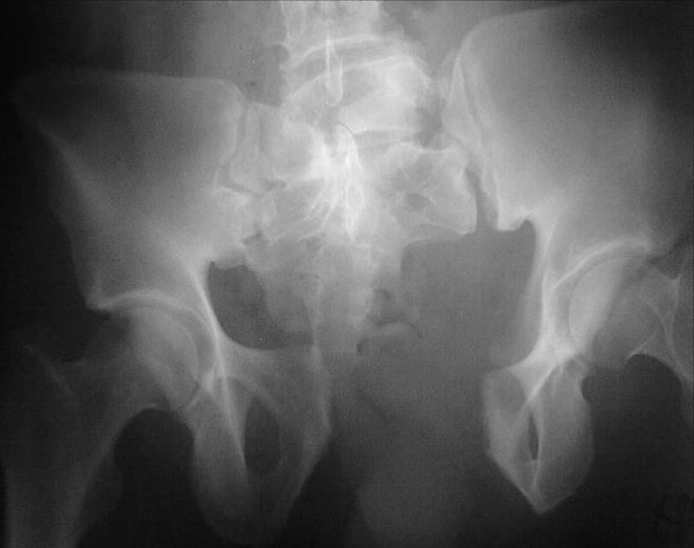
Joint Trauma System
Pelvic Fracture Management
Joint Trauma System Battlefield Trauma Educational Program
1
Notes:
The basic understanding and management of pelvic fractures is an important skill for all providers in the deployed setting.

Slide 2
EWS Pelvic Fracture Scenario
A 21M AD soldier is involved in a vehicle rollover. He complains of left hip and left leg pain. The left leg appears shortened and externally rotated. His initial vital signs are BP 130/60, HR 120, RR 24 with an O2 saturation of 98% on room air.
What types of injuries would you suspect?
What are the steps in management of this patient?
2021 v1.1
Notes:
The lecture begins with a scenario. Refer back to this scenario and the questions as you progress through the slides. We will revisit it at the conclusion of the segment.

Slide 3
EWS Pelvic Fracture Objectives
Identify patients at risk for pelvic fractures.
Learn initial pelvic fracture management.
Identify need for aggressive resuscitation and use of blood products.
Identify early need for multi-disciplinary approach involving trauma and orthopedic surgery.
2021 v1.1
Notes:
These are the four main objectives of the lesson. Early recognition of pelvic fractures and initiation of appropriate care can be the difference between life and death.

Slide 4
EWS Pelvic Fracture Background
Prevalence of improvised explosive device (IED) attacks have seen an increased incidence of blunt trauma pelvic injuries.
Blunt injuries may be associated with major hemorrhage and early mortality. Death within the first 24 hours of injury most often due to hemorrhage.
Civilian mortality rates have ranged from 6-35% with higher mortality rates associated with open fractures.
Anterior Posterior (AP) compression III fracture, a.k.a. “Open Book” fracture.
Source: Combat Casualty Care: Lessons Learned from OEF and OIF, Borden Institute.
2021 v1.1
Notes:
Pelvic fractures are a fairly common injury sustained by our soldiers on the battlefield. The high prevalence of IEDs as well as heavy vehicles and machinery make our population especially prone to these injuries. Severe pelvic fractures, like the one depicted on this slide, often result in massive hemorrhage and can carry a high mortality rate.

Slide 5
EWS Pelvic Fracture Evaluation
Initial questions to ask:
Is the patient hemodynamically stable?
Is the pelvic fracture mechanically stable?
Fractures can be identified with clinical signs such as leg-length discrepancy, scrotal or labial swelling/ecchymosis.
Assess pelvic stability by applying a posteriorly-directed force to the ileac crest.
This should only be done once by the most experienced provider.
Further manipulation can exacerbate hemorrhage.
2021 v1.1
Notes:
Upon initial evaluation of a casualty, clinical signs such as hypotension, leg length discrepancy or perineal ecchymosis raise the suspicion for a pelvic fracture. A pelvic exam should only be performed once to prevent potential hemorrhage from multiple manipulations.

Slide 6
EWS Pelvic Fracture Evaluation
Hemodynamically unstable patients should be thoroughly and rapidly investigated for sources of hemorrhage.
Evaluate chest, abdomen, and extremities for other potential sources of uncontrolled bleeding.
Bleeding from pelvic fractures may be concurrent with or independent of other sources.
Evaluate perineum for concurrent rectal or genitourinary/ gynecologic injuries.
AP Pelvic XR used as an adjunct to primary survey.
Early multidisciplinary consultation with orthopedic surgery is crucial.
2021 v1.1
Notes:
Pelvic trauma should be considered as a source of hemorrhage in the unstable patient, especially from blunt trauma. In these patients, an A/P pelvis XRAY should be obtained as an extension of the primary survey. Early consultation with Orthopedic surgery is critical.

Slide 7
EWS Pelvic Fracture Pelvic Fracture Clinical Pathway
Hemodynamically Unstable Patient with Pelvic Fracture
ALTERNATIVE OPERATIVE PATHWAY
Consider REBOA in hemodynamically unstable patients.
Initiate aggressive resuscitation with fluid and blood products
Rule out thoracic source of hemorrhage (i.e. ATLS and chest x-ray).
Wrap pelvis with sheet or apply pelvic binder.
If pelvis likely primary source of bleeding:
Extraperitoneal packing.
Exploratory laparotomy if pelvic packing fails or to control other injuries.
If abdomen likely primary source of bleeding:
Exploratory laparotomy – Try to limit initial incision to supraumbilical fascia.
Extraperitoneal packing if pelvis appears to be primary source.
Extend exploratory laparotomy as needed.
Ultrasound Abdomen
POS
NEG
CPG OPERATIVE PATHWAY
Laparotomy, consider extraperitoneal pelvic packing.
On table angiography if available.
Sheet/Binder, external fixation where/when applicable
Resuscitation for Hemorrhage
CPG OPERATIVE PATHWAY
DPL and/or exploratory laparotomy.
Consider pelvic packing when appropriate.
External fixation when applicable.
Bilateral iliac artery litigation if hemorrhage continues.
Hemo-dynamically Stable?
ICU (CT if available)
Plan for pelvic external fixation if applicable.
FURTHER OPERATIVE OPTIONS
Consider angiography if fluoroscopy available.
Consider external fixation if fluoroscopy available.
Unilateral iliac artery ligation on side of more severe fractures.
Bilateral iliac artery ligation for refractory bleeding.
NO
YES
ICU (CT if stable and available)
2021 v1.1
Notes:
This algorithm is from the Pelvic Fracture Care CPG. In the unstable patient with a pelvic fracture, two pathways for intervention can be considered. Patients with a positive FAST should be taken to the operating room for laparotomy and pre-peritoneal packing. Additional surgical maneuvers can be performed if bleeding continues. In patients with a negative FAST, Zone 3 REBOA is a viable option if the provider feels comfortable with the practice. In both scenarios, timely pelvic stabilization with an appropriately placed binder or external fixation is integral to obtaining hemostasis.

Slide 8
EWS Pelvic Fracture Initial Treatment
In the austere/combat setting, all types should be treated the same initially until expert consultation with orthopedic surgery can be obtained.
Placement of a pelvic binder is first step in reducing pelvic volume.
Complete by any means necessary (wrapped sheet, bean bags, commercial pelvic binder, or external fixation).
Center binder around greater trochanters.
Tape ankles and knees together to minimize external rotation.
Best for control of venous bleeding (70% of all pelvic bleeding).
Pelvic external fixation is another option if surgical expertise present.
2021 v1.1
Notes:
The correct placement of a pelvic binder is a critical component of the deployed provider’s armamentarium. The actual composition of the binder is irrelevant as long as it is centered around the greater trochanters; a common mistake is centering on the anterior superior iliac spines, which is too high to provide adequate pelvic medialization. Early external fixation is another option if supplies are available. These maneuvers are effective against venous bleeding, which comprises 70% of pelvic hemorrhage.

Slide 9
EWS Pelvic Fracture Treatment Options
30% of pelvic bleeding is arterial.
May need massive resuscitation with blood products.
Temporary aortic occlusion can be useful.
Embolization is an excellent option for control but is only available at Role 3 or above.
Retroperitoneal packing via suprapubic packing (without violating the peritoneum) is the best surgical option.
Attempts at opening a retroperitoneal pelvic hematoma from inside the abdomen should be resisted and only attempted as a last resort, although it may be necessary due to other injuries requiring a laparotomy.
2021 v1.1
Notes:
An arterial source for pelvic hemorrhage is much less common, however it often requires surgical intervention to control. Pre-peritoneal packing is a good first option, however severe hemorrhage may require ligation of the internal iliac arteries. Angioembolization is an excellent option if available.

Slide 10
EWS Pelvic Fracture Treatment Options
If an open pelvic fracture continues to bleed despite packing, ligation of bilateral internal iliac arteries should be considered.
Once hemorrhage controlled, diversion of the fecal stream in the presence of wounds at risk for fecal soilage should be considered.
Definitive internal pelvic stabilization is done outside of the combat zone.
Exploratory laparotomy, if required, should follow closure of the lower anterior rectus sheath to allow for continued tamponade of the vessels of the retroperitoneum.
2021 v1.1
Notes:
Fecal diversion should be considered at the Role III in patients with large perineal wounds. Definitive pelvic fixation should also be delayed until the Role 3 or 4.

Slide 11
EWS Pelvic Fracture Treatment Options
Pelvic Packing
8 cm vertical midline incision from the symphysis pubis to umbilicus.
Divide the fascia of the rectus abdominus with care to avoid injuring the bladder.
Retract the bladder to one side and identify the pelvic brim.
Up to 3 lap sponges usually fit on one side.
Place the first lap sponge below the level of the pelvic brim at the level of the sacroiliac joint (likely with aid of a sponge stick).
The second sponge is then placed at the mid portion beneath the pelvic brim, and the third below the bladder.
Repeat for the opposite hemipelvis.
Close the rectus fascia.
2021 v1.1
Notes:
Pelvic packing is accomplished through a low midline incision. Bluntly create a pre-peritoneal plane that extends posteriorly to both sides of the spine. Then insert up to three folded laparotomy pads per side. Temporarily close the fascia to create a tamponade effect. Ensure the number of laparotomy pads inserted is recorded and relayed to the next level of care.

Slide 12
EWS Pelvic Fracture Scenario
A 21M AD soldier is involved in a vehicle rollover. He complains of left hip and left leg pain. The left leg appears shortened and externally rotated. His initial vital signs are BP 130/60, HR 120, RR 24 with an O2 saturation of 98% on room air.
What types of injuries would you suspect?
What are the steps in management of this patient?
2021 v1.1
Notes:
We now return to the scenario. The combination of subjective and objective findings are concerning for a pelvic or proximal femur fracture. The patients airway is intact and he doesn’t appear to have a significant pneumothorax based on the vitals. The next step is hemorrhage control. As there are no external signs of bleeding the pelvis and abdomen are the likely source for his tachycardia. A FAST exam will exclude the former. The latter will require an XRAY, if available. If not, empirically place a binder and triage appropriately. Remember to maintain spinal precautions as well.

Slide 13
EWS Pelvic Fracture References
Joint Trauma System, Pelvic Fracture Care Clinical Practice Guideline, 15 Mar 2017 https://jts.amedd.army.mil/assets/docs/cpgs/Pelvic_Fracture_Care_15_Mar_2017_ID34_updated.pdf
Emergency War Surgery, 5th US Edition, 2018. Chap 21. The Office of The Surgeon General, Borden Institute https://medcoe.army.mil/
Photos are part of the JTS image library unless otherwise noted.
2021 v1.1
Notes:
This concludes the segment on pelvic fractures. Please refer to the References should you require additional information.

