Slide 1
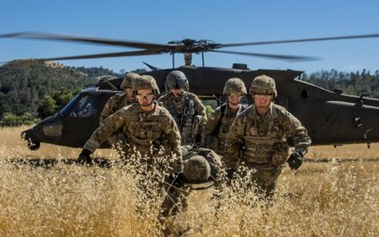
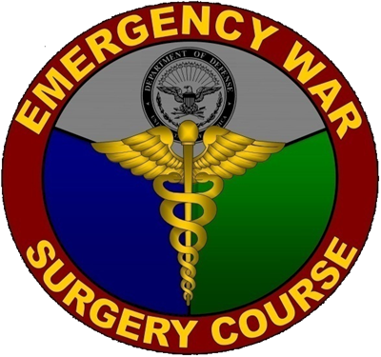
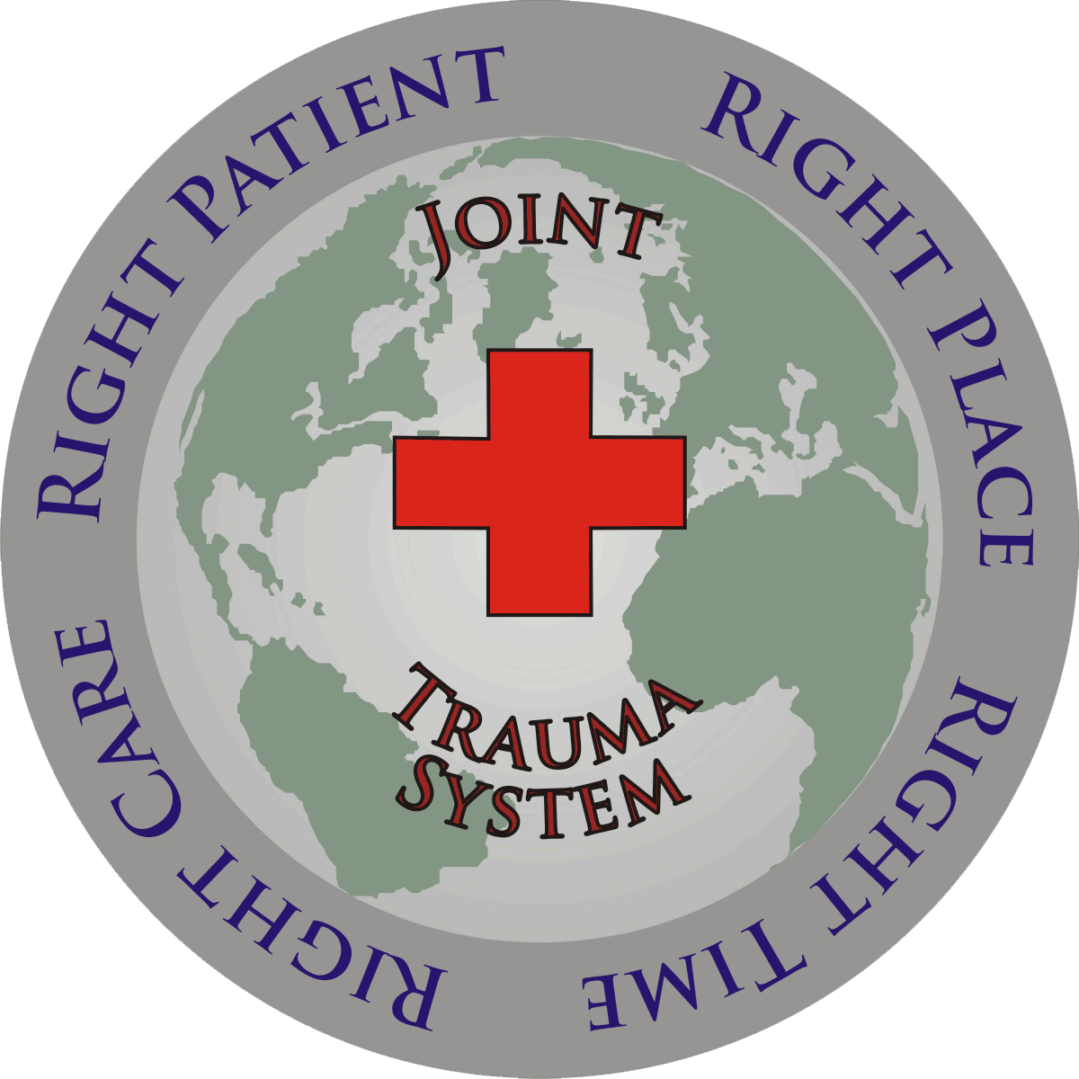
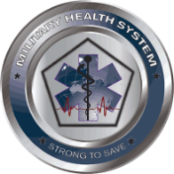
Joint Trauma System
En Route Care
Joint Trauma System Battlefield Trauma Educational Program
1
Notes:
In this lecture we will discuss En Route Care, or the continuum of medical care from the point of Injury (POI) to definitive multispecialty care at a CONUS or OCONUS hospital.

Slide 2
EWS En Route Care Scenario
A 30 year old infantry officer is injured in a rocket blast He has a posterior knee injury that is actively bleeding as well as penetrating injuries across his abdomen and chest. He is having difficulty breathing.
What type of care would you expect at a Role 1, 2, 3, and 4?
2021 v1.1
Notes:
First we will start off with a case scenario to get you thinking about the process that this patient will go through from point of injury to definitive care. We will revisit this scenario throughout the lecture.

Slide 3
EWS En Route Care Objectives
Understand capabilities at each level of care.
Understand military medical evacuation terminology.
Understand risks and limitations of aeromedical evacuation.
2021 v1.1
Notes:
These are the three terminal learning objectives of this lecture. Your goal at the end will be to have an understanding for the medical capabilities at each level of care, be fluent in medical evacuation terminology so you can effectively communicate across the En-Route Care spectrum, and understand the risks and limitations of aeromedical evacuation.

Slide 4
EWS En Route Care Definitions
Casualty Evacuation (CASEVAC): Move of a casualty from the point of injury to medical treatment by nonmedical personnel.
Medical Evacuation (MEDEVAC): Movement and en route care provided by medical personnel to the wounded being evacuated from the battlefield to medical treatment facilities (MTF) or between medical facilities.
Aeromedical Evacuation (AE): Generally utilized fixed-wing aircraft to move sick or injured personnel within the theater of operations (intra-theater) or between theaters (inter-theater).
En Route Care: maintenance of treatment initiated prior to evacuation and sustainment of the patient’s medical condition during evacuation.
2021 v1.1
Notes:
it is imperative that we first define and distinguish the two categories of casualty evacuation: CASEVAC and MEDEVAC. CASEVAC is the movement of a patient from POI to a higher level of care by non-medical personnel while MEDEVAC accomplishes the task using trained medical professionals. Clinically This is an important distinction as CASEVAC patients can arrive to Role 2 or 3 facilities without any prehospital interventions, thereby increasing the initial time to care.
Aeromedical Evacuation teams are designated crews of 10-12 including as nurses and technicians, who provide medical care to casualties on fixed wing aircraft both within and outside theatre. A Critical Care Air Transport Team (or CCAT) may accompany the transport of critically injured patients. CCAT is a 3 person team that augments the aeromedical evacuation team.
En-Route care is defined as maintaining treatment of the patient prior to transport and sustainment of the patients medical condition during evacuation. As stated in the definition, the operative goal of ERC is to maintain and sustain, meaning the ERC team is responsible for continuing the treatment plan along the transport chain from one level of care to another.

Slide 5
EWS Field Critical Care Background
Role
Army
Navy
Marines
Air Force
Reducing time to medical or surgical interventions improves patient outcomes
Care starts on the battlefield and ends at definitive care facilities in the U.S.
As a general rule, no level of care will be bypassed except on grounds of medical urgency, efficiency or expediency
Four roles of care, can have different names, but principles the same
1
Self Aid, Buddy Aid
Self Aid, Buddy Aid
Self Aid, Buddy Aid
Self Aid, Buddy Aid
First
Responder
Combat Lifesaver
Navy Corpsman
Navy Corpsman
Combat Medic
Surface Combatant Ship
Battalion
& Station
Marine Wing Support Squadron
Submarine
Medical
Technician
Battalion Aid Station
Dock Landing Ship
2
*Forward Surgical Team/ Forward Resuscitative Surgical Team
Fleet Surgical Team
**Shock Trauma Platoon
Forward Resuscitative Surgery System
Mobile Forward Surgical Teams
Forward
Resuscitative
Care
Aircraft
Carrier
Amphibious Transport Dock (San Antonio)
Amphibious Assault Ship (General Purpose)/ Amphibious Assault Ship (Multipurpose) (Casualty Receiving & Treatment Ship)
Medical Battalion
Surgical Company
Expeditionary Medical Support
Medical Company
(Brigade Support)
3
Theater Hospitalization
Combat Support Hospital/Field Hospital
Hospital Ship
Expeditionary
Medical Facility
Theater Hospitals
4
Veterans’ Hospitals
U.S. & Overseas Medical Treatment Facilities
Civilian Hospitals
Definitive Care
*Note: Army Forward Surgical Team/Forward Surgical Resuscitative Team are a Role 3 capability used to expand care available at Role 2 by providing resuscitative surgical care. **Marine Corps Shock Trauma Platoon are a Role 2 capability that can be used to expand care available at Role 1 by providing advanced resuscitative care.
2021 v1.1
Notes:
At first glance this slide may appear busy and somewhat daunting. the main takeaway is noting the capabilities offered at each role of care. Although the specific terminology differs between the individual services , the care provided at each role is similar. With few exceptions care will proceed along the continuum.
Role 1 is first responder care such as Self Aid, Buddy Aid, and Medic care in the field or POI.
Role 2s are forward operating resuscitative care facilities such as Forward surgical teams in the Army and Ground Surgical Teams in the Air Force. Role 2s are the first echelon of care with surgical capabilities. Timely transport to the Role 2 is vital, as time to surgical intervention is directly correlated with outcomes.
Role 3s are Theater hospitals such as Bagram AB, Navy Hospital ships and Combat Support Hospitals.
Role 4s are Definitive care facilities, such as MTFs both CONUS and OCONUS, and partner civilian hospitals.

Slide 6
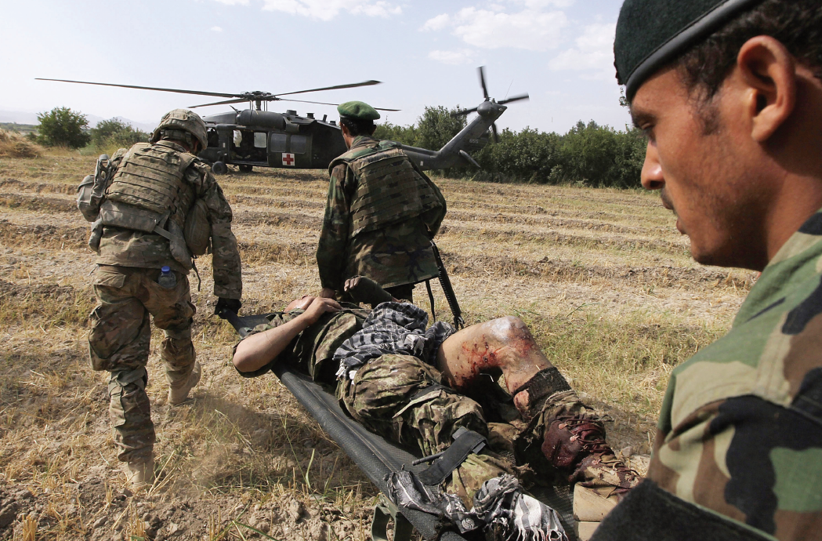
EWS En Route Care Role 1
Role 1: First medical care military personnel receive. This role includes:
Immediate lifesaving measures
Disease and non-battle injury prevention and care
Combat and operational stress preventive measures
Patient location and acquisition
Treatment provided (May not have physician):
Maintaining the airway
Stopping bleeding
Preventing shock
Protecting wounds
Immobilizing fractures
Other emergency measures as able
Patient evacuation after Role 1 level treatment
Source: Out of the Crucible.
2021 v1.1
Notes:
Role 1 medical care is typically the first level of care for combat casualties. Medical care at this level include: TCCC techniques to manage immediate life-threatening injuries, DNBI prevention and care, combat and operational stress prevention and care, and patient location and acquisition. There may or may not be a physician at this Role so self/buddy care is tantamount. Treatment provided includes maintaining airway by intubating or performing a cricothyroidotomy, stopping bleeding by applying and managing tourniquets, preventing shock by organizing and providing blood products or other resuscitative fluids, protecting wounds with dressing applications and antibiotic administration, immobilizing fractures with splints and other emergency measures.

Slide 7
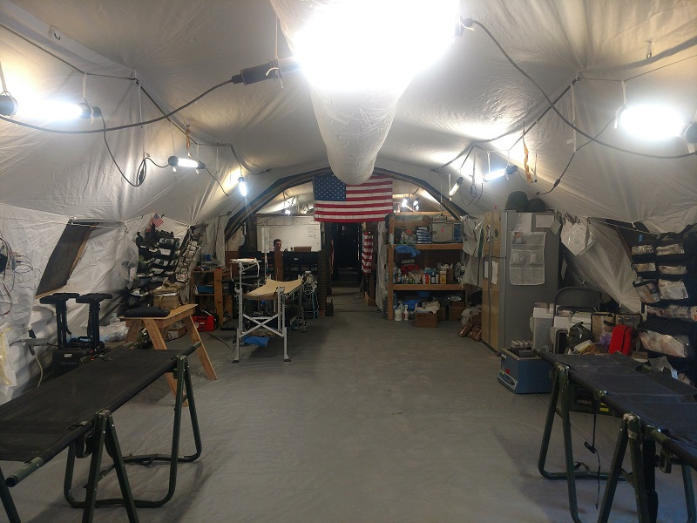
EWS En Route Care Role 2
Role 2: Provides advanced trauma management and emergency medical treatment.
Continues resuscitation with greater capabilities provided at Role 1.
Packed blood products
Limited X-Ray
Laboratory
Dental support
Combat and operational stress control
Resuscitative Surgical Support
Can conduct damage control surgery, but may have limited patient holding capabilities.
Role 2 Operating Room
2021 v1.1
Notes:
Role 2 medical facilities provide advanced trauma management and emergency medical treatment. It is a continuation of Role 1 resuscitative efforts with greater capability. These capabilities include component blood products, limited x-ray and laboratory, dental support, Combat and operational stress control, and surgical support. Damage control surgery is generally performed at this level of care, however there is limited capability to hold patients and provide prolonged field care.

Slide 8
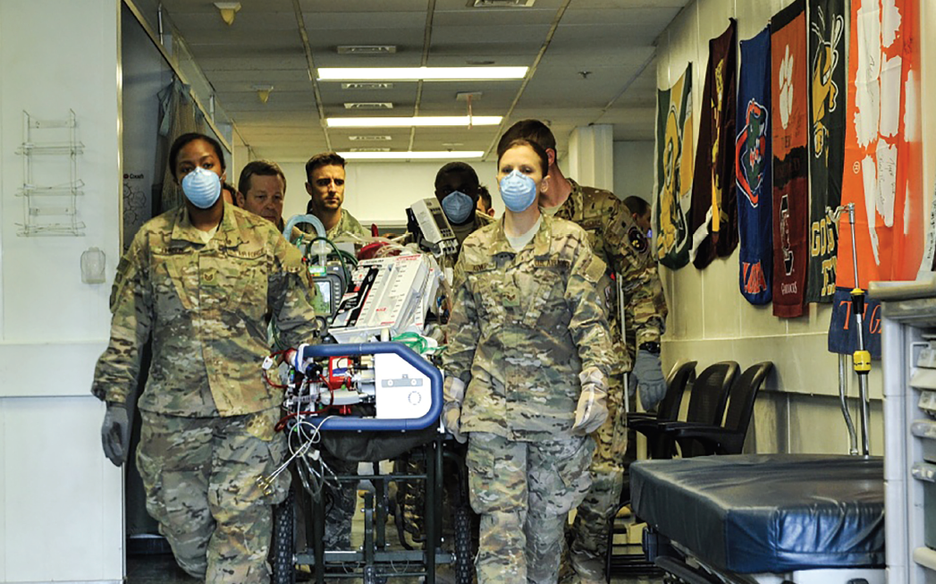
EWS En Route Care Role 3
Role 3: Provided additional resuscitation, wound surgery, specialty surgery (general, orthopedic, neurosurgical, etc.) and post-operative treatment
May provide definitive surgery for local nationals.
Patient holding until can tolerate and survive movement over long distances.
Patient placed on ECMO at Role 3 being prepared for transport
Source: Out of the Crucible
2021 v1.1
Notes:
Role 3 facilities provides continued resuscitation, general as well as subspecialty surgery, and post-operative care. Depending on the location, these facilities provide definitive care for host nationals and ally service members. Patients generally remain at this level until they are stable enough to tolerate longer fixed wing transports over long distances.

Slide 9
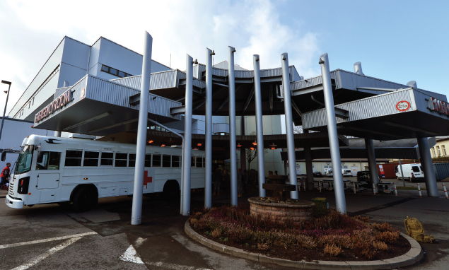
EWS En Route Care Role 4
Role 4: Care found in US and robust overseas hospitals.
Represents the most definitive medical care available within the medical care system.
Landstuhl Regional Medical Center, Germany
Source: Out of the Crucible
2021 v1.1
Notes:
Role 4 care is found in the US and other more established OCONUS locations like Landstuhl Regional Medical Center, Germany. This is the highest level of care, and where most patients receive definitive surgery and transition to recovery care and rehabilitation.

Slide 10
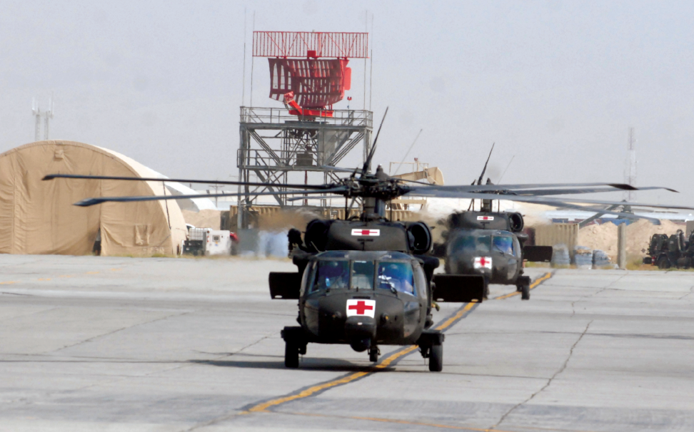
EWS En Route Care Aeromedical Evacuation
Aeromedical evacuation is often how patients move from one role to another
Air evacuation can reduce transport times, but creates unique stresses on the injured patient
MEDEVAC helicopters outside Role 3
Source: Out of the Crucible
2021 v1.1
Notes:
Aeromedical evacuation is a critical component in the continuum of medical care throughout the joint theater of operations. The combination of fixed and rotary wing aircraft is how patients move from one role to another in a timely manner, reducing transport times and improving outcomes. However there are drawbacks from this type of transport to include unique stressors which we will discuss in the following slides.

Slide 11
EWS En Route Care Risks and Benefits
Movement of patients is a medical intervention with associated risks and benefits.
Clinical parameters that suggest normal physiology:
Heart rate < 120 beats/minute
Systolic blood pressure > 90 mmHg
Hematocrit > 24%
Platelet count > 50/mm3
INR < 2.0
pH > 7.3
Base deficit < 5 mEq/L
Temperature > 35 C
2021 v1.1
Notes:
Like medical procedures or administered medications, patient movement through Air evacuation is an intervention that carries its own risks and benefits.
The overall goal of each Role is to establish normal physiology within the parameters and capabilities of that role before moving the patient to higher echelons of care along the continuum.
This slide outlines clinical parameters that suggest normal physiology. It is by no way complete. If these parameters are not met, the medical team should consider holding the patient for further resuscitation if capabilities allow.

Slide 12
EWS En Route Care Risks and Benefits
When any one or more of these criteria are not met, continued care should be rendered at the current facility unless institutional capabilities are exceeded.
Best outcomes occur when physiology is closest to normal.
Resuscitation may be ongoing in route, but should not require dynamic, complex, or life-preserving adjustments en route.
Packing and anticipation of patients needs is important and require careful planning.
Documentation of interventions important.
2021 v1.1
Notes:
Unless the capabilities and resources of the medical facility are exceeded, holding the patient for further resuscitation should be considered as patients do best when their physiology is closest to normal. This does not mean that resuscitation needs to be complete prior to transport, as ongoing treatment can be continued En-route. However life-saving treatments or procedures should be performed at the facility to minimize the potential for unanticipated and emergent interventions En-route. The sending and transporting medical teams should anticipate patient needs and packaging requirements to develop a safe and effective plan prior to movement. Last, but not least, documentation. Documentation is extremely important when moving patients through the military medical continuum. Patients can be moved through multiple facilities, encounter unexpected delays and layovers in austere locations and have numerous care providers during their treatment course. The only way to coordinate efforts between medical staff is thorough exemplary documentation.

Slide 13
EWS En Route Care Requirements
Air transport requires proficient personnel and people familiar with theater standards.
2 levels of capability recognized:
Critical Care Transport: Required when critical illness or injury impairs one or more vital organ system with threat to life during transport.
Intermediate Care: Required if dedicated medical attendant with skills equivalent to a paramedic needed & patient not expected to deteriorate.
2021 v1.1
Notes:
Air transport requires proficient personnel and people familiar with theater standards. There are two levels of recognized capability: Critical Care Transport and Intermediate Care. The decision as to which level of care is required is made following discussion between the flight surgeon and specialty care consultants in theater and in consultation with Role 4 specialists if necessary. The care provided by a Critical Care Air Transport is equivalent to a Role 4 ICU and is required when one or more organ systems are failing and a threat to life during transport is present. These teams augment standard AE crews that generally provide the next level of care, intermediate care. AE crews consist of nurses and technicians that have paramedic level skills. This level is appropriate when the patient’s condition is not expected to deteriorate, however life-saving procedures can be performed and critical care can be administered if emergencies arise. AE crews are not only trained medical professionals but are also experts in configuration and interface with the aircraft that they transport within.

Slide 14
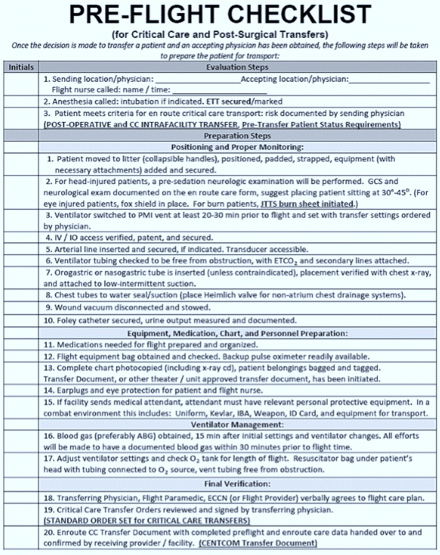
EWS En Route Care Requirements
Transport platforms are also required.
Vehicle selection can directly impact care.
Weight and space restrictions dependent on vehicle used at time.
Expendable supplies (e.g. blood, gauze, oxygen) from transferring location should be used until last possible moment given limitations on vehicles.
Source: Interfacility Transport CPG
2021 v1.1
Notes:
The type of vehicle used to transport the patient is another crucial decision in the patient’s care. There are a multitude of vehicles available capable of transporting injured or ill patients. Each have varied capabilities that must be considered. These include weight and space restrictions, available supplies, oxygen, refrigeration for medications, warmers for blood, etc. If at all possible, expendable supplies should be used last to prevent exceeding limitations on certain vehicles.

Slide 15
EWS En Route Care Considerations
General Considerations Prior to Transport
Physicians should tailor vital sign monitoring, wound care requirements and neurovascular checks to an environment with altitude, restricted mobility and limited staffing.
Patients with significant medical or surgical conditions should have:
Foley catheters and NG Tubes
Provisions for IV medications
Appropriate nutrition setup
Consideration for prophylactic endotracheal tube
Wounds dressed for delayed primary closure
Splints or bivalved casts – avoid circumferential casts
Liberal use of fasciotomies/escharotomies
2021 v1.1
Notes:
Transport physicians have a responsibility to consider how the patient will be monitored and managed in the aerial environment. Space limitations often exist that impact working room and patient packaging. It also impairs patient access once En-route. Patients are packaged on a litter with all monitoring equipment on a bracket device called a SMEAD that located over the pelvis. The SMEAD spans the width of the litter and is a foot or more in length, further impeding access to the patient and limiting potential interventions. Vital signs, wound care and neurovascular checks should be tailored for altitude. This is a list of devices or interventions that should be performed on every patient prior to transport.

Slide 16
EWS En Route Care Decreased Barometric Pressure
General Considerations Prior to Transport
Volume of a gas bubble doubles at 18,000 feet above sea level.
Military plains routinely maintain pressurization between 8,000 to 10,000 feet.
Can fly lower but impacts operations, fuel efficiency, and range.
Considerations can be made for:
Penetrating eye injuries with intraocular air
Free air in body cavity
Severe pulmonary disease
Decompression sickness and arterial gas embolism – destination altitude should not be higher then origin
Fly with 100% oxygen if available.
2021 v1.1
Notes:
One of the more impactful considerations of air transport is how changes in barometric pressure affect the patient. In general, air expands as altitude increases. The volume of a gas bubble doubles at 18,000 feet above sea level. Most military aircraft maintain cabin pressurization between 8,000 and 10,000 feet. They are capable of maintaining lower pressures , roughly 6,000 feet, for patients requiring altitude restriction, but this reduces fuel efficiency and increases flight times. The effects of increased barometric pressure should be considered in penetrating eye injuries with intraocular air, free air in non-drained body cavities like the chest and abdomen, and severe pulmonary disease. Unique issues such as arterial gas embolism and decompression sickness may also arise. It is imperative to have 100% oxygen available, either built into the aircraft or brought with the patient in cylinders. Additional supplemental O2 will likely be needed, especially with ventilated patients, due to the decreased partial pressure of oxygen at altitude leading to lower oxygen saturations.

Slide 17
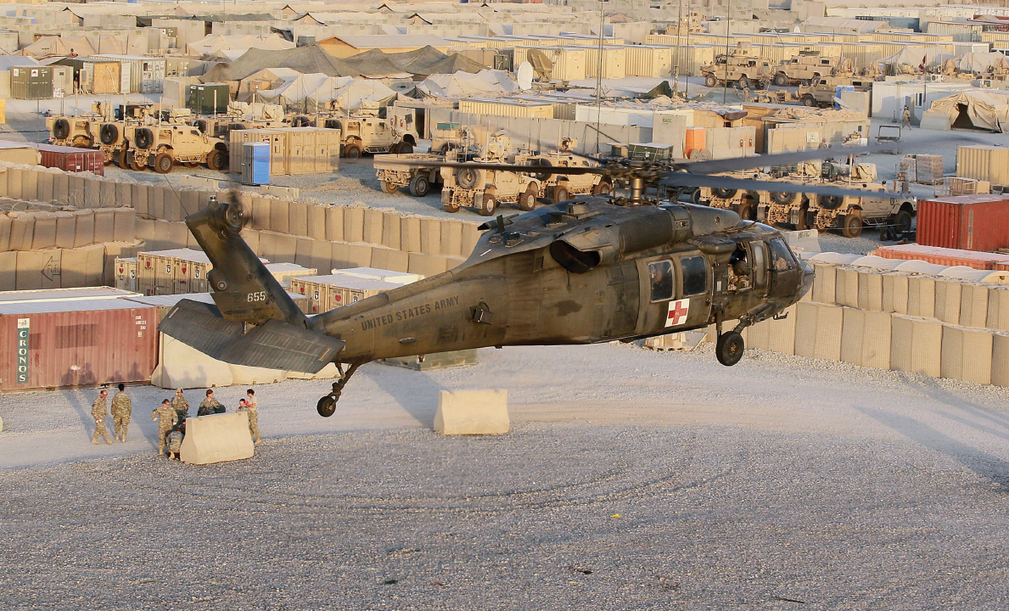
EWS En Route Care Decreased Barometric Pressure
General Considerations Prior to Transport
Other Recommendations:
Pneumothorax – chest tubes in all pneumothoraces
Air Splints – Avoid
Ostomy patients – Vent collection bags
Decreased Partial Pressure Oxygen – At 8,000 feet, room air oxygen saturation 90% at room air. Corrects to 98%-100% with 2 L/min Oxygen
Neurosurgical Patients – hypoxia may worsen neurologic injury; adjust oxygenation
MEDEVAC Helicopter Landing at Role 2. Source: Out of the Crucible
2021 v1.1
Notes:
Because air expands at altitude, all pneumothoraces should be managed with chest tubes prior to transport, as the risk of tension pneumothorax increases without drainage. Air splints should be avoided as overexpansion can lead to pressure-related injuries with prolonged transport. Patients with ostomies should have them vented periodically to avoid overpressure damage to the bags. As previously mentioned, at altitude there is a decrease in the partial pressure of oxygen causing a reciprocal decrease in oxygen saturations. At 8,000 feet patients with normal pulmonary physiology may only maintain an O2 saturation of 90% on room air, but this can easily be corrected to 98-100% with as little as 2L/min of supplemental oxygen. These effects on oxygenation are critical to consider and manage in patients with severe TBIs, in whom even minor and brief episodes of hypoxia lead to worse outcomes.

Slide 18
EWS En Route Care Effects of Flying
Acceleration Stress – Transient increase in intracranial pressure can effect TBI. Adjust patient position can minimize risk.
Head forward on takeoff
Head aft on landing
Thermal Stress – Variability in temperature dependent on environment.
Colder at higher altitudes
Take steps to mitigate hypothermia
Noise – Heavy noise environment. Expect trouble communicating with staff; auscultation is impossible.
Non-invasive blood pressure monitoring and/or arterial line.
Place hearing protection on patient.
Audible alarms are useless.
AE Evacuation on fixed wing asset, note dark conditions with ear protection. Source: Out of the Crucible
2021 v1.1
Notes:
There are a few aircraft-related factors that must be considered during patient transport. First, acceleration stresses imposed by takeoff and landing can increase intracranial pressure in TBI patients so they must be positioned accordingly. Most aircraft, and specifically the C-17, cruise in a position where the front is slightly higher than the aft.
Next, thermal stresses during flight can also be detrimental, especially to combat casualties. In most military aircraft that are designed for cargo transport like the C-17, C-5, and KC class refuelers, there is limited cabin insulation and climate control. Cabins tend to be colder at altitude, especially toward the back of the plane by the cargo bay doors. Steps should be taken to mitigate these effects and avoid hypothermia.
Lastly, noise and vibration can negatively affect both the patient and the care team. The noisy environment limits some components of the physical exam, such as auscultation, and impairs communication among team members and the patient. Staff must rely on visual clues as audible alarms cannot be heard and thus likely missed. It is important to ensure the patient and crew appropriately wear noise protection. Vibrations can have both a physical and psychological effect. Patients can experience increased pain in injured extremities or wounds with turbulence and critical phases of flight, as well as anxiety and fatigue from the constant noise and vibration. Ensure they are briefed on these conditions and treat appropriately prior to takeoff.

Slide 19
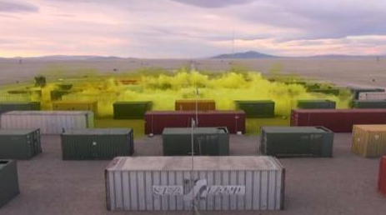
EWS En Route Care Nuclear, Biological, Chemical
Nuclear, Biological, and Chemical (NBC) Environments
Nuclear and chemical casualties must be externally decontaminated. Allow time for off-gassing of residual chemical agents.
Biological casualties varies by nature of agent.
Any AE movement with NBC can be delayed.
Aircraft decontamination
Availability of non-contaminated crew
Cohorting of similarly affected patients
Special approval for highly communicable diseases
Decontamination of patients
Chlorine gas release Photo by US Army – Dugway Proving Ground Public Affairs
2021 v1.1
Notes:
NBC environments are complex air evacuation situations for multiple reasons. Nuclear and chemical causalities require decontamination prior to transport; biological casualties may as well on a disease-specific basis. Logistical challenges such as aircraft decontamination, availability of non-contaminated crews, co-horting together of similarly affected patients, obtainment of special approval for highly communicable diseases, and decontamination of patients can all lead to delays in patient transport, and potentially prolonged management at the current facility. The COVID-19 pandemic exemplified these challenges as specific evacuation teams with designated and equipped aircraft are required to transport large groups of COVID positive patients out of theater. Furthermore, the Negative Pressure Containment (NPC) system used on these aircrafts requires decontamination between transports which can be time consuming.

Slide 20
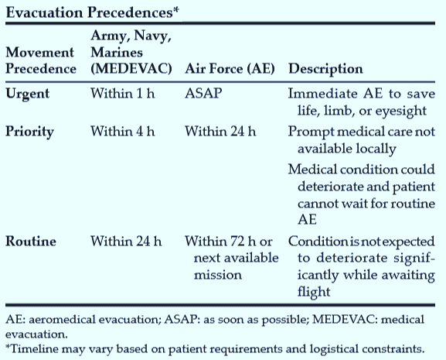
EWS En Route Care MEDEVAC Precedence
Type of evacuation assets used depends on the evacuation environment and the patient status
Aeromedical liaison team and Aeromedical Staging Facilities facilitate movement through AE system
Consult with local flight surgeon to determine en route care plan and timing of evacuation
2021 v1.1
Notes:
The use of aircraft, priority of patient movement ,and utilization of command assets are all considerations made prior to a patient evacuation. These considerations are made between the TACC, the flight surgeon, and aeromedical support systems. Patients are designated as Routine, Priority, and Urgent depending on their condition as well as current theater-related risks.

Slide 21
EWS En Route Care Scenario
A 30 year old infantry officer is injured in a rocket blast He has a posterior knee injury that is actively bleeding as well as penetrating injuries across his abdomen and chest. He is having difficulty breathing.
What type of care would you expect at a Role 1, 2, 3, and 4?
2021 v1.1
Notes:
Lets revisit the scenario presented at the beginning of the lecture. Now that we are familiar with the care provided at the various roles we should be able to answer the question.
At the Role 1 we should expect the patient to have undergone: tourniquet placement to his injured extremity, vascular access and blood transfusion, empiric antibiotic administration, chest tube placement or needle decompression, and airway stabilization if needed.
At the Role 2 we can expect the patient to undergo emergent damage control surgery of his thoracic, abdominal, and vascular injuries with continued resuscitation as needed.
At the Role 3 we can expect the patient to receive definitive vascular repair as well as repeat intervention of his thoracic and abdominal wounds
Finally, at the Role 4, the patient will receive definitive surgical care to include skin grafts and other specialized procedures. Rehabilitation is initiated with transition to specialized outpatient facilities like the Center for the Intrepid (CFI).

Slide 22
EWS En Route Care References
Transport of Patients Between Theater Medical Treatment Facilities
https://jts.amedd.army.mil/assets/docs/cpgs/Prehospital_En_Route_CPGs/Transport_of_Patients_in_Theater_24_Apr_2018_ID27.pdf
The Office of The Surgeon General, Borden Institute. Emergency War Surgery, 5th U.S. Edition, 2018. Chap 2, 4.
https://medcoe.army.mil/
Photos are part of the JTS image library unless otherwise noted.
Other photo source: U.S. Army Medical Department Center and School. Out of the Crucible: How the US Military Transformed Combat Casualty Care in Iraq and Afghanistan, 2017. Borden Institute.
2021 v1.1
Notes:
This concludes the lecture on En-Route care. Please refer to these resources should you require additional information on the topic.

