Slide 1
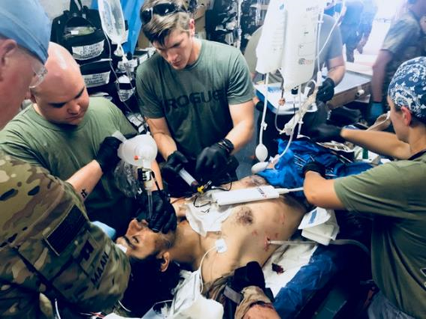
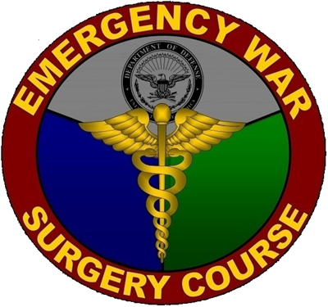
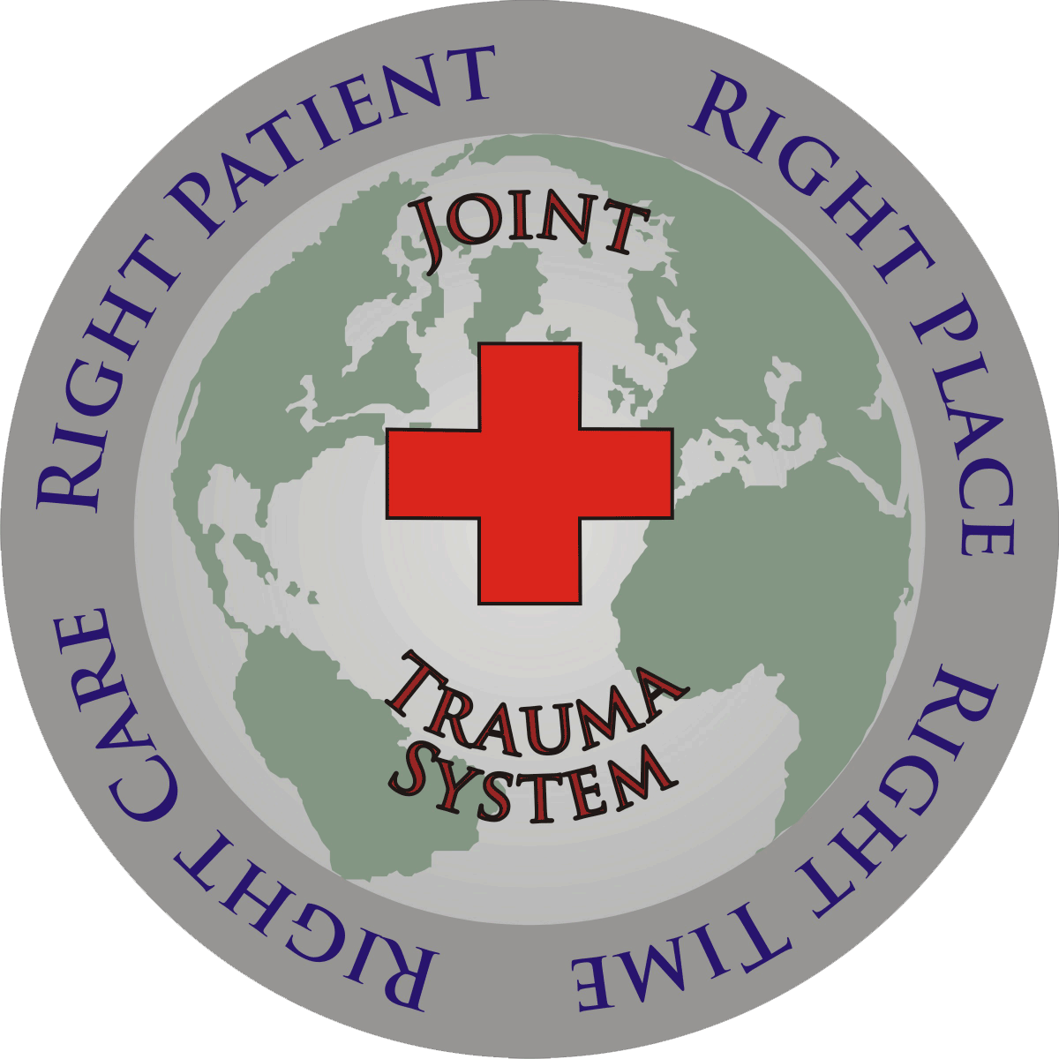

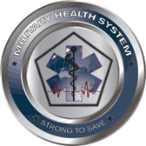




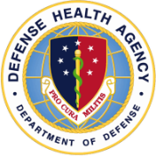


Joint Trauma System
DAMAGE CONTROL CONCEPTS & PRINCIPLES
Joint Trauma System Battlefield Trauma Educational Program

Slide 2
EWS Damage Control
Scenario
A 24-year-old service member presents with a single GSW to the abdomen with no other visible injuries. His airway is patent, and he initially has a palpable pulse with a heartrate of 140 and blood pressure of 70/40.
He is confused/agitated. Within moments, he becomes bradycardic and pulseless.
How will you proceed?
Notes:
This scenario presents a patient who has sustained a gunshot wound to his abdomen, arrives in traumatic shock, and then arrests. What is the best way to proceed to give this person a maximal chance at survival?

Slide 3
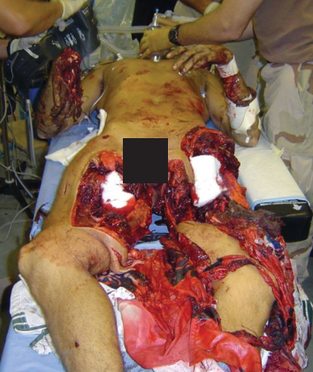
EWS Damage Control
Objectives
  Damage Control Resuscitation (DCR)
  and Damage Control Surgery (DCS)
  Risk Factors and Indications for Damage Control
  Resuscitative Agents
  Resuscitative Procedures
Severe polytrauma patient, War Surgery in Afghanistan and Iraq--Borden Institute
Notes:
Damage control is broken into two main components: damage control resuscitation and damage control surgery. We will go through the indications for performing damage control resuscitation and surgery as well as how to execute those strategies.

Slide 4
EWS Damage Control
Background
Hemorrhage is the leading cause of preventable death on the battlefield. It typically occurs in the first 24 hours.
Damage Control Resuscitation (DCR) works in synergy and in parallel with the concepts of Damage Control Surgery (DCS).
DCR/DCS Benefits
  Proven successful in combat (and civilian) casualty care.
  This saves lives.
Notes:
As discussed in the War Wounds lecture, hemorrhage is the leading cause of death on the battlefield. Hemorrhage causes several physiologic changes that propagate further hemorrhage. Breaking that cycle is key to survival. Damage control resuscitation and surgery are two synergistic strategies utilized to improve survival. Although scenarios may occur where one could perform only damage control resuscitation due to the paucity of surgical assets, in general a provider does not do one strategy without doing the other.

Slide 5
EWS Damage Control
Damage Control Principles (1)
Minimize blood loss with early hemorrhage control measures.
Target low-normal blood pressures (SBP≈100 mmHg)
during resuscitation efforts.
Avoid delays in surgical or angiographic hemostasis.
Abbreviated initial operation (rapidly control bleeding,
limit contamination).
Avoid/reverse hypothermia.
Prevent acidosis.
Notes:
The next two slides will cover some of the key damage control principles. First and foremost, the sooner one stops hemorrhage and the lethal triad of hypothermia, acidosis, and coagulopathy, the better chance a severely injured patient will have at survival. If a patient is actively dying, focus only on procedures that are immediately life-saving procedures. Don’t do unnecessary “stuff”, such as non-emergent diagnostic studies or reconstructive procedures. Wait until the patient has stabilized for non-emergent activities.

Slide 6
EWS Damage Control
Damage Control Principles (2)
Minimize crystalloid administration.
Use massive transfusion protocol in a pre-specified, balanced ratio that optimizes hemostasis (whole blood functionality).
Obtain functional laboratory measures of coagulation
(e.g., TEG or ROTEM) to guide resuscitation and correct coagulopathy.
Give pharmacologic adjuncts to safely promote hemostasis.
Expeditious delivery to definitive surgical control with planned reoperation.
Notes:
Avoid overresuscitating patients; raising their systolic blood pressure significantly above 100 mmHg can dislodge clots. Large volume crystalloid resuscitations can lead to dilutational coagulopathy and even metabolic acidosis. Resuscitate with balanced blood products, ideally low titer O whole blood or fresh whole blood. If those aren’t available, proceed with 1:1:1 ratios as best able. Obtain clotting studies and adjust resuscitations to address specific deficiencies. Give adjunct factors like transexamic acid to promote hemostasis.

Slide 7
EWS Damage Control
DCR/Massive Transfusion (MT)
Recognition of Patients Requiring DCR/MT
Expected or given ≥10 units PRBCs
in the initial 24 hours post injury
  Identify early!
  Obtain hemostasis at earliest
  level of care possible.
  Improved survival if you can
  prevent or mitigate shock
  and coagulopathy.
If 3 of 4 features below:
70% predicted risk for MT
If 4 of 4 features below:
85% predicted risk for MT
SBP < 110 mm Hg
HR > 105 bpm
Hct < 32%
pH < 7.25
Notes:
Certain clinical findings are suggestive of a massive hemorrhage and need for mass transfusion. Examples include hypotension below a systolic blood pressure of 110, a heart rate of greater than 105, an admission hematocrit of <32, especially in the young and healthy, and an admission acidosis of <7.25. The more findings a patient has, the higher the risk. Ultimately, the earlier you stop bleeding and achieve hemostasis, the higher the chance a patient will have at survival.

Slide 8
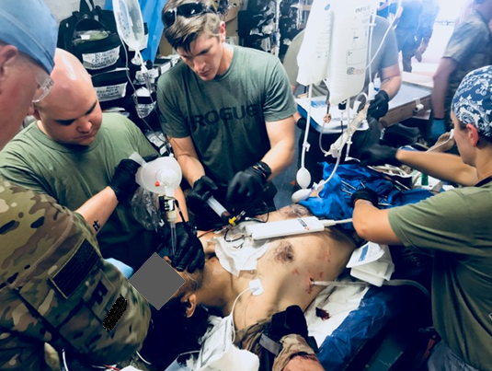
EWS Damage Control
Risk Factors
Risk Factors Associated with MT / Aggressive Resuscitation
Clinically obvious penetrating injury to chest or abdomen
Above-the-knee traumatic amputation with pelvic injury
Multi-limb traumatic amputations
>2 regions positive on FAST scan
Lactic Acid (admission): > 2.5
INR (admission): ≥ 1.2-1.4
Base Deficit: < -6 mmol/L
Damage control resuscitation in progress
Notes:
Additional findings suggesting a patient is at risk for massive hemorrhage is penetrating torso trauma, multi-limb traumatic amputations, above knee traumatic amputations with associated pelvic injuries, multiple areas positive on a FAST exam, and pre-existing lactic acidosis, coagulopathy, or volume deficit.

Slide 9
EWS Damage Control
Indications
Other Indications to Perform/Recognize Need for DC
Difficult to Control Hemorrhage/Injury Pattern Recognition
  Complex liver injuries
  Retroperitoneal/pelvic injuries
  Mediastinum, neck injuries
  Uncontrolled truncal/junctional bleeding
  Trajectory across the midline or multi-cavity injuries
  Uncontrolled major bleeding from: large soft tissue injuries, proximal/bilateral/multiple traumatic amputations
  Mangled extremity
  Clinical signs of coagulopathy (paucity of clots; presence of petechial bleeding)
  Complex vascular injuries
  Severe hypothermia
Suboptimal environments (limited resources)/inexperienced surgeon
Notes:
Specific injuries and injury patterns can also pre-dispose to massive hemorrhage, simply because they are difficult to control. This can be exacerbated by severe injuries to multiple parts of the body and having to provide care in an austere, resource limited environment.

Slide 10
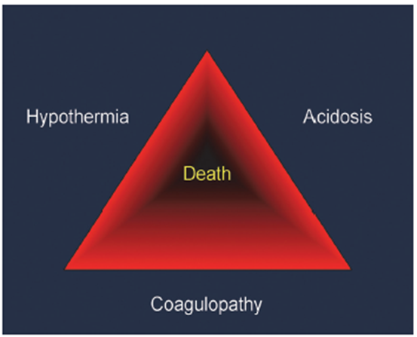
EWS Damage Control
Damage Control Principles (3)
For Maximum Benefits
Damage Control should be considered early, before the patient reaches extremis—before the Triad of Death!
Often the decision is made before the operation even begins.
Triad of Death
Crucible – Borden Institute
Notes:
To provide the maximum benefit, the decision to perform damage control resuscitation and surgery should be made early. Once the patient enters the lethal triad, it can be extremely difficult to break the cycle.

Slide 11
EWS Damage Control
Damage Control Principles (4)
Abbreviated Operation May Go Against Your Initial Instinct
Efficient; goal < 1 hr in OR. Simple solutions are usually the best solutions.
Rapid hemorrhage control of non-compressible and major vascular injury sites.
Ligate or temporarily shunt, rather than repair, some major vascular injuries.
REMOVE, rather than repair, some organs that are injured.
Leave the bowel in discontinuity. No anastomoses, no ostomy maturations.
Pack, Pack, Pack oozing spaces and organs (e.g., pleural/abdominal cavity, liver spleen, retroperitoneum).
Leave cavities open with temporary closure/coverage techniques.
Notes:
The remainder of the lecture focuses on damage control strategies and principles. Some of the over-arching surgical principles are covered here. First, be quick and get to the point. Focus on stopping the source of hemorrhage. Don’t do complex repairs. Ligate or shunt injured vessels. Remove injured organs that can be removed, like the spleen and kidneys, and pack those that cannot, like the liver and retroperitoneal surfaces. Control contamination by removing injured bowel and leaving it in discontinuity. Temporarily close cavities and get out of the OR to rewarm and resuscitate the patient. Once the patient’s bleeding has been stopped and physiology has been restored, more definitive procedures can be performed.

Slide 12
EWS Damage Control
Damage Control Principles (5)
Optimization of Fluids (Point of Injury, En Route, Remote DCR)
Blood products are preferred for hemorrhagic shock.
  Crystalloid or colloid should be used sparingly,
  if at all, in the pre-hospital setting. They worsen
  acidosis and coagulopathy, increase tissue
  edema, increase risk for MODS/MOF.
Prolonged evacuation/absence of blood
  Crystalloid/non-blood colloid may be needed
  for casualties at risk of imminent death,
  but should be balanced against the risk
  of worsening coagulopathy, contributing to
  further blood loss. Consider albumin with
  fibrinogen concentrate or TXA. Last Resort.
Order of Priority
for Fluid Administration:
Whole blood (Group O Low Titer preferred; type specific whole blood may be available in rare instances)
Balanced transfusion = RBCs plus plasma plus platelets = 1:1:1 ratio
Walking Blood Banks
(as necessary)
RBCs plus plasma = 1:1 ratio
Plasma with or without RBCs
RBCs alone
Notes:
Resuscitation should be performed with blood products, not crystalloids. Crystalloids have neither oxygen carrying capacity nor clotting factors. In fact, they can dilute one’s clotting factors and create a metabolic acidosis, worsening bleeding rather than ameliorate it. The order of priority for transfusion is somewhat dependent on one’s location, whether it is pre-hospital or in a role 1 facility without blood storage facilities or at a role 2 or 3 facility with blood storage capabilities. Either way, the focus should be on giving a balanced resuscitation that provides both oxygen carrying capacity and clotting factors. The best way to do this is with whole blood. In the prehospital and role 1 setting, the best blood product to use is Low-titer O whole blood. This blood is screened for infectious diseases and low anti-A and anti-B antibodies and is FDA approved. If this is unavailable, a walking blood bank would be the next best choice.
In the role 2 and 3 setting, we lean towards using pre-screened, FDA approved products first. This will be low-titer O whole blood or type specific whole blood, if available. Next, a balanced resuscitation with packed red blood cells, plasma, and platelets deliver in a 1:1:1 ratio. Before delivering unbalanced resuscitation, role 2 and 3 providers should consider activating a walking blood bank for those requiring a mass transfusion. Should that not be available, or that resource exhausted, unbalanced ratios as listed should be administered.

Slide 13
EWS Damage Control
Damage Control Principles (6)
Why Blood and not Crystalloid/Colloid? It improves mortality.
Blood Products (Components) for DCR
  “Treatment of hemorrhagic shock should involve the replacement of shed blood, with products that functionally resemble what has been lost.”
  A high ratio of Plasma:RBC and Platelet:RBC should be administered.
  1:1:1 Ratio (6 units plasma, 1 unit [6 pack] apheresis platelet, 6 units PRBCs) per Massive Transfusion Pack/Cooler.
Notes:
As previously discussed, crystalloid restores volume but doesn’t deliver oxygen carrying capacity or clotting factors whereas whole blood performs all three functions. Whole blood doesn’t exacerbate coagulopathies or acidosis either. In the absence of whole blood, a balanced resuscitation is preferred.

Slide 14
EWS Damage Control
Damage Control Principles (7)
Why Blood and not Crystalloid/Colloid? It improves mortality.
Give Platelets and Plasma early!
  Lead with the transfusion of hemostatic plasma/platelets EARLY and catch up with RBCs; this is a safe guiding principle.
Initiate massive transfusion protocols if patient has received or is expected to receive 4u PRBC/4u FFP.
100%
50%
0%
Percent (%) Death
Balanced Intermediate Traditional
Notes:
The addition of plasma and platelets to packed red blood cells replaces the clotting factors the body is rapidly using to control hemorrhage. They restore hemostasis and reduce mortality.

Slide 15
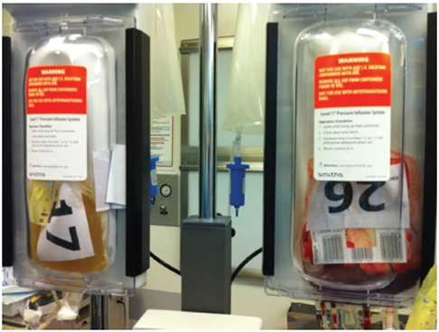
EWS Damage Control
Damage Control Principles (8)
1:1:1 Ratio of Blood Components
Does not faithfully reconstitute whole blood
(does NOT replace what is lost).
Yields a diluted blood mixture:
  Hematocrit 29%
  Platelet count ~90,000/μL
  Coagulation factors diluted to
  ~62% of whole blood concentrations
Requires multiple products with
multiple storage modalities:
Increased workload and complexity for a clinical team.
Crucible – Borden Institute
Notes:
Whole blood is preferred over a balanced resuscitation for multiple reasons. Separated blood products have more dilute components than native blood. For example, the hematocrit of packed red blood cells is usually around 29%, the platelet count of an apheresis pack of platelets is roughly 90,000, and fresh frozen plasma has approximately 62% of the clotting factors of native blood. Fresh whole blood should have normal levels of all components. Low titer O whole blood, which needs to be refrigerated and preserved, is slightly diluted but better than component therapy.
Additionally, it is logistically easier to stock and provide one type of blood, low titer O whole blood, than it is to provide multiple components, which may have various shelf times and expiration dates.

Slide 16
EWS Damage Control
Whole Blood Transfusion
Whole Blood
  Delivers all the components of blood in the correct ratio (replaces what has been lost).
  Independently associated with IMPROVED survival.
Fresh Whole Blood [FWB] = “Walking Blood Bank”
  Emergency, onsite collection
  Can be stored at room temperature for 24 hrs. Can be refrigerated within eight hours of collection.
  ABO group-specific/matched with the recipient
  (A-A, B-B, AB-AB, O-O).
  Or Low Titer O WB (LTOWB): low anti-A and anti-B titer
  (<1:256, tube method) O blood.
Notes:
As previously stated, whole blood has components that are much closer to native levels. Additionally, they are in the correct proportions.
Fresh whole blood is collected via a walking blood bank from pre-screened donors. It can either be from O donors who have be pre-screened as having low anti-A and anti-B antibody levels, or from type specific donors.

Slide 17
EWS Damage Control
Whole Blood Transfusion
Cold-Stored WB (SWB)
  Mostly LTOWB
  If stored >3 weeks, has reduced hemostatic function.
  May require additional support with Platelets or FWB. Consider 3:1 CWB:FWB transfusion (if available).
Notes:
Low-titer O-whole blood comprises the majority of cold-stored whole blood, although units may occasionally get type specific O-whole blood. Whole blood stored in CPDA-1 is good for 35 days and blood stored in CPD is good for 21 days, both of which the Armed Services Blood Program uses. If a unit receives low-titer O-whole blood preserved in CPDA-1, it starts to lose its function after 21 days. If using older blood, one may need to adjunct it with fresh whole blood or component therapy, if available.

Slide 18
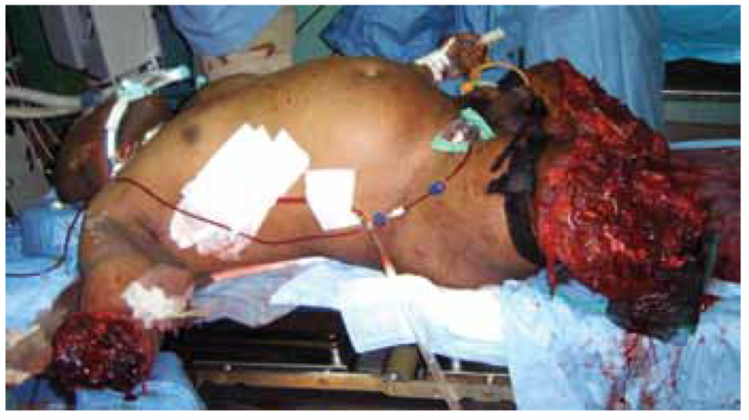
EWS Damage Control
Adjunct Hemostatic Agents (1)
  Control of life-threatening hemorrhage following extremity injury has been greatly improved through the field application of the extremity tourniquet.
Image courtesy of Joint Combat Trauma Management Course, 2007.
Notes:
The next portion of the lecture will transition into additional adjuncts that can be given to control massive hemorrhage, the first and foremost of which is a tourniquet.

Slide 19
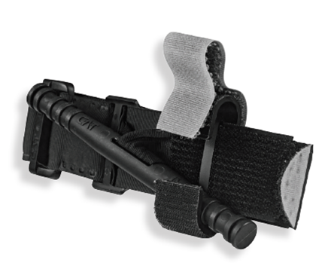
EWS Damage Control
Adjunct Hemostatic Agents (2)
Mechanical Hemorrhage Control
Effective Tourniquets
  Examples: Combat Application Tourniquet (CAT), Special Operations Forces Tactical Tourniquet (SOFTT)
  May be responsible for saving more wounded service members in Iraq and Afghanistan than any other single medical intervention.
CAT: Crucible – Borden Institute
Notes:
The implementation of tourniquet use in Iraq and Afghanistan has been the most significant improvement in care of combat casualties during those two decades of conflict.

Slide 20
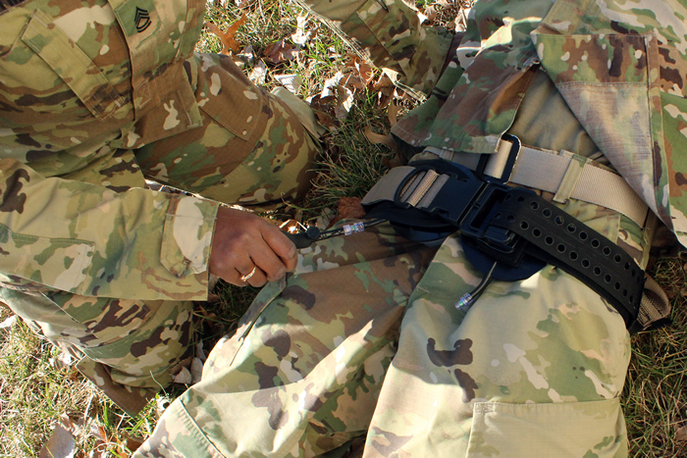
EWS Damage Control
Adjunct Hemostatic Agents (3)
Mechanical Hemorrhage Control
  Junctional Tourniquets
  Ex: SAM® Junctional Tourniquet, Combat Ready Clamp, JETT, XSTAT™
  Axillary, neck, groin hemorrhage (previously a near intractable problem)
  SAM® Junctional Tourniquet: Used for high amputations and penetrating wounds. Also serves as a pelvic binder for blast injuries.
SAM Junctional Tourniquet
Source: MRMC on army.mil
Notes:
A junctional tourniquet is a variant of a normal tourniquet. It is used to control bleeding in the groin and axilla. The term junction refers to the fact that the groin and axilla are the junction between the torso and the limbs. The SAM Junctional Tourniquet also functions as a pelvic binder, which can be useful for blast injuries that cause high amputations and pelvic fractures.

Slide 21
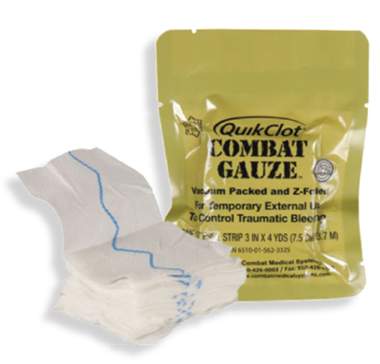
EWS Damage Control
Adjunct Hemostatic Agents (4)
Mechanical Hemorrhage Control
  Hemostatic Dressings
  Ex: Combat Gauze (a.k.a. QuikClot),
  Celox Gauze
  Superficial wounds / deep wound packing
QuikClot Dressing
Crucible – Borden Institute
Notes:
Additional adjuncts like Combat Gauze and Celox are available to help achieve hemostasis. They have active ingredients to promote clotting. For Combat Gauze, that is a substance called kaolin; whereas in Celox, it is a derivative of chitin called chitosan. In the pre-hospital setting, these are usually used to pack wounds. They can also help with raw surface bleeding from amputations, the retroperitoneum, and solid organ bleeding. Most, if not all, are now radiolabeled to ensure they can be identified on plain films.

Slide 22
EWS Damage Control
Adjunct Hemostatic Agents (5)
Pharmacological Adjuncts
  Tranexamic Acid (TXA)
  Shown to reduce mortality in trauma, likely due to reduction in fibrinolysis.
  Should be given < 3 hours after injury. (If given > 3 hours after injury, mortality is higher.)
  Give empirically to those recognized at risk for DCR.
1 gram of IV TXA administered in 100 ml of normal saline over 10 minutes followed by another 1 gram of IV TXA over 8 hours.
Notes:
Transexamic acid (TXA) is probably the most well-known adjunct. TXA inhibits the conversion of plasminogen into plasmin, thereby slowing the breakdown of fibrin and the dissolution of clots. Its effectiveness in trauma has been shown to be when given within 3 hours of injury. There is a mortality risk if given after three hours. The most readily accepted administration regimen is given 1 gm immediately, followed by another gram over 8 hours. However, the Committee on Tactical Combat Casualty Care is now recommending 2 gm TXA be given up front. Therefore, check with the medic delivering the patient as that they may have already received 2 gm and should not receive additional doses.

Slide 23
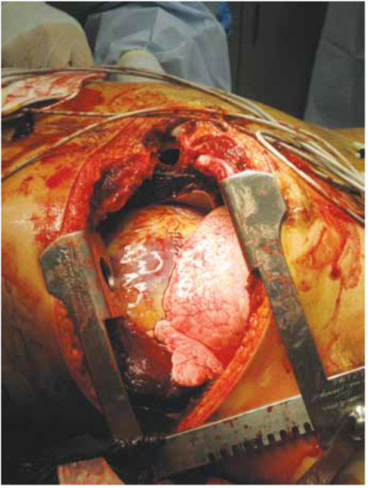
EWS Damage Control
Emergency Resuscitative Thoracotomy (ERT)
Purpose
  Control of intrathoracic hemorrhage
  Release of cardiac tamponade
  Internal cardiac massage
  Aortic occlusion to control infra-diaphragmatic hemorrhage and maximize cerebral and coronary perfusion
  Typically performed at Role 2 or higher (surgical capabilities)
Courtesy of U.S. Army &
J. Christian Fox, MD,
University of California, Irvine
Notes:
We’ll now transition into surgical procedures used for damage control. The emergency resuscitative thoracotomy, or left anterolateral thoracotomy, is probably the most well-known. It facilitates multiple emergent issues. Cardiac tamponade can be released by opening the pericardium, allowing the heart to fill which then improves cardiac output. The aorta can be occluded by cross clamping to allow the heart to preferentially perfuse the coronary and carotid vessels. This allows for the heart and brain to be perfused while the patient is resuscitated and bleeding distal to the aortic occlusion is addressed. Finally, internal cardiac massage may be performed while a person is resuscitated. If the heart is full, it is unlikely that cardiac massage and intracardiac epinephrine will be effective.

Slide 24
EWS Damage Control
ERT (2)
Absolute indications for ERT in the combat/operational environment:
Penetrating truncal/extremity trauma with recent loss of vitals (less than 15 minutes) or impending cardiac arrest.
Blunt truncal/extremity trauma with pre-hospital vital signs and either witnessed arrest after arrival or refractory shock with impending cardiac arrest.
Notes:
Absolute indications for an emergency resuscitative thoracotomy are a patient who sustained penetrating torso or extremity trauma and lost vitals within 15 min of arrival to the Role II or III facility, and those with blunt truncal and extremity trauma who arrest after arrival.

Slide 25
EWS Damage Control
ERT (3)
Relative indications for ERT in the combat/operational environment:
Penetrating truncal/extremity trauma with pre-hospital arrest but with signs of life on arrival (narrow complex EKG rhythm and/or organized cardiac contractile activity on ultrasound).
Potentially salvageable blunt or penetrating cranial injury with vital signs and then arrest after arrival or impending arrest (uncommon).
Notes:
Relative indications for an emergency resuscitative thoracotomy are a patient who sustained penetrating torso trauma greater than 15 min prior to arrival to the Role II or III facility, but still have signs of cardiac activity on telemetry or ultrasound. Emergency resuscitative thoracotomies have very limited utility in brain injuries.

Slide 26
EWS Damage Control
ERT (4)
ERT Warnings
ERT should not be performed for blunt trauma with arrest before arrival and with no signs of life (absent organized narrow complex EKG rhythm and/or organized contractile activity on cardiac ultrasound).
ERT should not be performed during multiple or mass casualty (MASCAL) events or when performance will expend critical resources (such as blood products/surgeons/ORs) needed for more salvageable patients.
Notes:
Emergency resuscitative thoracotomies are not cure-alls. For those with blunt trauma and no signs of life upon arrival, emergency resuscitative thoracotomy will not salvage the patient; the patient is dead. Additionally, in mass casualty situations, performing an emergency resuscitative thoracotomy in a patient may utilize time and resources better directed at procedures on patients with higher chances of survival.

Slide 27
EWS Damage Control
ERT Diagram
Notes:
This algorithm can help guide decision making and is from the emergency resuscitative thoracotomy CPG. This CPG also has more detailed information on the procedure.

Slide 28
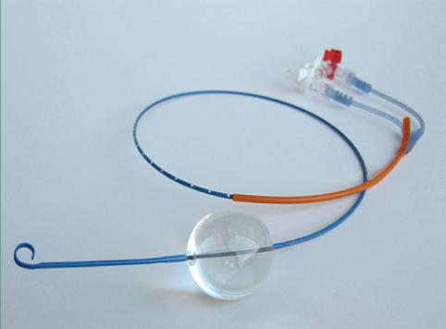
EWS Damage Control
REBOA (1)
REBOA for Hemorrhagic Shock
This maneuver affords distal hemorrhage control while increasing cardiac afterload and central aortic pressure until direct hemostasis can be achieved.
REBOA is not a comparable intervention to ERT but rather may be utilized to prevent hemodynamic collapse in non-agonal unstable patients.
This approach is best when the site of hemorrhage is below the diaphragm and no open thoracic intervention is needed.
Courtesy of COL (Ret) Matthew Martin and COL (Ret) John Holcomb
Notes:
REBOA, or Resuscitative Endovascular Balloon Occlusion of the Aorta, is a less invasive way of occluding the aorta while bleeding is controlled. Just like occlusion of the aorta with a DeBakey clamp in an emergency resuscitative thoracotomy, a REBOA blocks blood flow to the lower body, allowing for preferential perfusion of the heart and brain while the patient is resuscitated and bleeding is controlled. Unlike emergency resuscitative thoracotomy, REBOA does not allow for release of cardiac tamponade, repair of intra-thoracic trauma, or open cardiac message.

Slide 29
EWS Damage Control
REBOA (2)
REBOA for Hemorrhagic Shock
Can be used as an option to temporarily control
life-threatening hemorrhage in the setting of:
  Abdominal Injury
  Pelvic Injury
  Junctional Lower Extremity Injury
Followed by definitive surgical hemostasis.
The implementation of this technique must be determined at each site based on training, experience, local resources, and evacuation timelines.
Notes:
REBOA allows for temporary control of abdominal or pelvic bleeding. Bleeding in the lower extremities can usually be controlled with a tourniquet. Again, it is a temporary measure. The bleeding vessels or organs need to either be ligated, shunted, repaired, or removed. While the REBOA catheter is up, the distal tissue is becoming ischemic. Release of the balloon will result in ischemic reperfusion injury. The longer the occlusion time, the greater the ischemic-reperfusion injury.

Slide 30
EWS Damage Control
REBOA (3)
REBOA for Hemorrhagic Shock
Abdominal, Pelvic, Junctional Lower Extremity Injury/Hemorrhage
Such patients are identified by:
  Penetrating mechanism of injury to abdomen or pelvis.
  Blast or blunt mechanism with positive FAST or suspected pelvic fracture.
  Massive proximal lower extremity trauma with signs of impending cardiovascular collapse.
Contraindicated: thoracic exsanguinating hemorrhage
Notes:
Again, REBOA is best used for hemorrhagic shock from either abdominal or pelvic sources. It can be used for either penetrating or blunt trauma. Ideally, it is placed when the patient is in shock, but not after cardiac arrest. Should the patient arrest, emergency department thoracotomy allows for open cardiac message in addition to aortic occlusion. Furthermore, REBOA should not be used for hemorrhage from thoracic trauma. If the balloon is below the level of the injury, the REBOA catheter can exacerbate bleeding. Additionally, one will need to access the chest to control whatever the source of bleeding is.

Slide 31
EWS Damage Control
REBOA (4)
Notes:
This diagram comes from the REBOA CPG and shows the indications and placement zones for the REBOA balloon.

Slide 32
EWS Damage Control
Shock & Cardiac Arrest
Traumatic Hemorrhagic Shock or Traumatic Cardiac Arrest
Initial focus:
  Mechanism and pattern of injury
  Presence of a pulse
  Duration of cardiac arrest
  Presence or absence of an organized, narrow, complex cardiac rhythm and/or organized cardiac activity by ultrasound
  Resources available
  Number of concurrent casualties
Consideration of these factors can assist in determining the best resuscitative strategy, or making the decision to terminate efforts in a moribund patient.
Notes:
The decision to perform damage control procedures is a combination of the injury mechanism, the injury pattern, the patient’s condition upon arrival, available resources, and number of casualties.

Slide 33
EWS Damage Control
Surgery
When to Perform Damage Control Surgery
  Multiple life-threatening injuries
  Acidosis (pH<7.25)
  Hypothermia
  Shock on presentation
  Combined hollow viscus and vascular or vascularized organ injury
  Coagulopathy
  Mass casualty situation
Goal: To restore normal physiology rather than normal anatomy!
Notes:
This slide provides some general guidelines regarding when damage control surgery is beneficial. Patient with multiple life-threatening injuries or complex injuries benefit from damage control. Those presenting in the “terrible triad” of hypothermia, coagulopathy, and acidosis benefit. In mass casualty situations, damage control procedures on patients with less complex injuries may allow providers to treat more patients quicker.

Slide 34
EWS Damage Control
Surgery General Points
Exploration to Determine Extent of Injury
  Laparotomies, thoracotomies, neck exploration, exploration of extremity vessels
Control Hemorrhage
  Ligation and shunting of injured vessels; simple, fast repairs okay – e.g. running repair of simple linear vessel lacerations
        Think fasciotomies
  Shunts for major vessels recommended for patients in extremis
  External fixation of extremity or pelvic fractures
Notes:
The next several slides cover surgical principles of damage control. First, make big incisions to identify and control what is bleeding. Second, focus on stopping hemorrhage. Shunt major vessels. Ligate those vessels amenable to ligation. Control bleeding associated with fractures using external fixators, which can generally be placed quickly.

Slide 35
EWS Damage Control
Surgery General Points
Control Contamination
  Primary repair or resection without anastomosis of hollow viscus injuries or ostomy formation
Temporary Packing
  Packing provides tamponade of liver, pelvic,
  and retroperitoneal bleeding
  Once bleeding controlled, leave packs alone
  – do not “pack-and-peak”
Temporary Abdominal Closure
Critical Care
Planned Reoperation
Notes:
Control contamination in the abdomen by resecting or primarily repairing bowel injuries. Save anastomoses for subsequent surgeries. Temporary packing can help control solid organ and raw surface area bleeding, particularly in the liver, pelvis, retroperitoneum, and chest. The spleen should generally be removed. Injured kidneys may also require removal.
Once bleeding is controlled, leave the abdomen open. Place a temporary closure like a wound vac or Bogota bag.
Return to the ICU when bleeding is controlled to rewarm and resuscitate the patient. Once the patient is rewarmed, resuscitated, and no longer coagulopathic, return to the OR for definitive repair of the injuries.

Slide 36
EWS Damage Control
Abdominal Wall Closure
Temporary Abdominal Wall Closure/Coverage
Following Damage Control Surgery: abdominal fascia/skin should not be closed because of the high risk for intra-abdominal hypertension or abdominal compartment syndrome.
Temporary abdominal wall closure should be performed.
Ideal Method
  Prevents evisceration.
  Actively removes infected or toxin-loaded fluid from the peritoneal cavity.
  Minimizes the formation of enteroatmospheric fistulas.
  Preserves the fascial integrity.
  Minimizes the abdominal wall retraction.
  Facilitates reoperation.
  Helps achieve early definitive closure.
Notes:
Returning to the concept of “temporary abdominal closure”, there are multiple reasons for doing so in damage control surgery. Temporary abdominal closure eliminates the time consuming process of closing the abdominal fascia. It allows for easy re-exploration and minimizes the chance of abdominal compartment syndrome from occurring when the patient is resuscitated.
An ideal method protects the bowel from desiccation or injury, removes fluid, and minimizes the chance of enteroatmospheric fistula formation and abdominal wall retraction.

Slide 37
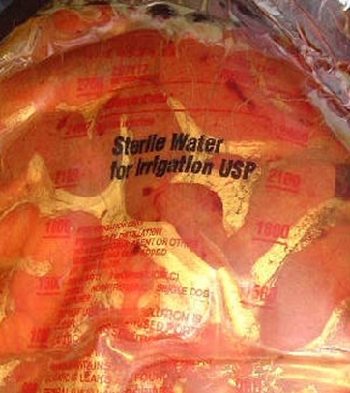
EWS Damage Control
Relaparotomy
Planning for Relaparotomy: “Bogota Bag”
Can be easily constructed.
3-liter sterile irrigation bag or sterile X-ray
cassette cover.
Stapled or sutured to the fascia or to the skin.
Prevents evisceration and prevents/treats IAH/ACS.
Does NOT allow effective removal of any contaminated or toxin/cytokine rich intra-peritoneal fluid.
Does NOT prevent the loss of abdominal wall domain.
Notes:
An easily constructed temporary abdominal closure is a “Bogota bag.” A “Bogota bag” is created by placing a sterile plastic sheet, such as an IV bag or X-ray cassette cover over the viscera, and making small holes in it with a knife to promote fluid evacuation. The plastic sheet is tucked under the edges of fascia. It is then covered with blue towels, NG tubes, and occlusive tape like Ioban. The NG tubes are then hooked to low continuous wall suction.

Slide 38
EWS Damage Control
Abdominal Closure
ABThera (KCI)
Relatively new, negative-pressure device
First Layer: Visceral protection layer (polyurethane foam
with six radiating foam extensions enveloped in a polyethylene sheet with small fenestrations).
  Placed directly over bowel and tucked under
  the peritoneum into paracolic gutters/pelvis.
  Can be trimmed (but only divide the foam squared
  in the middle, and residual foam should be pulled out).
Notes:
Depending on your location and the resources available, you may have access to an ABThera Wound Vac by KCI. The first layer is a sterile, fenestrated plastic bag which can be cut to the size of the patient’s abdomen. Again, the plastic is placed over the viscera with the edges tucked underneath the fascia.

Slide 39
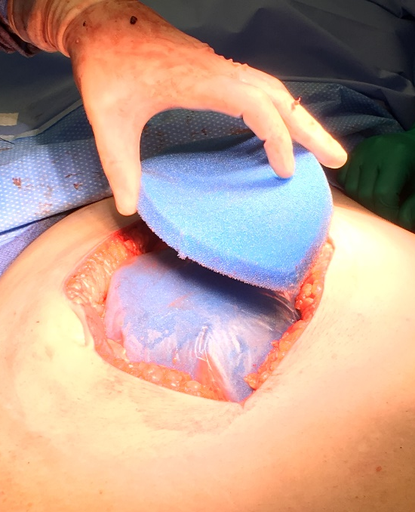
EWS Damage Control
Abdominal Closure
ABThera (KCI)
Second Layer: fenestrated foam placed over the protection layer, cut to size between fascial edges
Cover with semi-occlusive adhesive drape and application of negative pressure suction pad.
More even distribution and sustained negative pressure than the Barker Vacuum Pack.
Temporary abdominal closure with ABThera
Notes:
The second layer is a foam sponge, cut to the size of the abdominal wound. This is then covered with occlusive tape. A hole is cut in the tape, where a tract pad is placed. This pad has tubing that can be connected to a portable vacuum device. This device is set to a low continuous suction and evacuates abdominal fluid.

Slide 40
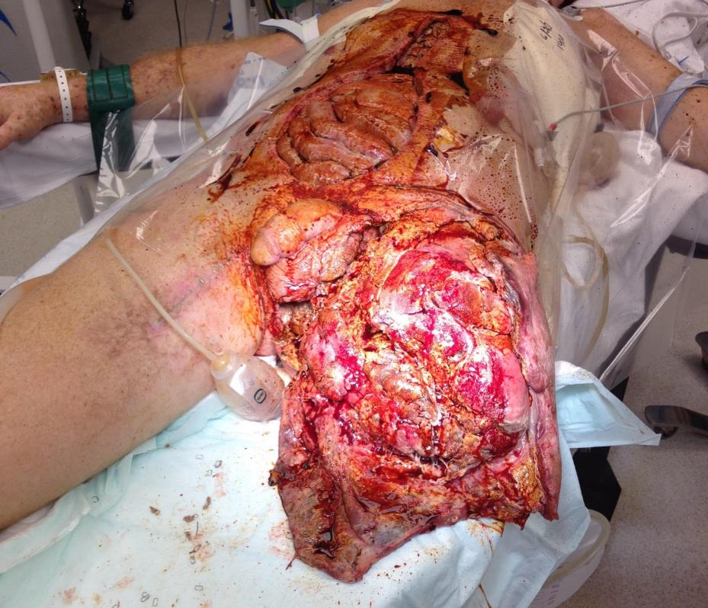
EWS Damage Control
Reoperation
Reoperation after Damage Control
Schedule when probability of achieving definitive repair and fascial closure is highest.
  Reversal/Major Improvement in hypotension, acidosis, hypothermia, and coagulopathy. Reduction in bowel edema (patient may even require diuresis).
  Typically 24-48 hours after initial operation.
Courtesy of Bracken Armstrong, MD, USAF, MC
Notes:
In general, one should not re-operate until the patient is warm, resuscitated, and without significant coagulopathy. That being said, recurrent bleeding and hemorrhage in the ICU require immediate reoperation. In general, re-operation occurs 24-48 hours after the initial operation. Waiting longer can result in missed injuries and make definitive repairs more difficult to do as the body starts to form adhesions.

Slide 41
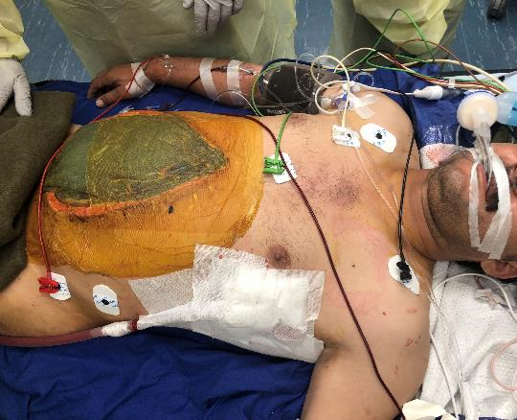
EWS Damage Control
Surgery General Points
Conduct of relaparotomy
  It is to be presumed that injuries were
  unrecognized on initial laparotomy.
  A complete exploration must be performed.
  Feeding tube placement should be
  performed at this time.
  Repacking may be reemployed if other
  measures fail to control hemorrhage.
  Radiographic images should be obtained
  that visualize nipples to mid thigh to
  ensure all packs are removed – do not rely on sponge counts.
  Unplanned re-exploration should be considered in any patient that remains unstable, persistently coagulopathic, or acidotic despite continued resuscitation or evidence of abdominal compartment syndrome (ACS).
Notes:
When re-exploring a patient, assume that injuries were missed in the haste of the damage control operation. Fully explore the abdomen. This is critically important if you were not the initial operating provider. Remove any retained packs. If removal of packs leads to raw-surface bleeding, the packs may be replaced. When the abdomen or chest is definitively closed, obtain plain films to verify removal of all the packs as these form infectious niduses if retained. Consideration must be made for enteral feeding access at this time.

Slide 42
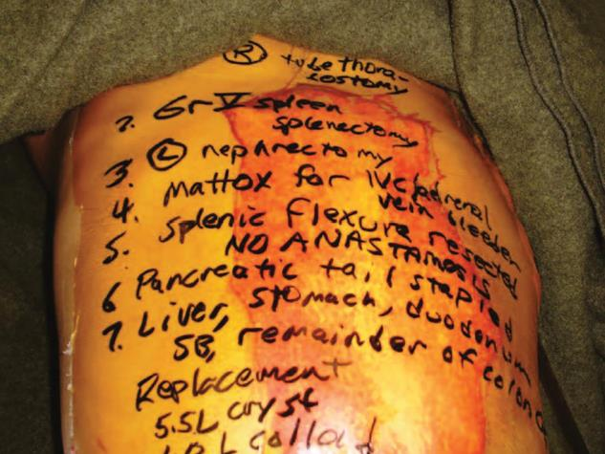
EWS Damage Control
Reoperation
Reoperation after Damage Control
Packs should be left in place until the patient’s hemodynamics are stable and all major sites of hemorrhage have had time to clot.
  Moisten packs with significant
  warm irrigation with careful removal.
  Packs should be taken out slowly
  with plans for vascular control
  (may require repacking).
  In case of gross contamination,
  retrieve packs within 36-48 hours.
May, and in many cases should,
occur at next echelon of care.
Source: Crucible – Borden Institute
Notes:
When utilizing packs to tamponade solid organ and raw surface injuries, do not remove the packs until after hemostasis appears to have been obtained. Moisten laparotomy pads to facilitate removal and not tear off clot from the organ’s surface.
When transferring patients between roles of care, removal of packs and definitive fixation usually occurs at the next level of care. Not only does this promote hemostasis, it also allows for further exploration and definitive repairs to occur in cleaner environments, with more resources.

Slide 43
EWS Damage Control
Abdominal Compartment Syndrome
Increased intra-abdominal pressure adversely affects the circulation and ventilation of the patient, threatening function and viability of the viscera.
Cardiac output and venous return are decreased.
Reduction of blood flow to liver, intestines and kidneys can results in anuria.
Two hemidiaphragms push upward, decreasing thoracic volume and resulting in elevated peak airway pressures.
Central venous pressures increase.
PaO₂ is decreased.
Notes:
A complication of aggressive resuscitation is abdominal compartment syndrome. Abdominal compartment syndrome is a state where the intra-abdominal pressure is increased, pressing on the viscera and vessels. This may result in ischemia of the bowel. The kidneys stop making urine due to compression of the renal arteries. The IVC is compressed, resulting in decreased return of blood to the heart and a drop in cardiac output, as manifest by hypotension. The diaphragm is pushed upwards, compressing the lungs and making ventilation more difficult. This is manifest as increases in peak airway pressures.

Slide 44
EWS Damage Control
Abdominal Compartment Syndrome
Any patient who has undergone a massive transfusion/major resuscitation, large body surface burn, or prolonged trauma laparotomy is at risk.
  Even those with open abdomen may have it.
Clinical suspicion is most important, but bladder pressures can be useful tool.
Abdominal Pressure | Degree of Elevation | Clinical Effect
10-20 mm Hg | Mild | Insignificant
20-30 mm Hg | Moderate | Oliguria and organ dysfunction
>30 mm Hg | Severe | Requires immediate attention
Notes:
Bladder pressures can help diagnose abdominal compartment syndrome. Typically, abdominal compartment syndrome occurs when the pressure exceeds 30 mmHg. However, the diagnosis is not made without end organ dysfunction as outlined in the previous slide. Treatment is re-opening of the abdomen and temporary abdominal closure.

Slide 45
EWS Damage Control
Scenario
A 24-year-old service member presents with a single GSW to the abdomen with no other visible injuries. His airway is patent and he initially has a palpable pulse with a heartrate of 140 and blood pressure of 70/40.
He is confused/agitated. Within moments he becomes bradycardic and pulseless.
How will you proceed?
Notes:
We return to our scenario from the beginning of the presentation. A patient with an abdominal gunshot wound presents in hemorrhagic shock. He then arrests in the emergency department. Knowing what you know now regarding damage control resuscitation and surgery, how would you proceed?

Slide 46
EWS Damage Control
References
Joint Trauma System Clinical Practice Guidelines https://jts.health.mil/index.cfm/PI_CPGs/cpgs
Damage Control Resuscitation, 12 Aug 2019.
Whole Blood Transfusion, 15 May 2018.
Vascular Injury, 12 Aug 2016.
Emergent Resuscitative Thoracotomy (ERT), 18 Jul 2018.
Resuscitative Endovascular Balloon Occlusion of the Aorta (REBOA) for Hemorrhagic Shock, 31 Mar 2020.
High Bilateral Amputations and Dismounted Complex Blast Injury, 01 Aug 2016.
Publications
Moore EE, Feliciano DV, Mattox KL. Combat Casualty Care (Chap 4/5. Damage Control Resuscitation, Ch.5 Damage Control Surgery) Trauma, 8e. 2017. McGraw-Hill Education.
Demetriades D, Inaba K, Velmahos G. Atlas of Surgical Techniques in Trauma. 2015. Cambridge University Press.
Cannon JW, Khan MA, Raja AS, et al. Damage control resuscitation in patients with severe traumatic hemorrhage: A practice management guideline from the Eastern Association for the Surgery of Trauma. Journal of Trauma and Acute Care Surgery; 2017. 82 (3) 605-617.
The Office of The Surgeon General, Borden Institute. Emergency War Surgery, 5th U.S. Edition, 2018. Chap 6/12. https://www.cs.amedd.army.mil/Portlet.aspx?ID=cb88853d-5b33-4b3f-968c-2cd95f7b7809
* All photos and images, not otherwise cited, are courtesy of the JTS Collection
Notes:
Further information on damage control resuscitation and surgery is contained in these six CPG’s found on the JTS website.

