Slide 1
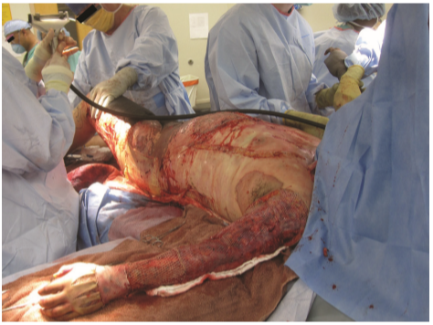
Burn Care
Joint Trauma System
Joint Trauma System Battlefield Trauma Educational Program

Slide 2
EWS Burn Care Scenario
You are at a Role 2 facility. A 19-year-old male E2, who had been assigned to burn trash by his supervisor, sustained burns after throwing JP8 Jet Fuel on the fire as an accelerant. Medics call in from the scene, estimating that he is burned over 80% of his body.
What are your priorities of care?
What are appropriate surgical interventions at a Role 2?
How would one go about resuscitating this patient?
2021, v1.1
Notes:
Let’s get everyone thinking about burn trauma with a very simple scenario.
You are at a Role 2 facility. A 19-year-old male E2, who had been assigned to burn trash by his supervisor, sustained burns after throwing JP8 Jet Fuel on the fire as an accelerant. Medics call in from the scene, estimating that he is burned over 80% of his body.
What are your priorities of care?
What are appropriate surgical interventions at a Role 2
How would one go about resuscitating this patient?

Slide 3
EWS Burn Care Objectives
Estimate burn size based on the Lund-Browder Chart.
Resuscitate using Rule of 10’s and Joint Trauma System’s (JTS) Clinical Practice Guidelines (CPGs).
Prevent hypothermia.
Learn indications for and how to perform escharotomies.
Learn basics of wound care.
2021, v1.1
Notes:
The Objectives for this lecture include:
Estimate burn size off of Lund Browder Chart.
Resuscitate using Rule of 10’s and Joint Trauma System’s (JTS) Clinical Practice Guidelines (CPGs).
Prevent hypothermia.
Learn indications for and how to perform Escharotomies.
Learn basics of wound care

Slide 4
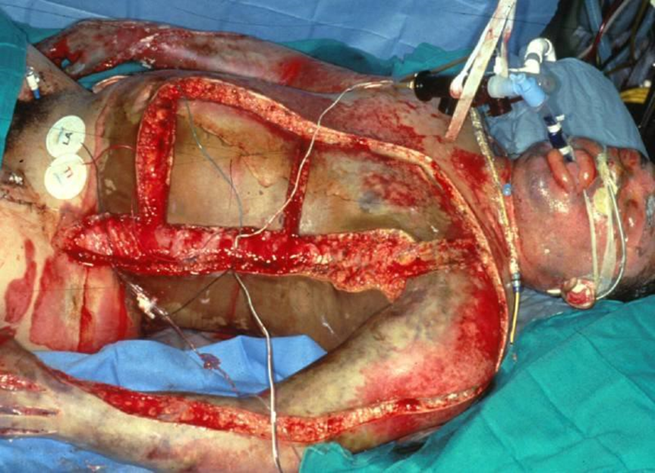
EWS Burn Care Background
Approximately 5% of combat injuries are burns.
Burn patients are trauma patients FIRST!!!
Burns may not be the most life-threatening injury.
Control hemorrhage first. Bleeding is immediately life threatening.
Avoid being distracted by the burn wound itself.
ABCD’s
Source: Combat Anesthesia, Borden Institute
2021, v1.1
Notes:
Burn patients are trauma patients first. Some burn injuries are witnessed and are immediately known not to involve concomitant trauma, however most are not. In the combat setting, the vast majority of wartime burn injuries involve some sort of blast or blunt force trauma. Blasts may produce thermal injuries, which can be impressive and distracting. Burn injuries, however, are generally not immediately life-threatening. A patient can present GCS 15, alert and oriented x3, and be conversant after being >90% total body surface area (TBSA) burned. Bleeding, airway, and pulmonary trauma is immediately life-threatening. Evaluate and treat any life-threatening trauma before moving on to burns. Carbon monoxide and cyanide poisoning, usually sustained by people trapped in a burning structure or vehicle, are the exceptions. Securing an airway and providing mechanical ventilation is the immediate treatment of these injuries. More on carbon monoxide and cyanide poisoning later.

Slide 5
EWS Burn Care Triage Considerations
For all burn patients: stop the burning process!
Remove chemical agents using water, remove burned clothing, etc.
Immediate
Inhalational injuries, specifically carbon monoxide and cyanide poisoning.
Severe facial burns: angioedema.
Electrical injuries.
Alternating current: Cardiac Arrhythmia (Low voltage <1000V or household voltage in US.)
Direct current: Project patient away from power source, fractures from tetany (High voltage >1000V or transmission wires in US.)
2021, v1.1
Notes:
A critical part of the initial point-of-care management for all burn patients is to stop the burning process. Remove chemical agents by brushing off dry powder or using significant volumes of water, remove burned clothing, etc…
Several elements of burn injuries can be immediately life-threatening, including the aforementioned inhalational injuries involving carbon monoxide and cyanide poisoning. Furthermore, severe facial burns can result in angioedema that can obstruct the upper airway. Electrical injuries can cause cardiac arrhythmias that require cardioversion or trauma. How do electrical injuries cause trauma? Direct current propels patients away from the power source, causing them to sustain blunt trauma. Direct current, or high voltage injuries, may result in falls from heights if a patient contacts a transmission line. Direct current also causes severe tetany, which can result in long bone and spinal fractures, and longitudinally, can cause rhabdomyolysis. Conversely, alternating current causes a “no let go” effect where the patient cannot extract himself or herself from an electrical source. This usually does not produce trauma but may cause cardiac arrhythmias.

Slide 6
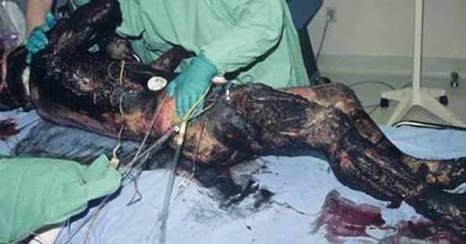
EWS Burn Care Triage Considerations
Delayed: > 20 % total body surface area (TBSA) burns.
Minimal: < 20 % TBSA burns.
Expectant: >50% TBSA burns in patients unable to be evacuated to higher level of care (i.e. local nationals). May vary and be lower based on supplies available, such as split Role 2 vs large Role 3.
2021, v1.1
Notes:
In the Delayed category are > 20 % total body surface area (TBSA) burns. Patients with > 20% TBSA burns will probably go into burn shock. However, this usually takes several hours. Life-threatening blunt and penetrating trauma should take priority.
In the Minimal category are < 20 % TBSA burns. Less than 20% TBSA burns are infrequently life-threatening in young healthy individuals.
In the Expectant category are > 50% TBSA burns in patients unable to be evacuated to higher level of care (e.g. local nationals). These large burns require tremendous resources. Between resuscitative fluids, wound care, surgical instruments, analgesics, sedatives, and blood products, a deployed medical facility may be entirely depleted of resources within hours. These patients also require weeks or months of care. Be very careful in offering care to severely burned local nationals. A Role II with limited supply and resupply can be quickly depleted of all of its resources while a large, well established Role 3 may be able to manage.

Slide 7
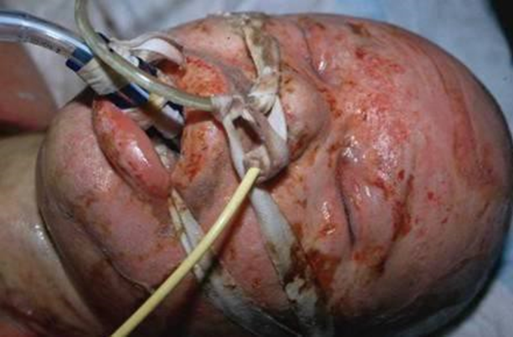
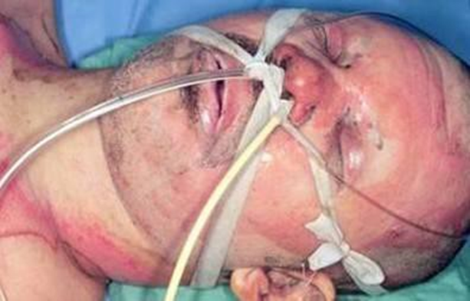
EWS Burn Care Airway
Anticipate need for early intubation for:
Severe facial burns.
Extensive burns (>40% TBSA) due to edema from resuscitation requirements.
Smoke inhalation injury.
Prolonged transportation.
Secure the endotracheal tube.
Cotton ties (adjustable).
Stainless steel wires to premolar tooth.
NO TAPE!!! Tape and adhesives do NOT work.
2021, v1.1
Notes:
Anticipate the need for early intubation of patients with severe facial burns for angioedema, burns >40% TBSA due to edema from resuscitation requirements, smoke inhalation injury, or anticipated need for prolonged transportation. The majority of the injury from smoke inhalation is a chemical injury from the products of combustion. Inhalational injuries typically occur in enclosed spaces where smoke cannot evacuate. In outdoor spaces, inhalational injuries are uncommon as that smoke rises. Physical exam findings suggesting inhalational injury include facial burns, singed facial hairs, difficulty breathing, and carbonaceous sputum.
Special consideration must be made for how to secure endotracheal tubes. Facial burns are very moist and tape or other adhesives will not stick, putting the ET tube at serious risk of dislodgement. Either cotton ties or securing the tube to the gum line with steel sutures is the preferred methodology. Cotton ties work well the overwhelming majority of the time.

Slide 8
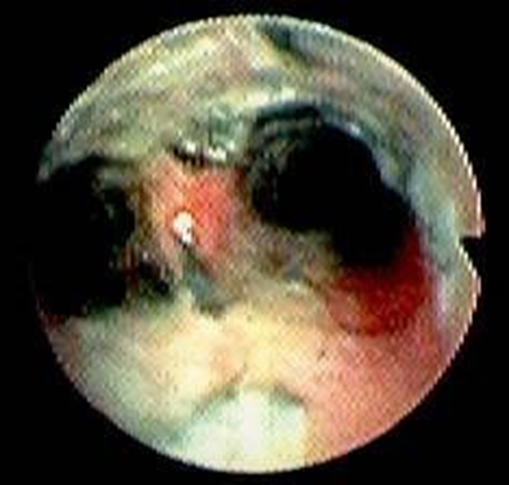
EWS Burn Care Inhalation Injury
< 20% of burn patients have an inhalation injury
Mechanisms
Enclosed space.
Structural fires.
Vehicle fires.
Large explosions.
Symptoms
Carbonaceous sputum.
Hoarseness.
Singed facial hairs.
Rhonchorous lung sounds.
2021, v1.1
Notes:
Inhalational injuries occur primarily in large explosions or enclosed spaces such as buildings or vehicles. Again, it is unusual for an inhalational injury to occur with an external fire as that smoke rises. Patients may have hoarseness, stridor, carbonaceous sputum, singed facial hairs, and rhonchorous lung sounds. Sometimes a high degree of suspicion is all you have. It is formally diagnosed via fiberoptic bronchoscopy, which should be done as soon as possible to guide management.

Slide 9
EWS Burn Care Inhalation Injury
Diagnosed via Fiberoptic Bronchoscopy: Perform as soon as available.
Bronchoscopy can clear out epithelial and hemorrhagic casts that obstruct the bronchioles.
Until airways clear of casts, administer 5000 U aerosolized heparin mixed with albuterol down endotracheal tube Q4H.
2021, v1.1
Notes:
Inhalational injury causes sloughing of the airway epithelium, and subsequently blood clots, from the epithelial lining of the trachea and bronchi. These “casts” then obstruct the smaller airways, leading to progressive atelectasis and lobar collapse. Bronchoscopy is used to remove the casts via suctioning. Several bronchoscopies may be needed in the first 48-72 hours to remove all the casts. Flushing 5000 U of heparin down the endotracheal tube every 4 hours can help break up the clots. The heparin should be mixed with albuterol to prevent vasospasm and administered via a syringe with a spray tip catheter to “nebulize” it or with a formal nebulizer.

Slide 10
EWS Burn Care Carbon Monoxide
Heaters, furnaces, fireplaces, stoves, and vehicles can produce CO.
Binds hemoglobin, shifting the oxygen-dissociation curve to the left, thereby preventing the release of O2.
Diagnosis:
Elevated Carboxyhemoglobin on ABG.
SaO2 falsely elevated.
Treatment: 100% FiO2
2021, v1.1
Notes:
Carbon monoxide or cyanide poisoning usually occur from prolonged exposure to smoke from a structure fire, however can be seen in patient’s after prolonged extrication from a burning vehicle.
Carbon monoxide is produced from burning hydrocarbons. CO binds hemoglobin, shifting the oxygen-dissociation curve to the left, thereby preventing the release of O2 and aerobic metabolism. A carboxyhemoglobin level will be elevated on ABG, if available. Treatment is with 100% FiO2.

Slide 11
EWS Burn Care Cyanide
Burning wood and other compounds (anything that contains carbon and nitrogen) in enclosed spaces.
Inhibits mitochondrial cytochrome c oxidase (electron transport chain).
Body cannot use oxygen.
Diagnosis: Elevated SvO2 on ABG +/- elevated lactate.
Treatment: Hydroxycobalamin (Vitamin B12 analog) AKA Cyanokit
2021, v1.1
Notes:
Cyanide poisoning occurs from exposure to burning compounds that contain both carbon and nitrogen. It inhibits mitochondrial cytochrome c oxidase on the electron transport chain, preventing the body from utilizing oxygen. The SvO2 becomes inappropriately elevated and a person may have an elevated lactate. The treatment is the Vitamin B12 analog, hydroxycobalamin, a.k.a. Cyanokit.

Slide 12
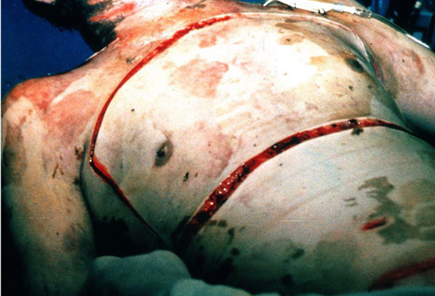
EWS Burn Care Breathing
Full-thickness (3rd degree) burns
Eschar Compartment Syndrome
Physiologic tourniquet
Results in difficulty ventilating
↑ Airway pressures
↑PaCO2
↓SaO2
Full thickness burn with escharotomies
2021, v1.1
Notes:
Circumferential full-thickness burns can result in an eschar compartment syndrome. While eschar syndrome in an extremity with complete loss of pulses is an emergent problem that needs to be intervened on soon, it is not an immediate life threatening situation. Chest eschar syndrome sufficient to impair ventilation, by contrast, must be intervened on right away.
In the torso, this can lead to difficulty ventilating and oxygenating as that the eschar acts as a constrictive band. After all, an eschar is just leather, albeit from a human rather than a cow. Releasing the constrictive skin bands with a knife or a Bovie can result in a marked increase in the ease of ventilating a patient. These do bleed, so a Bovie is probably preferred and combat gauze is helpful to pack the wounds. Just make sure to give analgesia as that the current carries to healthy tissue beneath and therefore hurts.
On the abdomen, circumferential full-thickness burns can lead to abdominal compartment syndrome in patients with large burns requiring massive resuscitations. Performing a laparotomy for abdominal compartment syndrome in burn patients is almost 100% fatal. A laparotomy results in a large loss of domain that can almost never be repaired before a fatal infection takes hold.

Slide 13
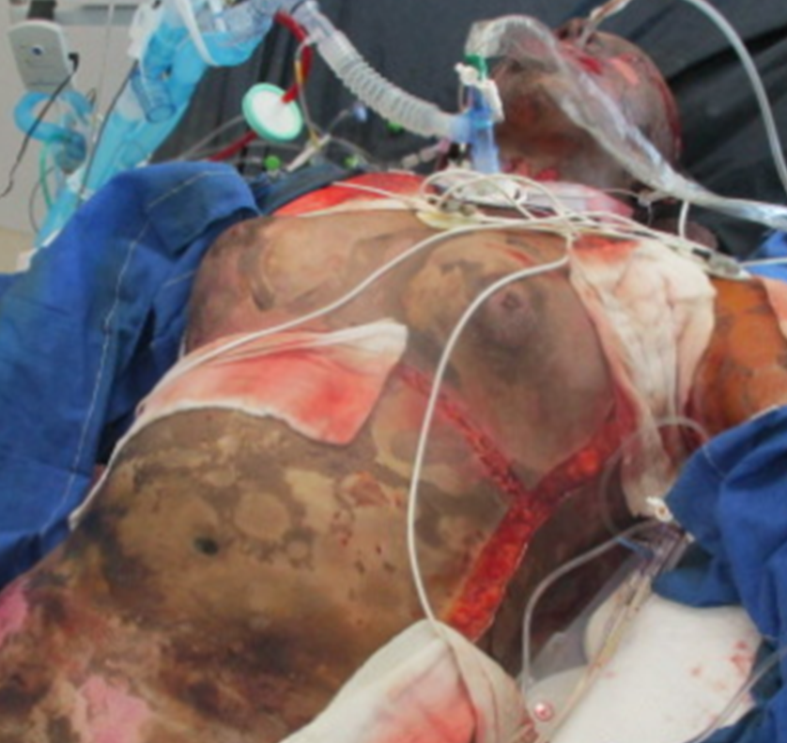
EWS Burn Care Breathing
Escharotomy: Excise SKIN only
Bilateral anterior axillary lines
Subcostal margin
Abdomen if involved
Can be useful if there is evidence of abdominal compartment syndrome.
DON’T perform a laparotomy for abdominal compartment syndrome in burns.
Optional
Full thickness burn with escharotomies
2021, v1.1
Notes:
Escharotomy is performed by making an incision through the SKIN only. Generally an incision in the shape of a shield is created by going down along the bilateral anterior axillary lines, making a horizontal incision along the subcostal margin, and connecting superiorly right around the clavicles or extending onto the neck if the constrictive eschar also involves the neck. A diagram of this incision is in Appendix E of the burn CPG as well as later in this presentation. Releasing the abdomen if involved can be useful if there is evidence of abdominal compartment syndrome. A laparotomy for abdominal compartment syndrome in burns should be a intervention of last resort.

Slide 14
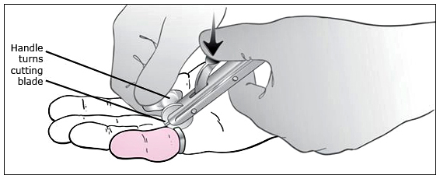
EWS Burn Care Circulation
Remove constrictive articles.
Extremities swell with resuscitation.
Constrictive articles (i.e. rings) can cause distal ischemia.
Obtain IV access.
Prefer through healthy skin.
Through burn skin okay if required.
Secure with sutures or staples.
Tape doesn’t stick to burned skin!
IO access acceptable if unable to obtain IV.
Avoid placing through burns.
Also require arterial line and central lines.
Try to avoid placing through burns.
If there is no choice, place through burns.
2021, v1.1
Notes:
Again, remember that burn patients are trauma patients first. Evaluate for any signs of hemorrhage and treat as appropriate. If the patient is bleeding, resuscitate as a trauma patient (i.e. whole blood or a 1:1:1 balanced transfusion) and then transition to a burn resuscitation when the bleeding is controlled. Remove constrictive clothing or jewelry that can cause distal ischemia when a patient is being resuscitated.
Preferably, IV or IO access is performed through healthy skin though they can absolutely be performed through burned skin if needed. However, if placed through burned skin, IV’s need to be secured into place with sutures or staples as that tape WILL NOT stick to burn wounds.
A difficult clinical situation is one where a trauma patient has a large burn, say 50% TBSA, concomitant with a major vascular injury requiring emergent operative intervention. In this case it is easy to forget that the patient, while in the OR, needs crystalloid resuscitation while hemorrhage control is being obtained.

Slide 15
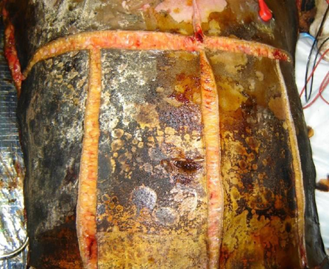
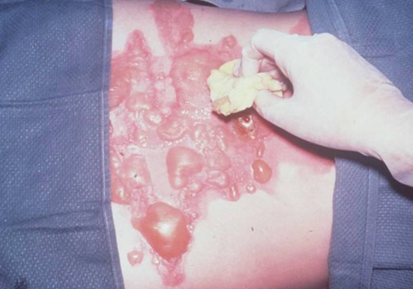
EWS Burn Care Examination
Estimating Burn Size
Use for Estimate
Superficial or 1st Degree Burn
Full Thickness or 3rd Degree Burn
Do Not Use for Estimate
Partial Thickness or 2nd Degree Burn
2021, v1.1
Notes:
Superficial burns, or first degree burns, turn the skin erythematous and are moderately painful. Most sun burns are superficial burns. Partial thickness burns, or second degree burns, are divided into two types. Superficial partial thickness burns blister. When the blister ruptures, the underlying dermis is exposed as a very moist, highly reflective, white surface. These burns are extremely painful. Deep partial thickness burns extend deeper into the dermis. The dermis starts to appear pink and is less moist than superficial partial thickness burns. Deep partial thickness burns blanch when touched and have evidence of hair follicles when inspected closely as that hair follicles are at the base of the skin. These burns are painful, but generally less painful than superficial partial thickness burns. Full thickness burns appear as a dirty white or grey color. They are dry, feel similar to leather, and are largely insensate and non-painful due to destruction of dermal nerve endings.
When calculating the size of the patient’s burn, DO NOT count first degree burns (i.e. superficial burns). They do not anatomically or physiologically damage the skin. They do not cause burn shock or cause a need for resuscitation and will not require surgery.

Slide 16
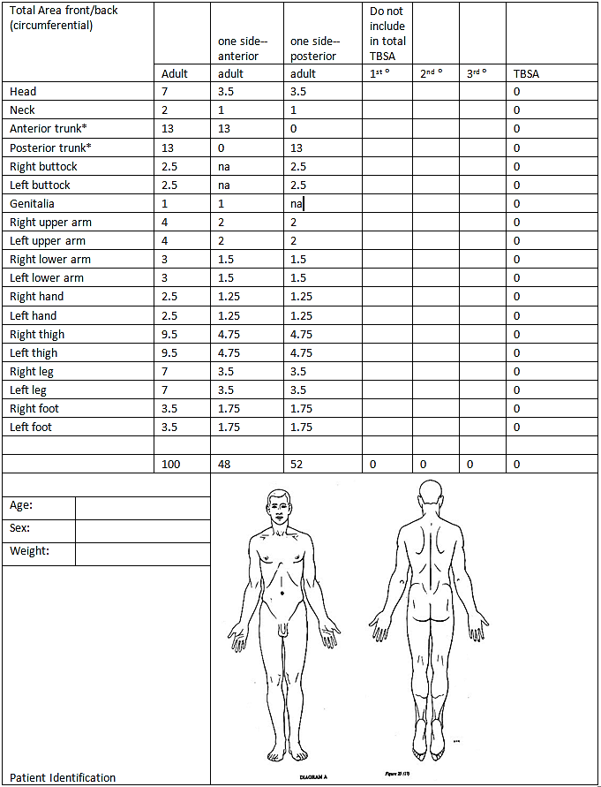
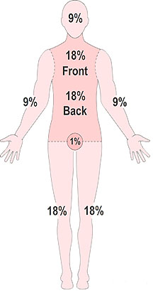
EWS Burn Care Calculating %TBSA
Assess Total Body Surface Area (TBSA) involvement.
Use that number to drive resuscitation.
Quick estimate can be done by using the Rule of Nines.
Smaller areas can be estimated by the patient’s palm ~1% TBSA.
Lund-Browder Chart (left) is the most accurate.
2021, v1.1
Notes:
The Total Body Surface Area or TBSA is used to guide burn resuscitations and is a marker for severity of the injury. The % TBSA burn is the sum of the % partial thickness (2nd degree) and % full thickness (3rd degree) involvement. A quick estimate can be made using the rule of nine’s (i.e. head is 9%, upper extremities are 9% each, the thighs are 9% each, the calves and feet are 9% each, the chest is 9% on the front and 9% on the back, the abdomen is 9% on the front and 9% on the back, and the genitals are 1%). A Lund-Browder chart is a much more accurate way of estimating TBSA and should be performed after a quick wound debridement. A copy of the Lund Browder chart is in the Burn CPG and should be incorporated into the patient’s medical record.
For smaller burns it is quick and easy to estimate TBSA by using the patient’s palm as an indicator for 1% TBSA.

Slide 17
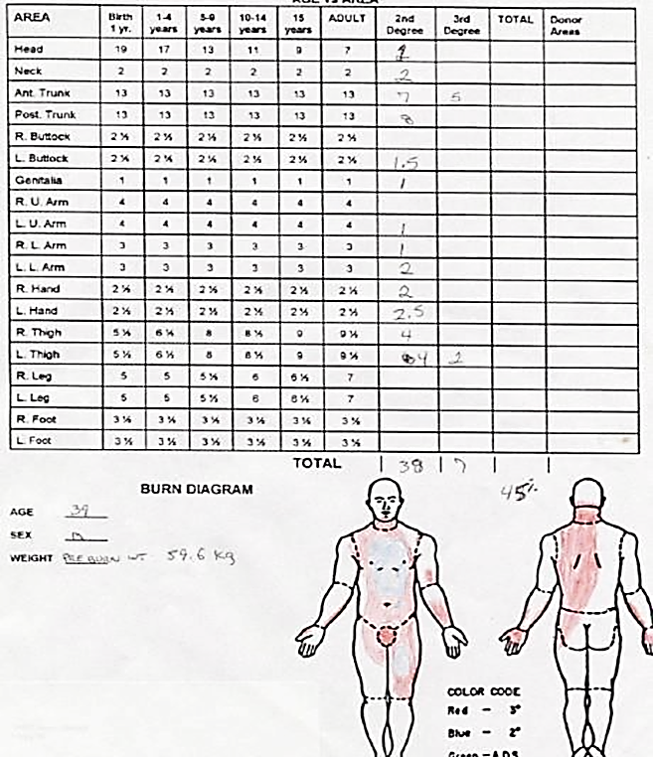
EWS Burn Care Lund-Browder Chart
Correctly completed Lund-Browder Chart
2021, v1.1
Notes:
This is an example of a completed Lund Browder chart. Blue coloring represents partial thickness burns and red coloring represents full thickness burns. And yes, if anyone notices, the person who filled out this chart accidentally used the colors backward, which happens all the time.

Slide 18
EWS Burn Care Initial Fluid Resuscitation
DO NOT BOLUS fluids.
Utilize Rule of Ten for initial fluid rate in adults.
Needed for > 20% TBSA burns.
Example: 45% TBSA burn started at 450 mL/hr.
Add 100 mL/hr for every 10 kg > 80 kg if patient weighs >80 kg.
Use balanced salt solutions (e.g., LR or Plasmalyte).
Resuscitation formula is a starting point.
2021, v1.1
Notes:
We begin the resuscitation by using the Rule of Tens formula. The Parkland Formula tends to overestimate resuscitation needs which can lead to severe complications. The Modified Brooke formula, at 2 ml/kg/%TBSA, is a better formula for initial fluid rate. However, the Rule of Tens is much easier and faster. Simply multiply the estimated % TBSA by 10 and start the fluid at that rate in mL/hr.
Generally, patients with less the 20% TBSA burns will not go into burn shock and will not need a burn resuscitation, however there are outliers so be mindful of the occasional young healthy patient with 15% TBSA, completely normal vitals, making adequate urine, and a Hgb concentration of 18 or 19.
Always use balanced salt solutions such as lactated Ringer’s solution or Plasmalyte.
Do NOT bolus fluids. Bolusing fluids in burn shock just results in all of the fluid entering the extravascular space and not treating the shock. The one exception is concurrent trauma – if you suspect the patient is bleeding, then feel free to bolus with blood.
Adjust fluid rate by no more than 20% up or down per hour based on UOP, Hct/Hgb concentration, and lactate. Alcohol and elevated blood glucose (e.g. poorly controlled diabetics) are diuretics and may falsely increase UOP in the setting of burn shock.

Slide 19
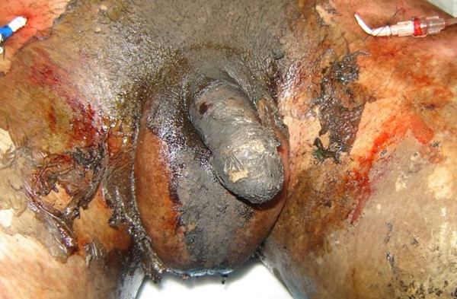
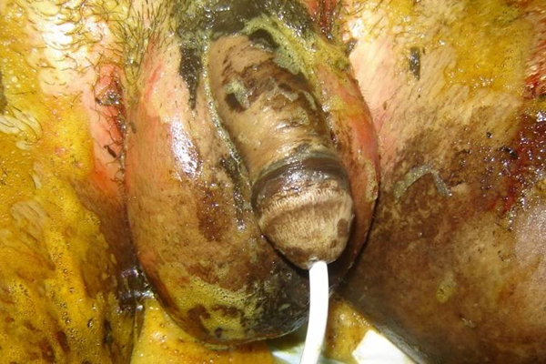
EWS Burn Care Initial Fluid Resuscitation
Adjust fluid rate hourly based on urinary output (UOP), single most reliable indicator of adequate resuscitation.
Place Foley catheter (try to avoid suprapubic catheter).
Target urine output – 30-50 mL/hr.
Target urine output if rhabdomyolysis (e.g., high voltage electrical injury) – 75-100 mL/hr.
Adjust rate ↑ or ↓ by 0-20%. Do not make changes >20%.
Resuscitation ends when maintenance rate is achieved.
This will be higher than normal as the patient will lose free water from the burn wounds at ~ 1 mL/kg/%TBSA/day.
2021, v1.1
Notes:
Regardless of the method used to obtain the initial fluid rate for a burn resuscitation, what is most important to do subsequently is titrate based on the patient physiology. Placement of a Foley catheter will allow targeting a urine output of 30-50 mL/hr. The target urine output with rhabdomyolysis (e.g. high voltage electrical injuries) is 75-100 mL/hr. The fluid rate should then be adjusted up or down by no more than 20% roughly every hour based on the UOP, lactate, and Hct/Hgb concentration.
Resuscitation ends when maintenance rate achieved. This will be higher than normal as the patient will lose free water from the burns wounds at about 1 mL/kg/%TBSA/day.

Slide 20
EWS Burn Care Difficult Resuscitation
5% Albumin Infusion (mL/hr) | 30-49% TBSA | 50-69% TBSA | 70-100% TBSA
<70 kg | 30 | 70 | 110
70-90 kg | 40 | 80 | 140
> 90 kg | 50 | 90 | 160
After 8 hours post burn:
If IV fluid rate is > 1500 mL/hr OR
If 24 hr total fluid volume exceeds 250 mL/kg
THEN
Add colloids (5% albumin) or fresh frozen plasma if coagulopathic
OR
Start vasopressors: Vasopressin 0.04 Units/min or Norepinephrine (Levophed) 2-20 mcg/min
OR DO BOTH
2021, v1.1
Notes:
As will be demonstrated in a few slides, over-resuscitation can lead to a myriad of problems. Should a patient require a high volume resuscitation (described as 1500 mL/hr in the CPG, but as low as 1000 mL/hr for most of the burn surgeons at the ISR), consider either adding a colloid or starting vasopressors. Or both. The Ivy Index or 250 mL/kg of fluid resuscitation given before 24 hours post burn is also significant as it predicts complications such as abdominal compartment syndrome.
Use the following chart from the CPG as a guide to an appropriate albumin rate. The albumin is generally initiated 8 hours post burn and usually continued until 48 hours post-injury. Alternatively, plasma can be used if the patient is coagulopathic. Supplies available in a role 2 may mean that this option is not available.

Slide 21
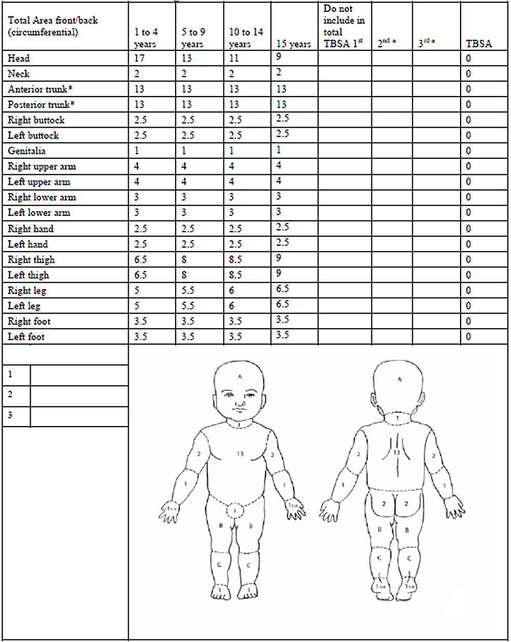
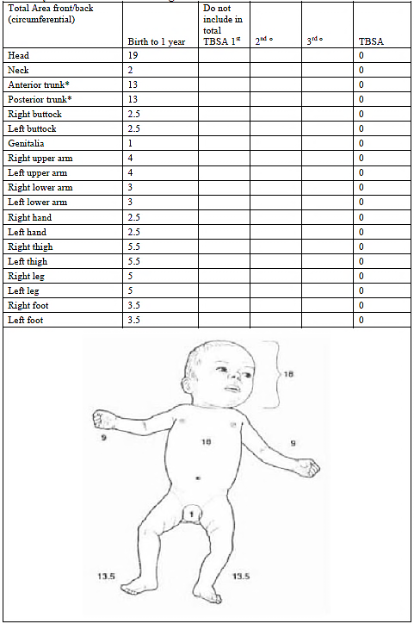
EWS Burn Care Pediatric Resuscitation
3 mL / kg / % TBSA over 1st 24 hours
Half in first 8 hours, half in second 16 hours.
Adjust as one would for adults.
Goal UOP 0.5-1.0 mL/kg/hr.
Add maintenance rate of D5LR for children < 20 kg.
See Burn Care CPG for details.
Pediatric Lund-Browder Burn Estimate & Diagram
2021, v1.1
Notes:
The recommended formula for initiating a pediatric burn resuscitation is 3 mL/kg/% TBSA over the first 24 hours. Half in the first 8 hours, half in the second 16 hours. Adjust as one would for adults with a goal UOP 0.5-1.0 mL/kg/hr. You must also add a non-titrated maintenance rate of D5LR for children < 20 kg.
The Burn Care CPG goes into detail about pediatric resuscitations. For the most part, you will not be able to evacuate these patients, so be profoundly careful about what you choose to engage in. Even though these are pediatric patients, they are profoundly resource intense patients who will be with you for a long time.

Slide 22
EWS Burn Care Over Resuscitation
Airway obstruction from angioedema
Difficulty ventilating and oxygenating - acute respiratory distress syndrome (ARDS)
Compartment syndrome
Abdominal
Extremity
Cerebral herniation
Ocular compartment syndrome
May need lateral canthotomies if it develops.
Burn wound conversion
2nd degree wounds convert to 3rd degree.
2021, v1.1
Notes:
Over and under resuscitation can lead to a host of potentially life-threatening problems. Over resuscitation can result in airway edema, ARDS, compartment syndrome in the extremities or abdomen, ocular compartment syndrome, cerebral herniation, and burn wound conversion. Abdominal compartment syndrome, should it occur in burn patients, is almost universally fatal.

Slide 23
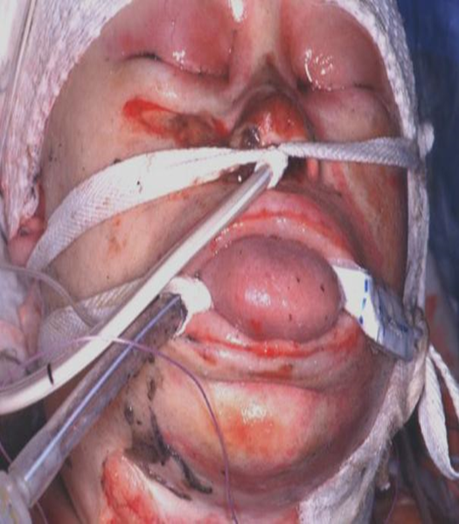
EWS Burn Care Under Resuscitation
Shock
End organ malperfusion
Renal failure
Non-ST-elevation myocardial infarction
Anoxic brain injury
Burn wound conversion
2nd degree wounds convert to 3rd degree
Patient post burn resuscitation
2021, v1.1
Notes:
Under resuscitation, by contrast, can cause end organ dysfunction from malperfusion. And, just like with over resuscitation, burn wounds can convert from 2nd degree to 3rd degree.

Slide 24
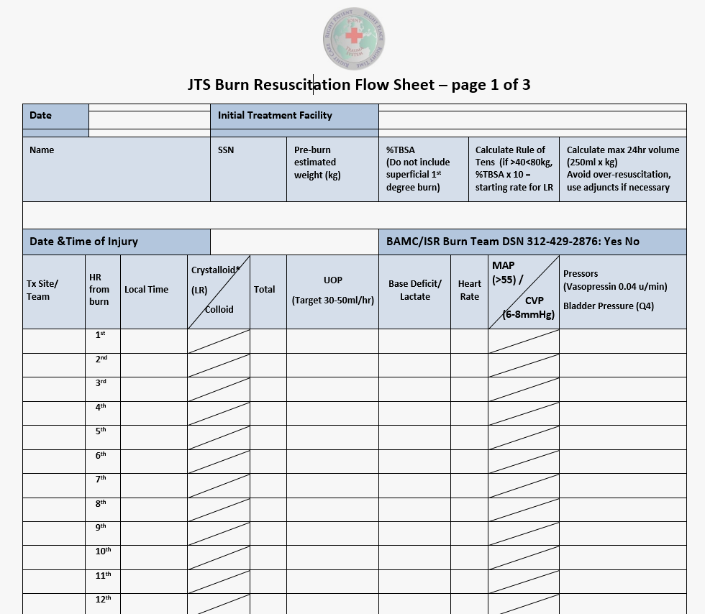
EWS Burn Care Documentation
Documentation is important and necessary to help guide management along the continuum of care.
For instance, the JTS Burn Resuscitation Flow Sheet provides clinicians with a tool to track burn resuscitation over a 72-hour period.
☑ JTS Burn Resuscitation Work Sheet
☑ JTS Burn Resuscitation Flow Sheet
☑ Lund Browder Burn Estimate & Diagram
2021, v1.1
Notes:
Documentation is important and necessary to help guide management along the continuity of care.
For instance, the JTS Burn Resuscitation Flow Sheet provides clinicians with a tool to track burn resuscitation over a 72-hour period.
Please document the patient’s vitals, UOP, and resuscitation using the flow sheet found in the burn CPG. It greatly helps to guide a patient’s resuscitation as they move across the roles of care (Role 2 -> 3 -> 4 -> USAISR burn center). Please send the document with the patient when they transfer and ask the transferring team (e.g. Dustoff, CCATT) to continue to document on the resuscitation flow sheet.

Slide 25
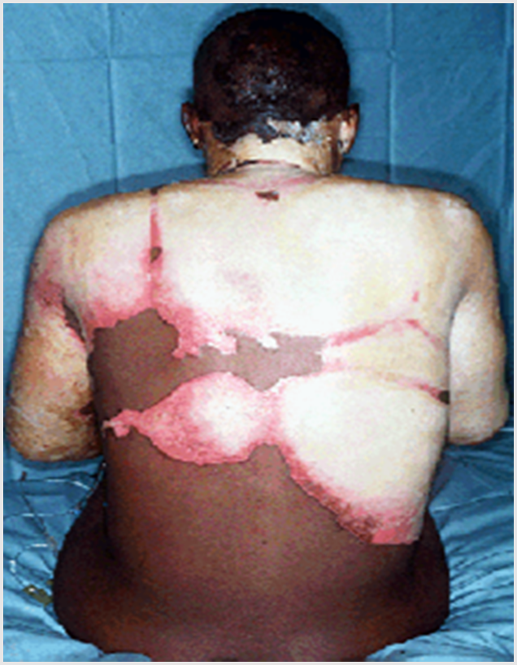
EWS Burn Care Hypothermia
Burn patients are prone to hypothermia.
Damaged skin loses the ability to regulate temperature.
Keep patient warm.
Keep room warm - 90⁰F+ if possible
Warm IV fluids
Warm blankets
Bair Hugger (or equivalent device)
Reflective blanket
2021, v1.1
Notes:
Body temperature regulation is controlled by the hypothalamus and skin. Burned, damaged skin loses the ability to auto regulate body temperature. Therefore, burn patients are extremely predisposed to hypothermia. We have lost service members from hypothermia following burn injuries. To mitigate hypothermia, try to keep the patient in a warm room, >90⁰F if possible. Use warm IV fluids, warm blankets, Bair Huggers, and reflective blankets to keep a patient warm.

Slide 26
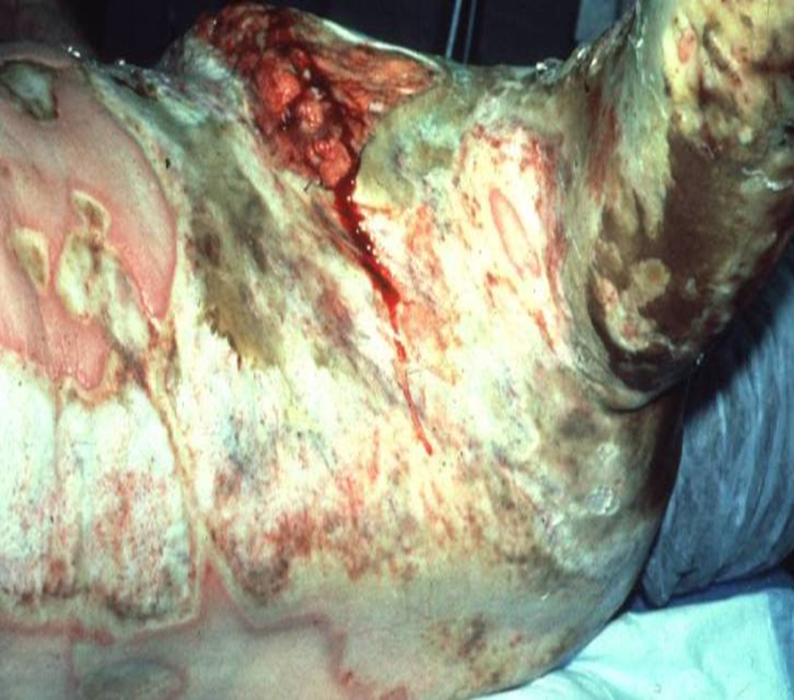
EWS Burn Care Acute Wound Care & Prophylaxis
Debride wounds.
Clean with Hibiclens.
Use IV narcotics and/or ketamine for analgesia
Inspect daily for cellulitis.
Defer excision and grafting to definitive care facility.
Update Tetanus.
Provide GI prophylaxis (e.g. 40 mg IV pantoprazole daily) for all burns > 20%TBSA.
No need for IV antibiotic prophylaxis.
2021, v1.1
Notes:
In the acute setting, burn wounds should be debrided (i.e. dead skin wiped away), cleaned with Hibiclens or equivalent, and inspected daily for cellulitis. This will require IV narcotics and/or ketamine for analgesia.
Unless you are highly experienced with excision and grafting it should be deferred to a definitive care facility such as the USAISR Burn Center. These patients are resource intense and frequently require multiple surgeries and need extensive surgical planning for the patients to survive. Furthermore, it is unusual for a patient to get a significant burn wound infection in the first 48-72 hours post injury. The resources required to successfully excise and graft large burns and do the subsequent wound care almost always exceeds what is available in Role II and III facilities.
All burn patients should have their tetanus prophylaxis updated and patients with > 20% TBSA burns should be put on GI prophylaxis with IV pantoprazole. There is no need for IV antibiotic prophylaxis in isolated burn patients. Antibiotic prophylaxis is provided via topical antibiotics, which is covered in a couple of slides.

Slide 27
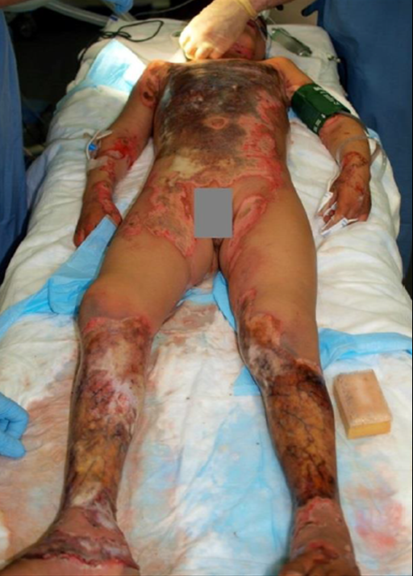
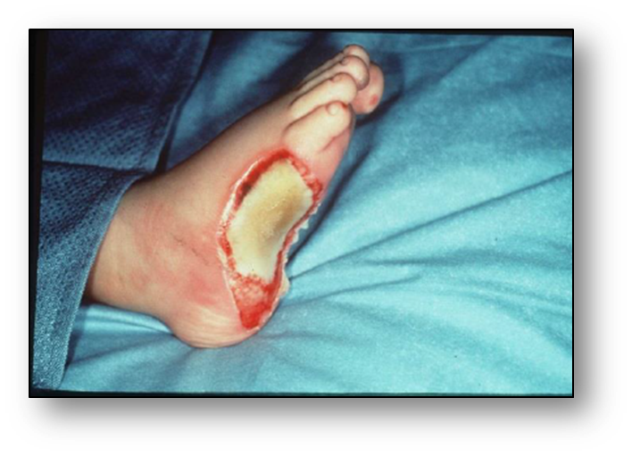
EWS Burn Care Prolonged Field Care
BEWARE
Burn surgery is resource intense.
Even small burns will deplete a Role 2 or Role 3 of supplies if surgery is undertaken.
Maybe. Be careful.
Not on U.S. Nationals.
Wait to evacuate.
Don’t even think about it!
2021, v1.1
Notes:
Again, the resources needed to perform burn surgery are extensive. This is why there are only a limited number of burn centers in the US. Burn patients require a large amount of narcotics and other analgesics, wound care supplies, and blood transfusions, all of which exceeds what is available at most role II’s and role III’s. If you receive a patient that you cannot evacuate (e.g. z Local National or are in a Prolonged Field Care situation), be very careful with what you choose to tackle. Even small burn surgeries are resource intense and may compromise your facility’s ability to provide subsequent care to other patients. All US nationals should be evacuated prior to receiving definitive burn care (i.e. excision and grafting). There is information in the Burn Wound Management Prolonged Field Care CPG on oral rehydration; an alternative if IV resuscitation is not possible due to limited supplies.

Slide 28
EWS Burn Care Topical Agents
Topical agents have different positives and negatives associated with each and preferred uses for different burn depths.
 | Silver Sulfadiazine (Silvadene®) | Mafenide Acetate (Sulfamylon®) | Silver Nylon (Silverlon®, SilverSeal®) | Bacitracin
Coverage | GPC, GNR, fungal | GPC, GNR | GPC, GNR | GPCs
Eschar Penetration | Poor | Good | Contact variable | Horrible
Irritation | Soothing | Painful | Soothing | Soothing
Complications | Transient leukopenia | Metabolic acidosis | Maceration due to moisture | Allergy
Wounds | 2nd Degree | 3rd Degree | 2nd Degree | Superficial 2nd Degree – Face, genitals, hands
2021, v1.1
Notes:
This table covers the different types of burn wound dressings available in the deployed setting. Silversulfadiazine, mafenide acetate, and bacitracin are creams whereas silver nylon is a sheet of silver impregnated material that requires moistening with water to activate. The pros and cons of each is listed in the table. Bacitracin is usually reserved for superficial partial thickness burns to sensitive areas of the body with good blood flow, specifically the face, genitals, and palms of the hands. Specifics on how to apply the dressings is in the Burn Care CPG.

Slide 29
EWS Burn Care Escharotomies
Escharotomy is used for full thickness, circumferential burns.
Eschar acts as constrictive band.
Creates compartment syndrome.
Progressive diminution of audible arterial flow is a primary indication.
Escharotomy is appropriate for:
Upper extremities (beware radial nerve in lateral upper arm).
Lower extremities (beware saphenous vein in medial thigh and calf).
Thorax.
Abdomen.
Neck.
2021, v1.1
Notes:
Escharotomy is used for full thickness, circumferential burns. The eschar can create a constrictive band leading to progressive impairment of venous outflow and arterial inflow causing compartment syndrome. Escharotomy is appropriate for: Upper extremities, Lower extremities, Thorax, Abdomen, and the Neck.
While these incisions can be performed with a knife, they tend to bleed quite a bit. Electrocautery can help with bleeding; just make sure to give the patient some IV narcotics or ketamine for analgesia first because the electric current and heat carry to healthy, innervated tissue underneath burned skin.
DO NOT, DO NOT, DO NOT perform prophylactic fasciotomies. This causes the extremity to swell significantly and can cause profound problems with wound coverage longitudinally, putting the patient at increased risk of dying from a wound infection or losing a limb. Fasciotomies should only be performed if the patient has compartment syndrome after an escharotomy is performed. Be sure to use a Stryker needle or arterial line to measure compartment pressures first.
Prior to transport, seriously consider prophylactic escharotomies.

Slide 30
EWS Burn Care Escharotomies
Prior to transport, seriously consider prophylactic Escharotomies.
No role for prophylactic fasciotomies in isolated burns.
Only through skin
Have Bovie available – they will bleed
IV narcotics – electrocautery current carries to healthy tissue
Dashed lines: preferred sites for escharotomy incisions. Bold lines indicate importance of extending incision over involved major joints.
Source: Emergency War Surgery, 5th U.S. Edition, 2018. The Office of The Surgeon General, Borden Institute.
2021, v1.1
Notes:
This diagram shows the proper positioning of escharotomy incisions. The incisions travel up and down the medial and lateral aspects of the extremities. Be careful of the radial nerve in the lateral upper arm near the elbow and the saphenous vein in the medial calf and thigh. Make sure to cross the joints if the circumferential burns extend across the joint. Torso escharotomy incisions are typically started in the midclavicular line and then carried down the anterior axillary lines. A transverse incision underneath the inframammary fold is also made. A separate, lower transverse incision can be made if the patient is developing abdominal compartment syndrome. Escharotomies can also be performed on the lateral aspects of the neck.

Slide 31
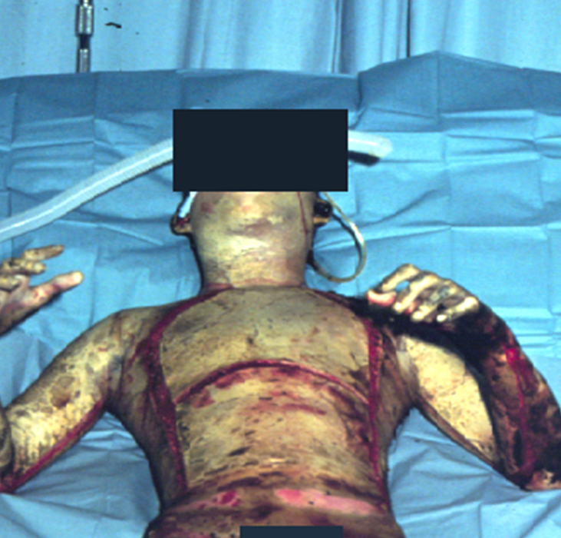
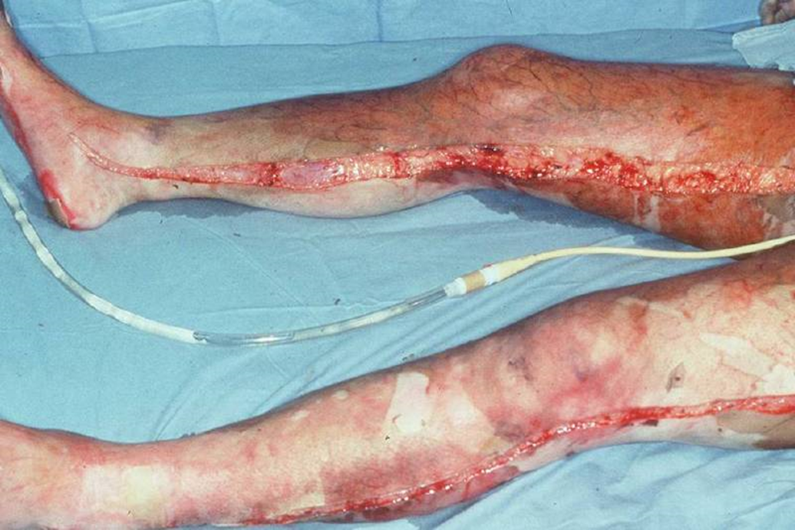
EWS Burn Care Escharotomies
Correctly performed escharotomy incisions.
2021, v1.1
Notes:
These photos demonstrate correctly performed escharotomies along the chest and upper extremities on the left and the lower extremities on the right.

Slide 32
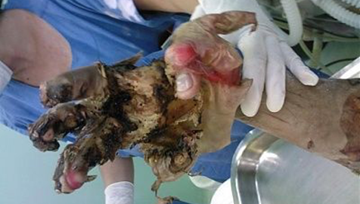
EWS Burn Care Electrical Burns
High voltage injuries (> 1000V, direct current)
Significant injury may be masked by small contact point burns.
Deep muscle injury.
Rhabdomyolysis.
Compartment syndrome.
Acute kidney injury.
Hyperkalemia.
Long bone and spinal fracture from tetany.
Blunt trauma from projection from power source.
2021, v1.1
Notes:
Electrical current is conducted in two forms, as alternating or direct current. Generally, alternating current is Low voltage, <1000V, and is seen within households in the US. Alternating current at the right frequency can induce cardiac arrhythmias. Direct current is conducted through high voltage, >1000V, usually seen in transmission wires in US.
How do electrical injuries cause trauma? Direct current propels patients away from the power source, causing them to sustain blunt trauma. Direct current, or high voltage injuries, may result in falls from heights if a patient contacts a transmission line. Direct current also causes severe tetany, which can result in long bone and spinal fractures, and longitudinally, can cause rhabdomyolysis. Conversely, alternating current causes a “no let go” effect where the patient cannot extract himself or herself from an electrical source. While this usually does not produce trauma, patients may fall from height after becoming unconscious secondary to arrhythmia.
High voltage electrical injuries are usually more severe than first appreciated. Patients may only have two small burn wounds, an entrance and an exit contact point. The electricity travels between the contact points internally, causing severe internal burns as well as tetany and fractures. These internal burns result in deep muscle injury which may cause rhabdomyolysis and compartment syndrome.

Slide 33
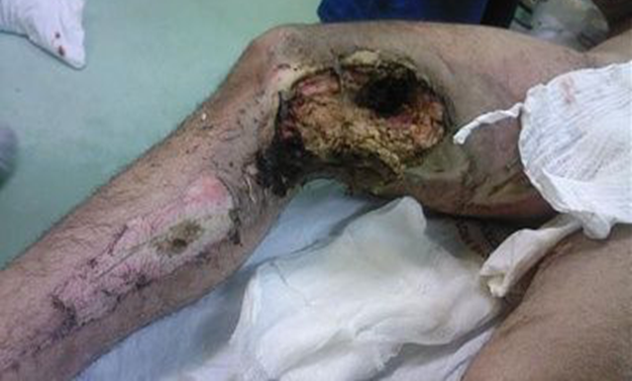
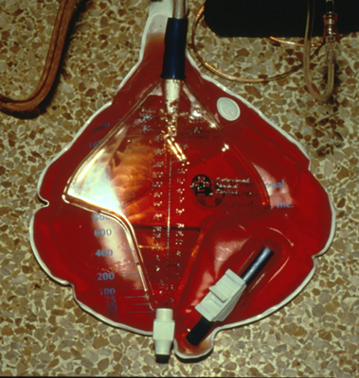
EWS Burn Care Electrical Burns
Treat rhabdomyolysis
Set IV fluids to achieve UOP 75-100 mL/hr
Until CK < 5000 IU/L
Contact Points BEWARE: Amount of tissue destruction far exceeds what is externally evident.
Red urine from myoglobinuria
2021, v1.1
Notes:
Rhabdomyolyis leads to acute kidney injury, which can result in hyperkalemia from the dying muscle. To prevent an acute kidney injury, a patient should be hydrated to produce a UOP of 75-100 mL/hr until the CK drops below 5000 IU/L.

Slide 34
EWS Burn Care Chemical Burns
Acids (sulfuric acid, hydrochloric acid)
Coagulation Necrosis
Burns outside in
Alkalis (ammonia, lime)
Liquefaction necrosis
Gets absorbed into skin; continues to damage after agent neutralized.
Stop the burning process.
Remove offending agent.
Brush-off dry material.
Irrigate with copious amounts of water or saline until skin pH 7-8 on pH strip.
Resuscitate and otherwise manage identical to a thermal burn.
2021, v1.1
Notes:
If a patient sustains a chemical burn, one must first remove the offending agent. First by brushing off dry powder, then the skin should be copiously irrigated with water or saline until a neutral pH is reached. Acids damage by coagulation necrosis, damaging the skin from the top down. Once the acid is neutralized, the burning stops. Alkalis, or bases, injure by liquefaction necrosis. The base gets absorbed into the skin and continues to cause damage even after the base is neutralized. Those wounds may appear much worse 24-48 hours after the alkali is neutralized. All further care is delivered in an identical format to thermal burns.

Slide 35
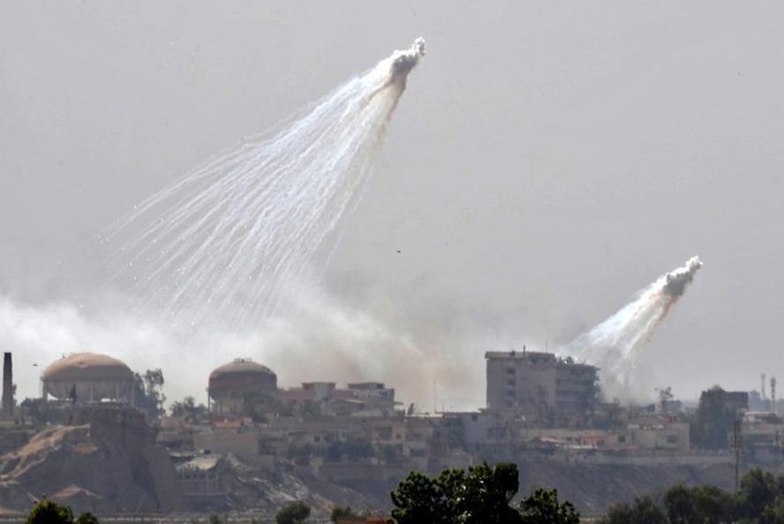
EWS Burn Care White Phosphorus
Residual fragments burn when exposed to air.
Most injury results from ignition of clothing.
Identify residual particles with a Wood’s Lamp.
Cover particles with saline-soaked dressings and irrigate affected areas with copious amounts of water.
Surgically remove all identifiable particles.
Can cause profound hypocalcemia and hyperphosphatemia.
Monitor with ABG’s and replete calcium as needed to get ionized Ca⁺² >1.00
Photo by Jack Moore. Source: Anti-Isis Coalition “Using White Phosphorus” in Iraq and Syria, Endangering Civilians. Newsweek 14 Jun 2017
2021, v1.1
Notes:
White phosphorus is used in some munitions and flares. It burns when exposed to air. Most burning occurs from clothing that ignites upon contact. Any residual particles need to be surgically removed. Cover the affected areas with saline or water soaked dressings until the particles can be removed to prevent them from combusting and causing further burn injury. A Wood’s Lamp may be required to identify the particles. White phosophorus can cause profound hypocalcemia and hyperphosphatemia. Monitor with ABG’s and replete calcium as needed to get ionized Ca⁺² >1.00

Slide 36
EWS Burn Care Physiologic Changes
> 20% TBSA burn wound patients
Hypermetabolic for weeks or months
SIRS: ↑HR, ↑Temp, ↑WBC are normal
Profound muscle catabolism to provide fuel to heal wounds
Prone to multi-drug resistant infections and acute kidney injuries
Early deaths: Hypothermia and under resuscitation
Late deaths: Burn wound sepsis and Multi-Organ Dysfunction Syndrome
2021, v1.1
Notes:
Patients with large burns, > 20% TBSA, enter into a hypermetabolic state for weeks to months after injury. They have elevated heart rates, fevers, and elevated WBC’s, making the diagnosis of infection or sepsis difficult. To heal the wounds, the patients’ undergo catabolic muscle break down to generate protein. The patients are prone to multi-drug resistant infections and renal failure.
Early deaths are usually due to under resuscitation or hypothermia while late deaths are due to infections and multi-organ failure.

Slide 37
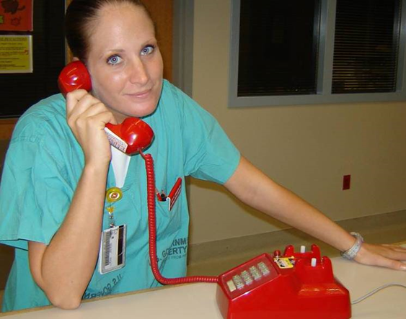
EWS Burn Care Telehelp
Consultation & Early Notification
Notify the U.S. Army Institute of Surgical Research (USAISR) Burn Center of any severely burned U.S. Service Member.
Burn Center can answer questions about minor burns.
USAISR is co-located with San Antonio Military Medical Center, Joint Base San Antonio, Fort Sam Houston, Texas.
Burntrauma.consult.army@mail.mil
(210) 916-2876 (BURN)
(210) 222-2876 (BURN)
DSN: (312) 429-2876 (BURN)
Yes, there is a red phone!
2021, v1.1
Notes:
Never hesitate to contact the Burn Center for questions.
The BICU Nursing station “Red Phone” is (210) 222-2876 (222-BURN)

Slide 38
EWS Burn Care Exercise
You are at a Role 2 facility. A 19-year-old male E2, who had been assigned to burn trash by his supervisor, sustained burns after throwing JP8 Jet Fuel on the fire as an accelerant. Medics call in from the scene, estimating that he is burned over 80% of his body.
What are your priorities of care?
What are appropriate surgical interventions at a Role 2?
How would one go about resuscitating this patient?
2021, v1.1
Notes:
Let’s go over the scenario again: You are at a Role 2 facility. A 19-year-old male E2, who had been assigned to burn trash by his supervisor, sustained burns after throwing JP8 Jet Fuel on the fire as an accelerant. Medics call in from the scene, estimating that he is burned over 80% of his body.
What are your priorities of care?
ABC’s, securing his airway, performing rapid TBSA assessment using rule of 9’s, initiating fluid resuscitation using rule of 10’s, insert Foley catheter, consider central venous catheter and arterial line placement, assess for need for escharotomies, debride wounds and do formal TBSA assessment via Lund Browder chart, track resuscitation using flow sheet.
What are appropriate surgical interventions at a Role 2?
Wound debridement with Hibiclens or equivalent and escharotomies if needed. Inspect wounds daily for cellulitis and Do not excise burn wounds!
How would one go about resuscitating this patient?
Initiate LR at 800mL/hr then titrate based on UOP, Hgb concentration, and lactate. Rapid evacuation to Burn center.

Slide 39
EWS Burn Care References
Joint Trauma System (JTS), Burn Care CPG, 11 May 2016. Accessed Apr 2020. https://jts.amedd.army.mil/assets/docs/cpgs/JTS_Clinical_Practice_Guidelines_(CPGs)/Burn_Care_11_May_2016_ID12.pdf
JTS, Inhalation Injury Toxic Industrial Chemical Exposure CPG, 25 Jul 2016. Accessed Apr 2020. https://jts.amedd.army.mil/assets/docs/cpgs/JTS_Clinical_Practice_Guidelines_(CPGs)/Inhalation_Toxic_Chem_Exposure_25_Jul_2016_ID25.pdf
Burn Wound Management in Prolonged Field Care CPG, 28 May 2017. Accessed Apr 2020. https://jts.amedd.army.mil/assets/docs/cpgs/Prehospital_En_Route_CPGs/Burn_Management_PFC_13_Jan_2017_ID57.pdf
Wound Management in Prolonged Field Care, 24 Jul 2017. Accessed Apr 2020. https://jts.amedd.army.mil/assets/docs/cpgs/Prehospital_En_Route_CPGs/Wound_Management_PFC_24_Jul_2017_ID62.pdf
The Office of The Surgeon General, Borden Institute. Emergency War Surgery, 5th U.S. Edition, 2018. Chap 26. Accessed Apr 2020 https://www.cs.amedd.army.mil/Portlet.aspx?ID=cb88853d-5b33-4b3f-968c-2cd95f7b7809
Anti-Isis Coalition “Using White Phosphorus” in Iraq and Syria, Endangering Civilians. Newsweek 14 Jun 2017. Accessed Apr 2020. https://www.newsweek.com/anti-isis-coalition-using-white-phosphorus-mosul-and-raqqa-endangering-625398
Photos are part of the JTS image library unless otherwise noted.
2021, v1.1

